Slide 1
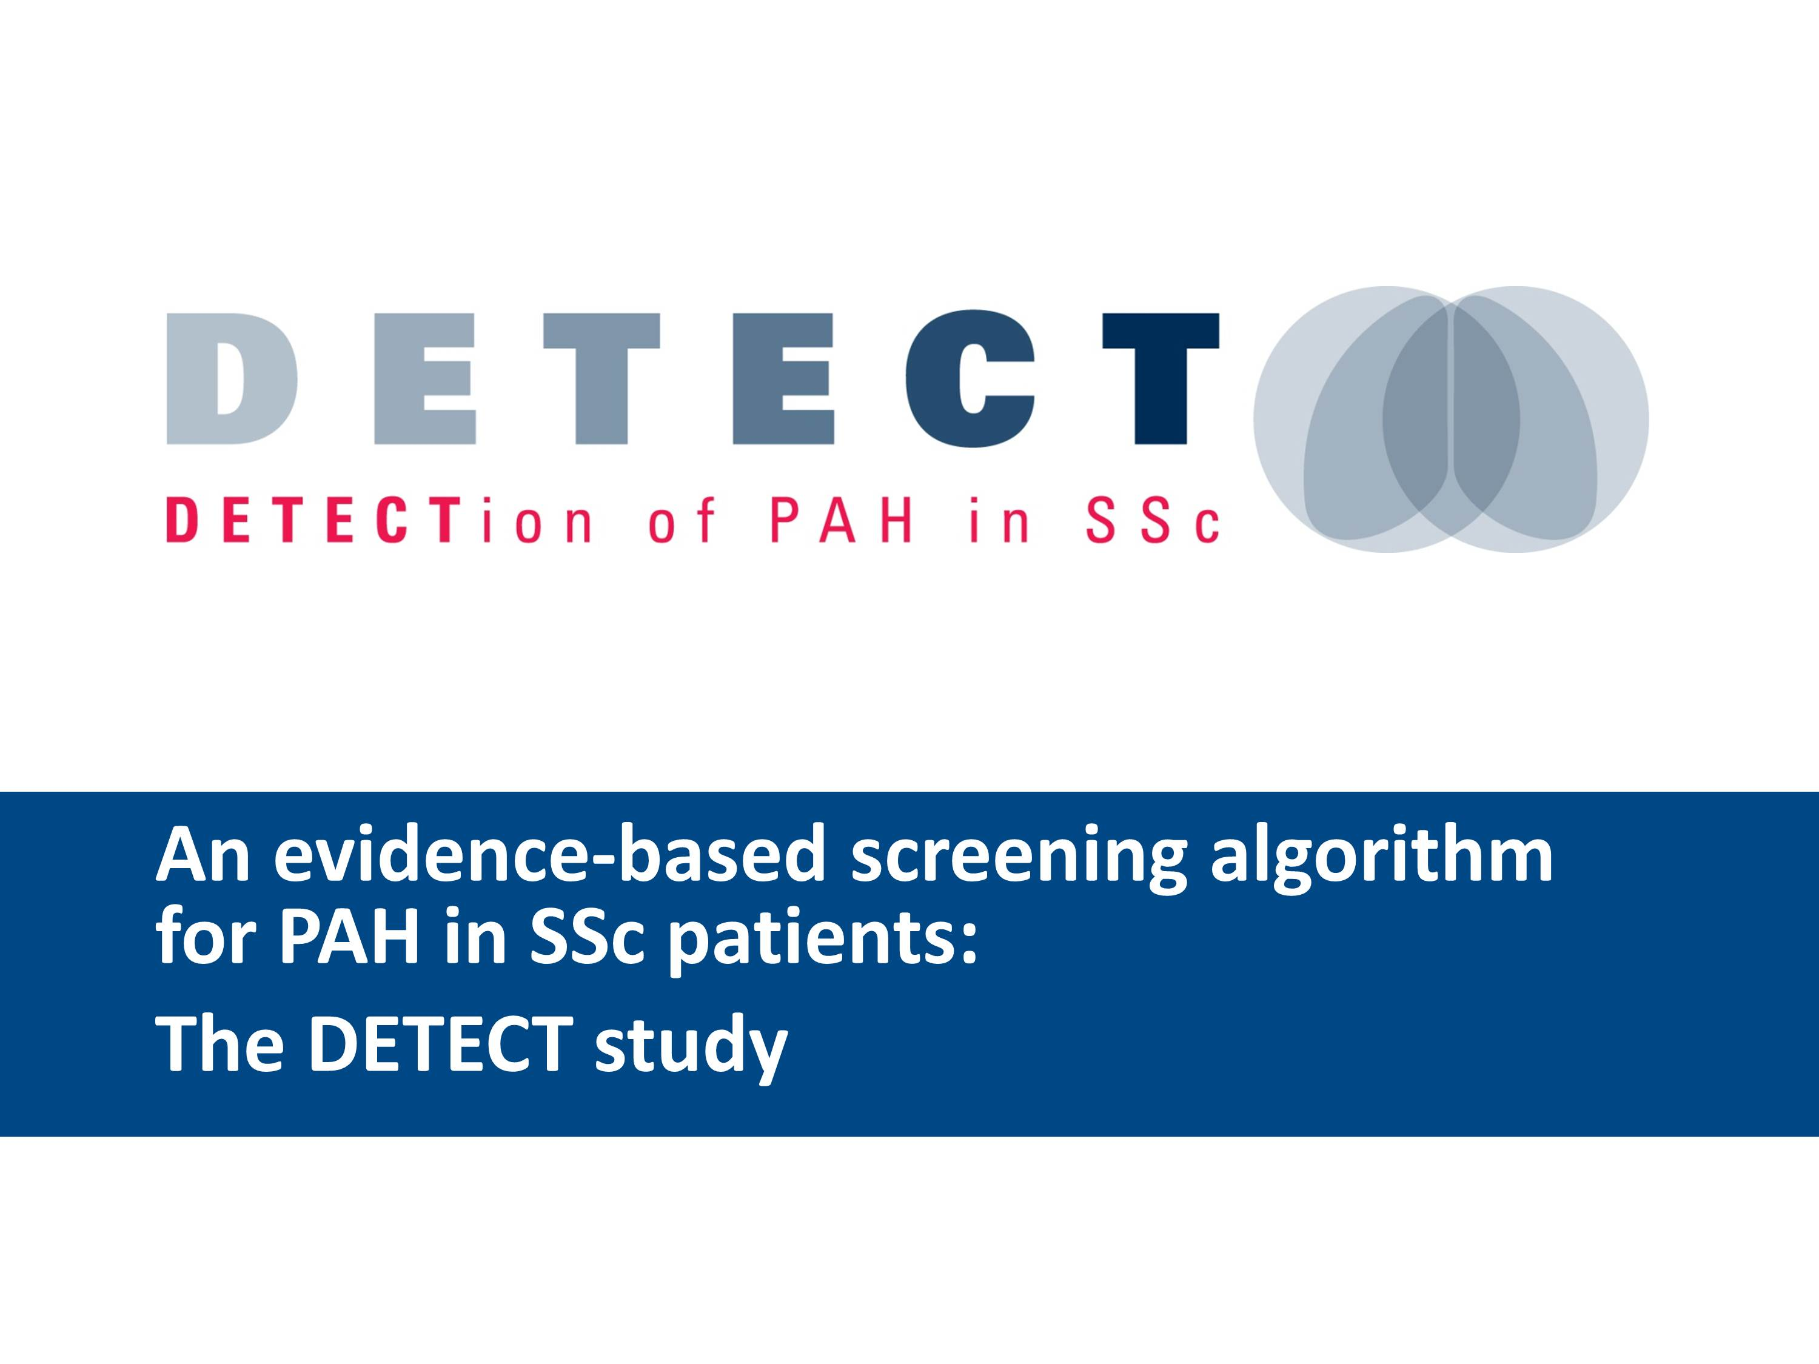

Slide 2
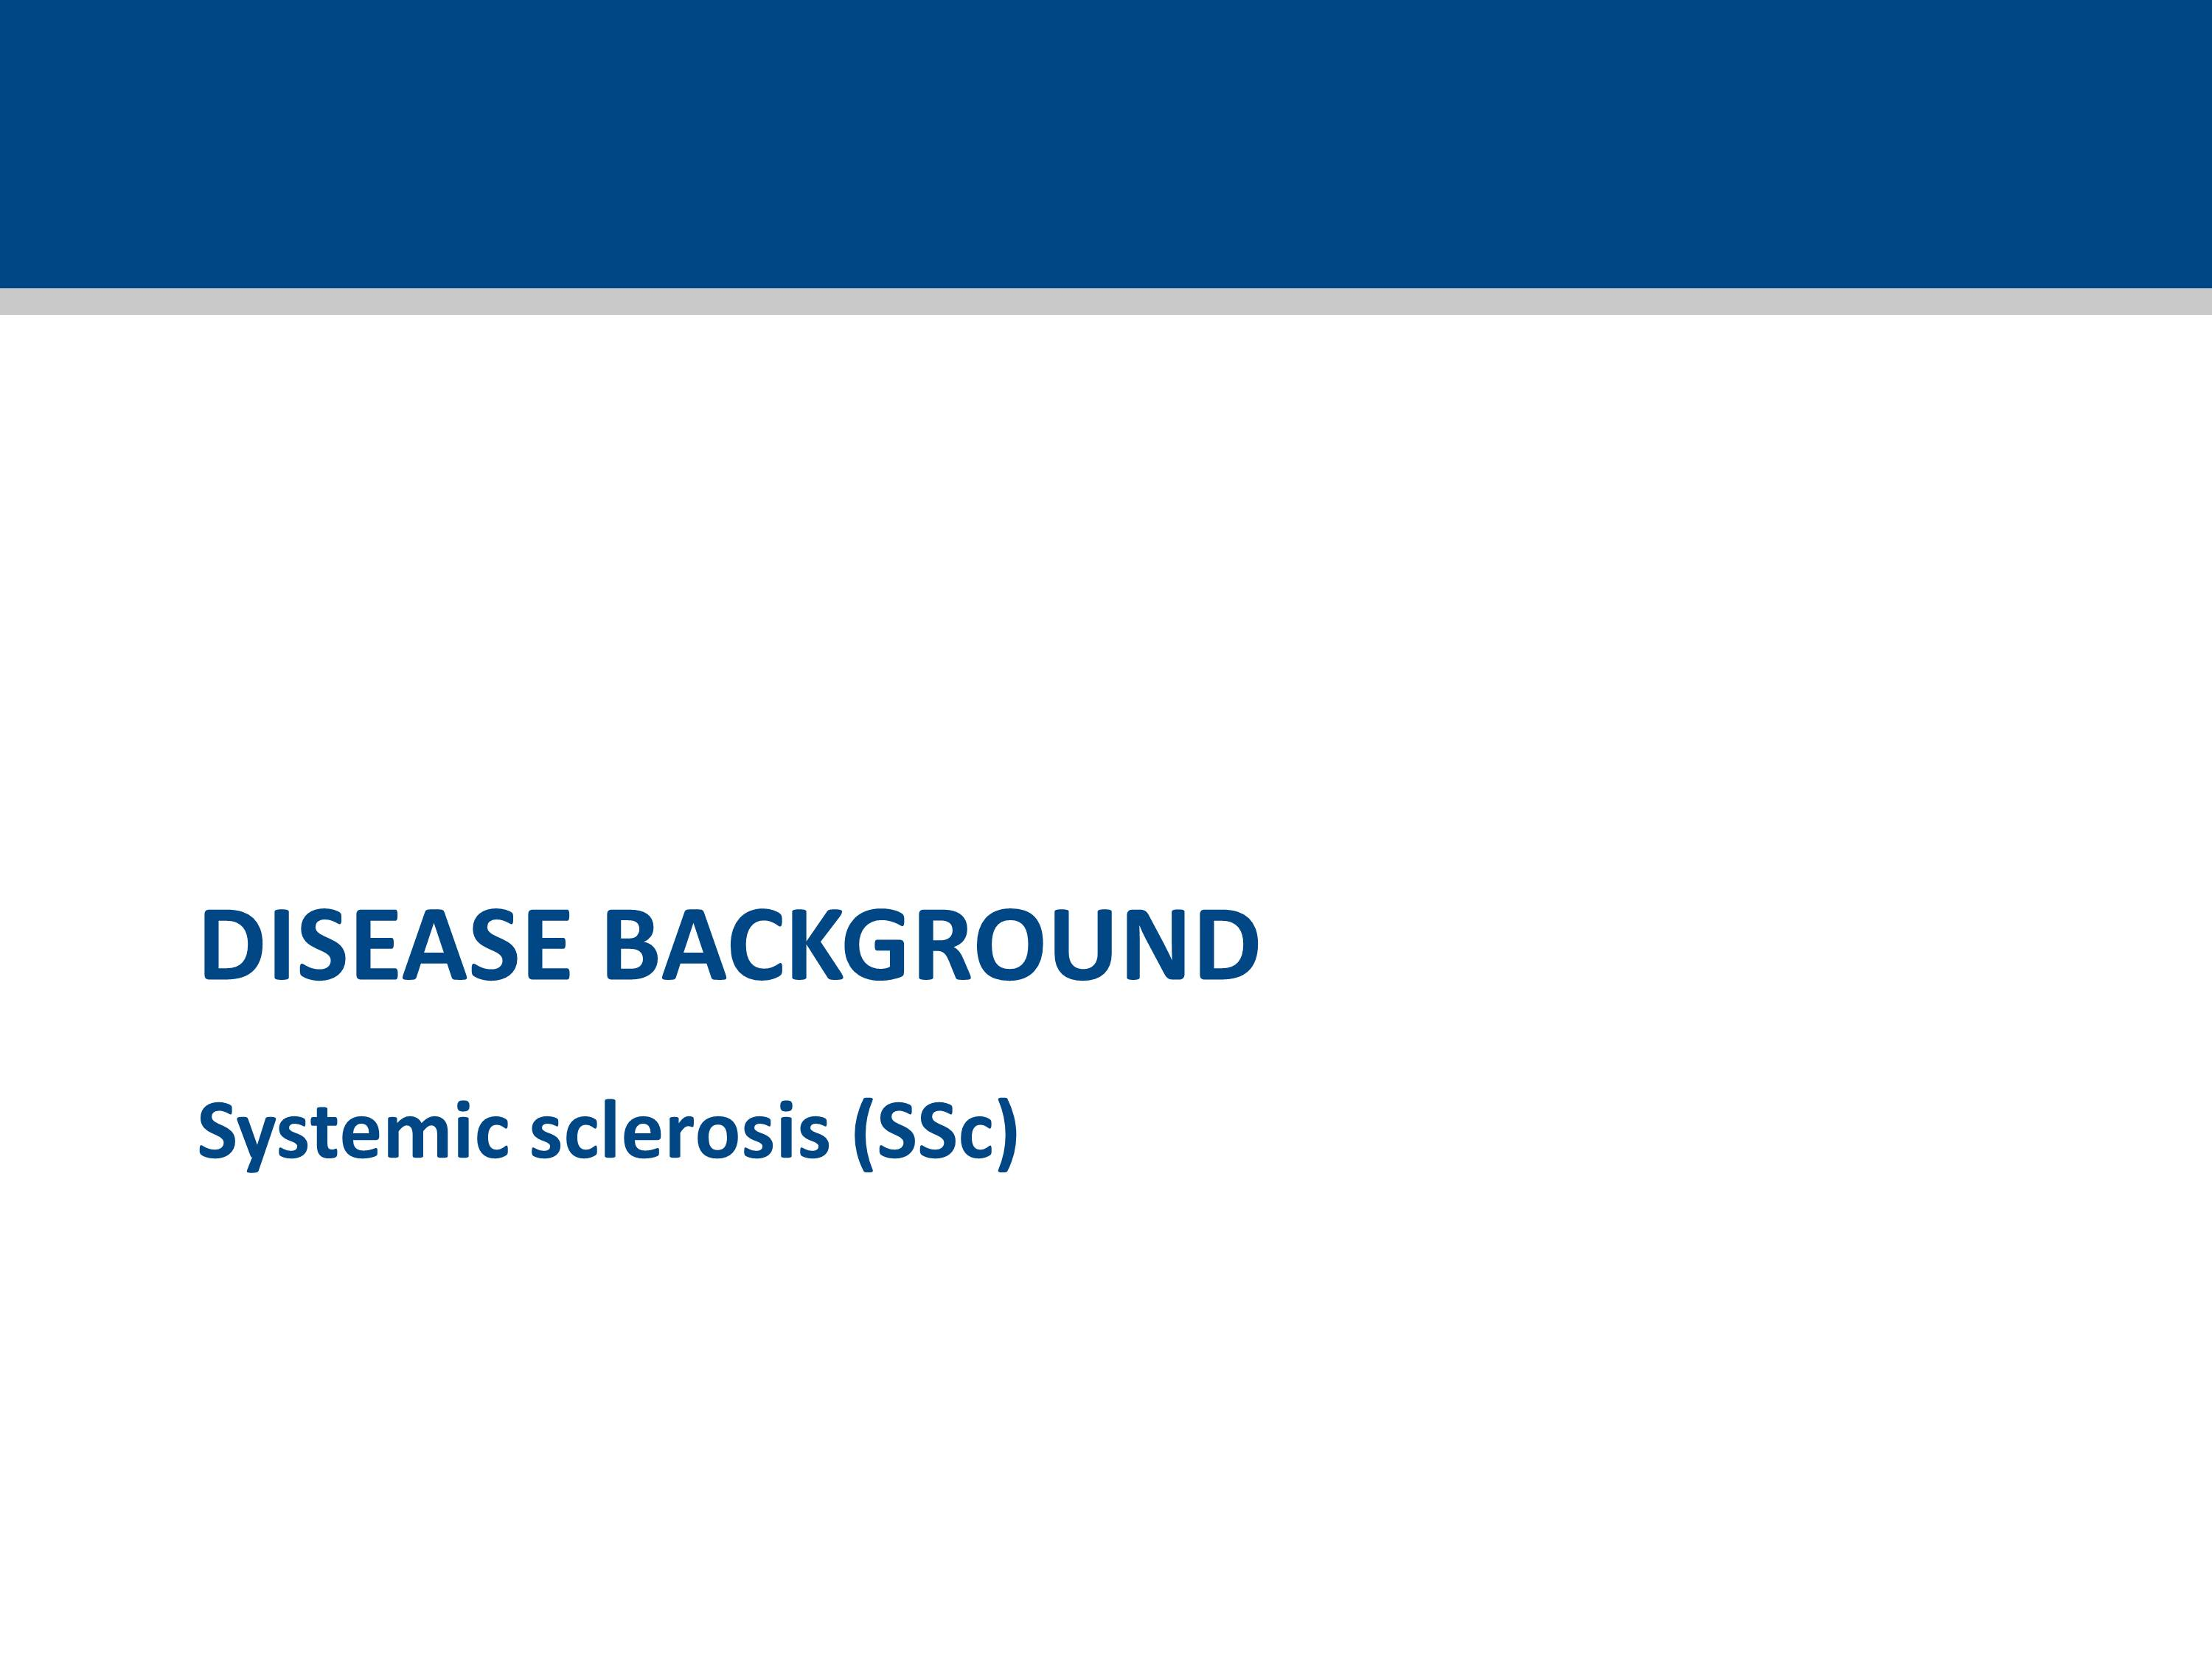

Slide 3
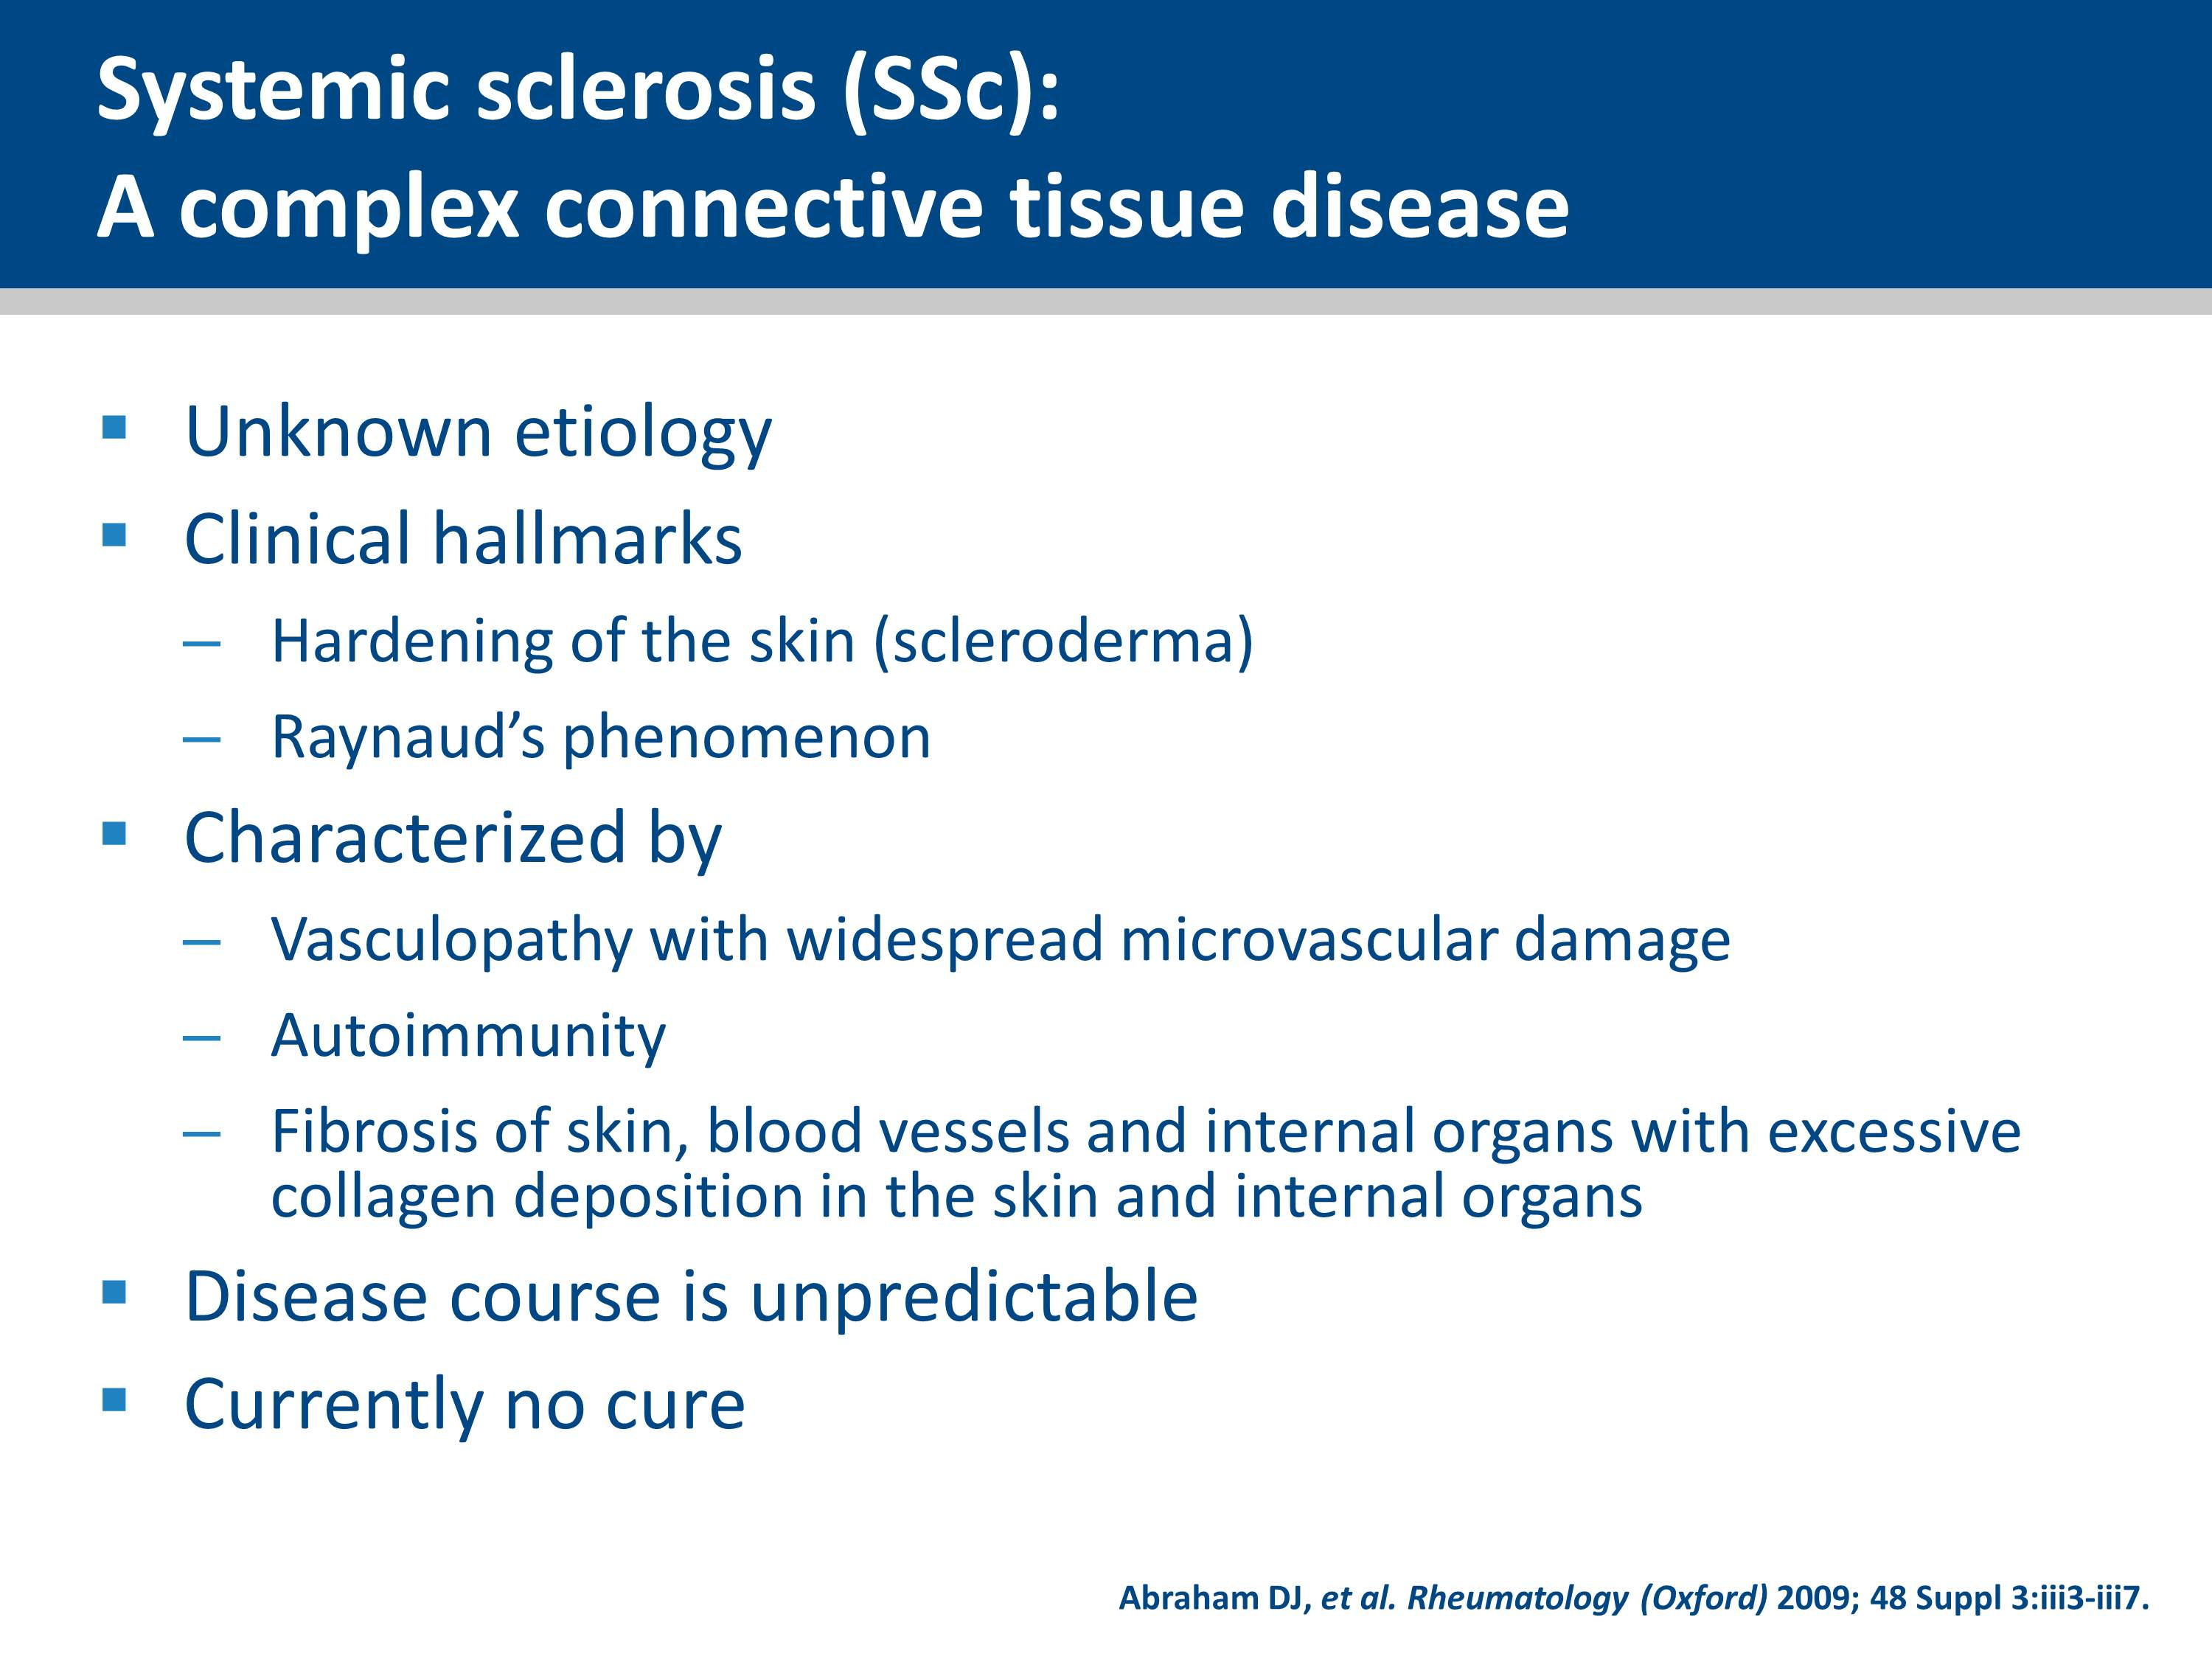
Notes:
Systemic sclerosis (SSc; also known as scleroderma) is a complex connective tissue disease (CTD) of unknown etiology.
It is characterized by fibrotic changes of the skin and underlying tissue which cause hardening of the skin and associated scarring, the most evident symptoms of the disease. Internal organs are also affected. These changes are associated with abnormalities and fibrosis of the blood vessels.

Slide 4
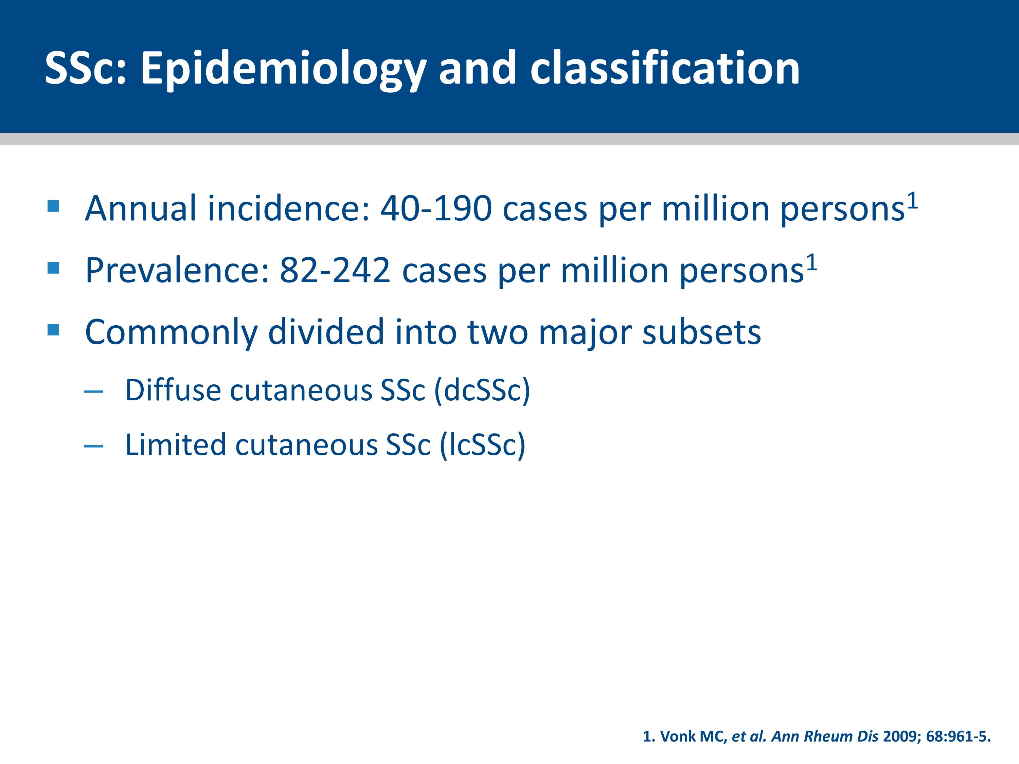
Notes:
Depending on the pattern of tissues and organs affected and clinical findings, SSc is commonly divided into two major subsets known as diffuse cutaneous SSc (dcSSc) and limited cutaneous SSc (lcSSc).

Slide 5
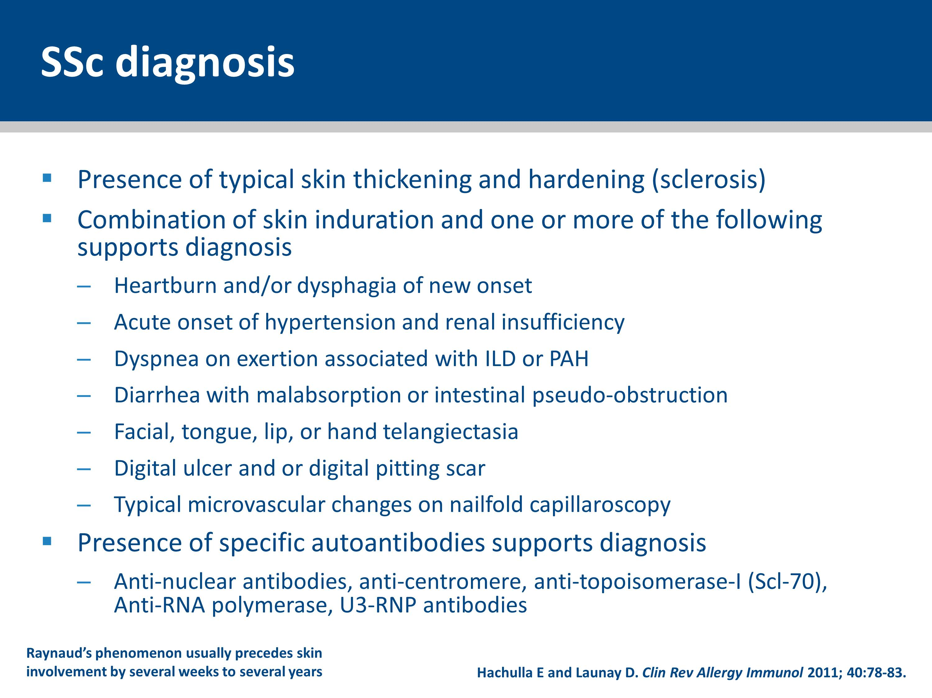
Notes:
The diagnosis of SSc is generally suggested by the presence of typical skin thickening and hardening (sclerosis) which usually begins with the fingers.
Raynaud’s phenomenon usually precedes the skin involvement by several weeks to several years.
The diagnosis is supported by the presence of additional extra-cutaneous features, capillaroscopic abnormalities, and characteristic autoantibodies.
The combination of skin induration and one or more of the following clinical features supports the diagnosis of SSc:
Heartburn and/or dysphagia of new onset due to distal esophageal dysmotility
Acute onset of hypertension and renal insufficiency
Dyspnea on exertion associated with interstitial lung disease
Dyspnea on exertion associated with pulmonary arterial hypertension
Diarrhea with malabsorption or intestinal pseudo-obstruction
Facial, tongue, lip, or hand telangiectasia
Digital ulcer and or digital pitting scar
Typical microvascular changes on nailfold capillaroscopy.
The presence of characteristic autoantibodies is supportive of the diagnosis of SSc. Specific autoantibodies include anti-centromere (ACA), anti-topoisomerase-I (Scl-70), anti-RNA polymerase, or U3-RNP antibodies. Antinuclear antibody positivity (with a nucleolar staining pattern) is also frequently observed.

Slide 6
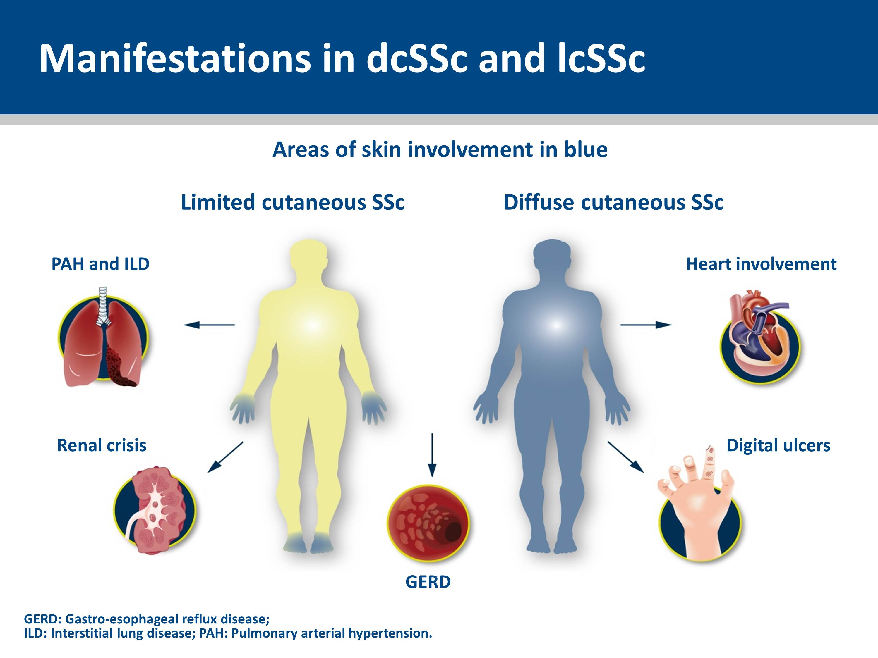
Notes:
This slide highlights they key differences between the two types of SSc:
lcSSc is defined by skin thickening in areas solely distal to the elbows and knees, with or without facial effects, such as telangiectases. In contrast, dcSSc is defined by the presence of skin thickening that is proximal, as well as distal, to the elbows and knees, with or without facial or truncal effects.
Therefore, in lcSSc, the characteristic hardening of the skin seen in SSc is usually confined to the hands, feet and face. You may hear lcSSc referred to as “CREST” syndrome, a previously used acronym describing the main features of lcSSc: Calcinosis (calcium deposits in the soft tissues), Raynaud’s phenomenon (a vasoconstrictive disorder of the fingers), Esophageal dysmotility, Sclerodactyly (localized thickening and tightness of the skin of the fingers and toes), and Telangiectasis (the appearance of small enlarged blood vessels near the surface of the skin).
dcSSc is a severe form of the disease which is characterized by a more rapid onset, more widespread skin hardening, and more severe internal organ damage.
Internal organ involvement is most common in dcSSc, although it can evolve in both subsets of disease. One of the most common manifestations of lung involvement is pulmonary arterial hypertension (PAH), which is present in up to 16% of patients with SSc. In summary, several organs can be involved in patients with SSc:
Kidney: scleroderma renal crisis
Lung: PAH and interstitial lung disease (ILD)
Gastro-intestinal tract: gastro-esophageal reflux disease (GERD)
Skin: thickening, Raynaud’s phenomenon, digital ulcers (DUs)
Heart: fibrosis, conduction problems.
6

Slide 7
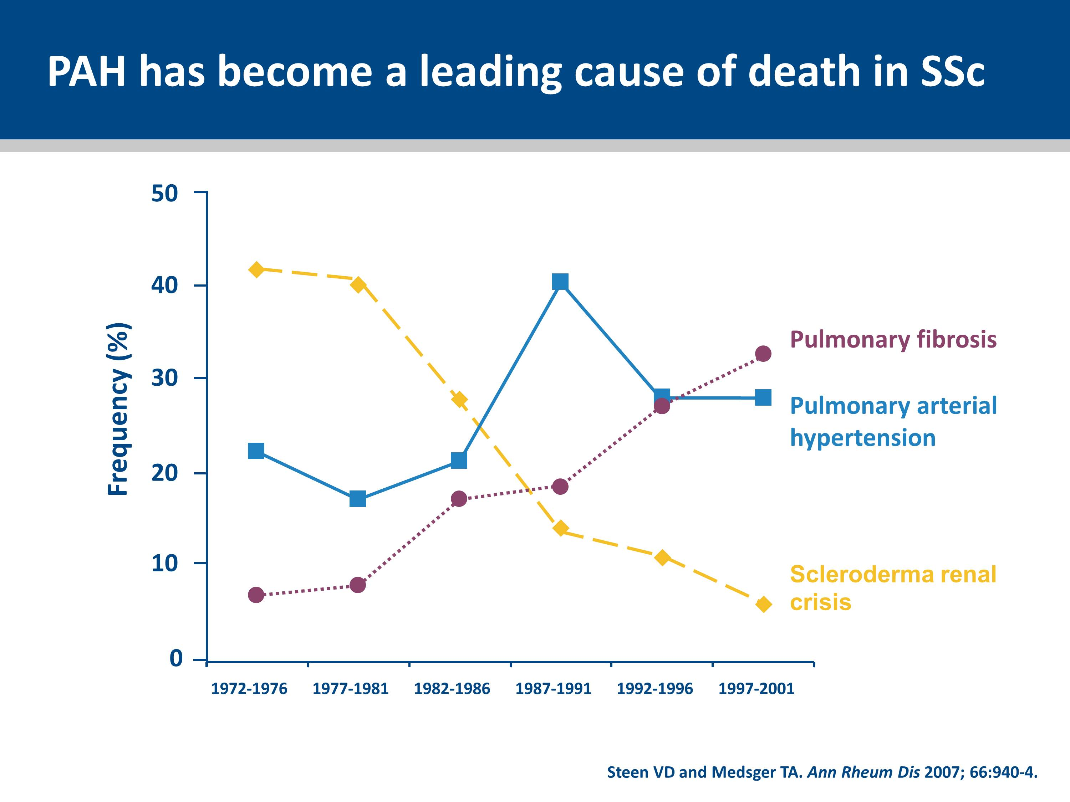
Notes:
The slide show the changes in causes of SSc-related deaths over time.
The frequency of renal crisis deaths dramatically decreased over the 30-year time period, probably due to earlier diagnosis and aggressive use of angiotensin converting enzyme inhibitors which can prevent or even reverse renal failure.
The proportion of scleroderma patients who died of pulmonary fibrosis increased. It is possible that patients who would have died of other SSc-related causes in the 1970s are now living longer. These additional years along with slow progression of fibrosis, aging, or infection are likely to contribute to the increase in deaths from pulmonary fibrosis.
Pulmonary arterial hypertension was the second most frequent cause of scleroderma related deaths in the 1970s and it has continued to be a leading cause of death. The increase in deaths from PAH is likely to be as a result of more aggressive search for PAH since treatment had become available.
7

Slide 8
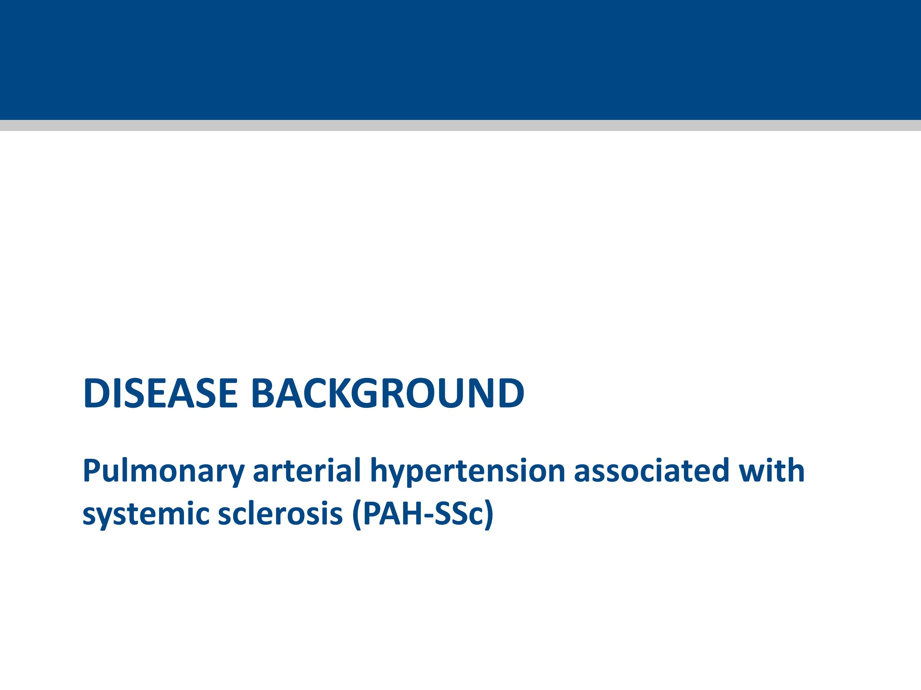

Slide 9
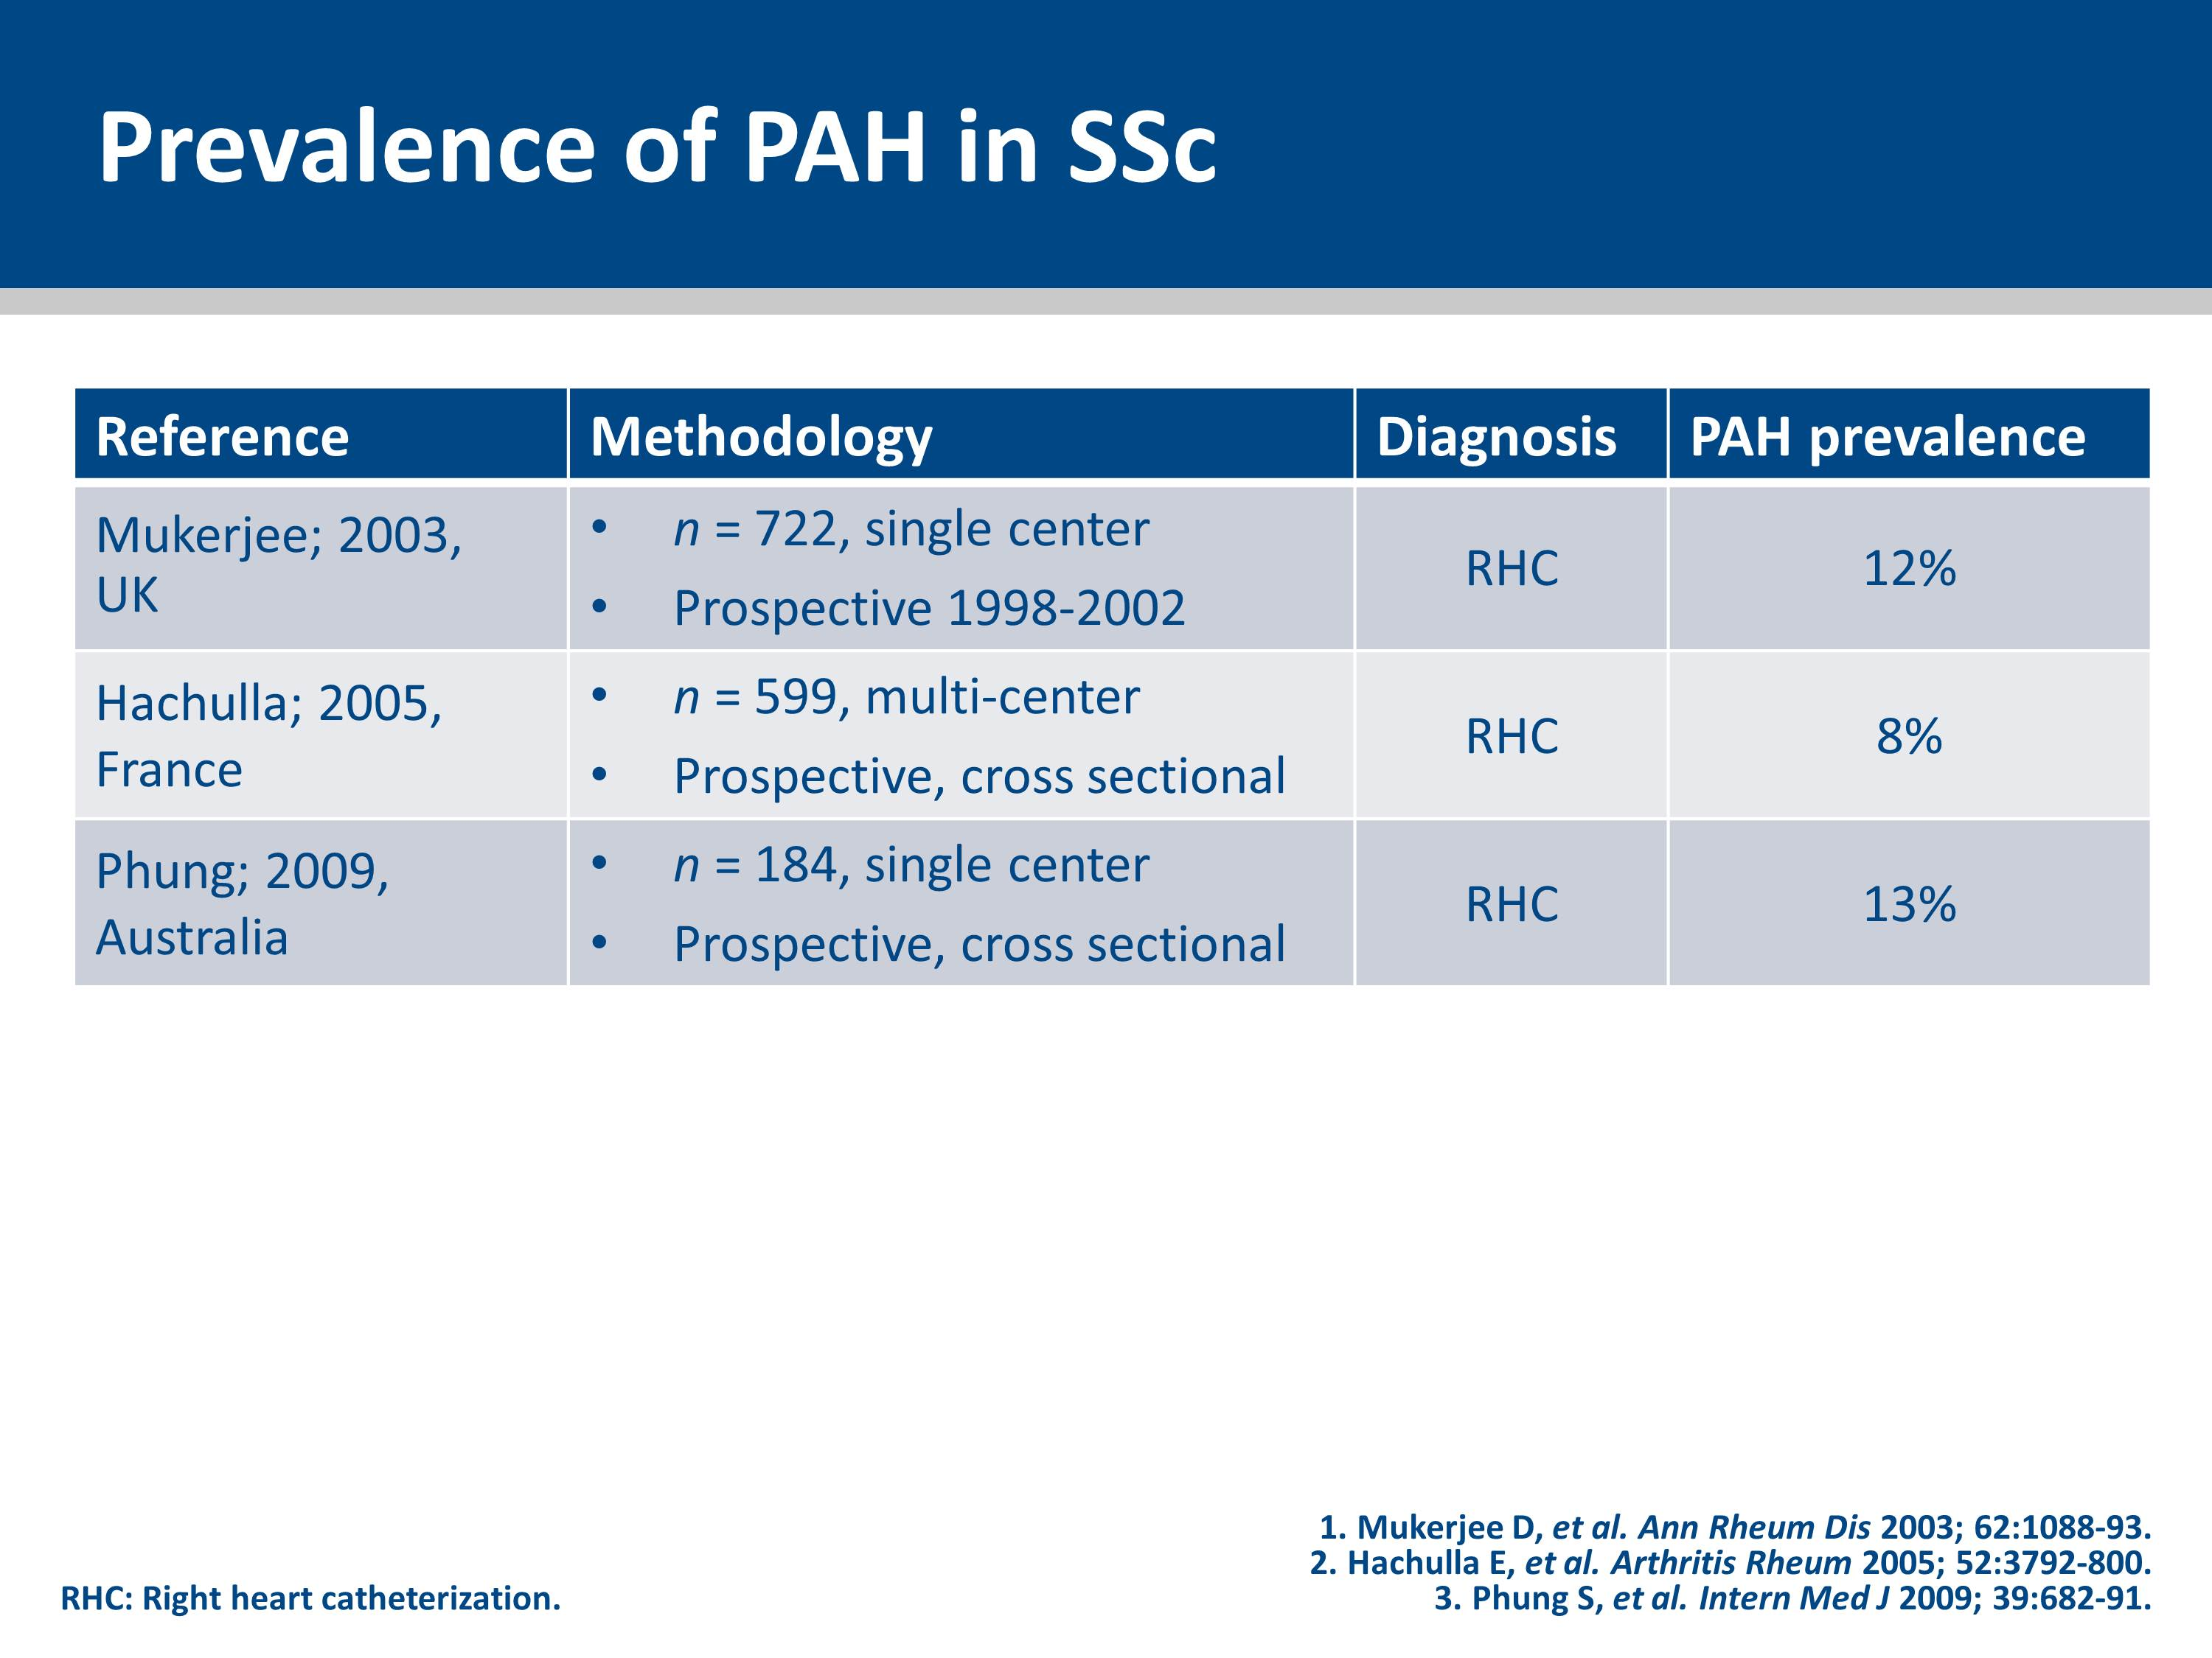
Notes:
9

Slide 10
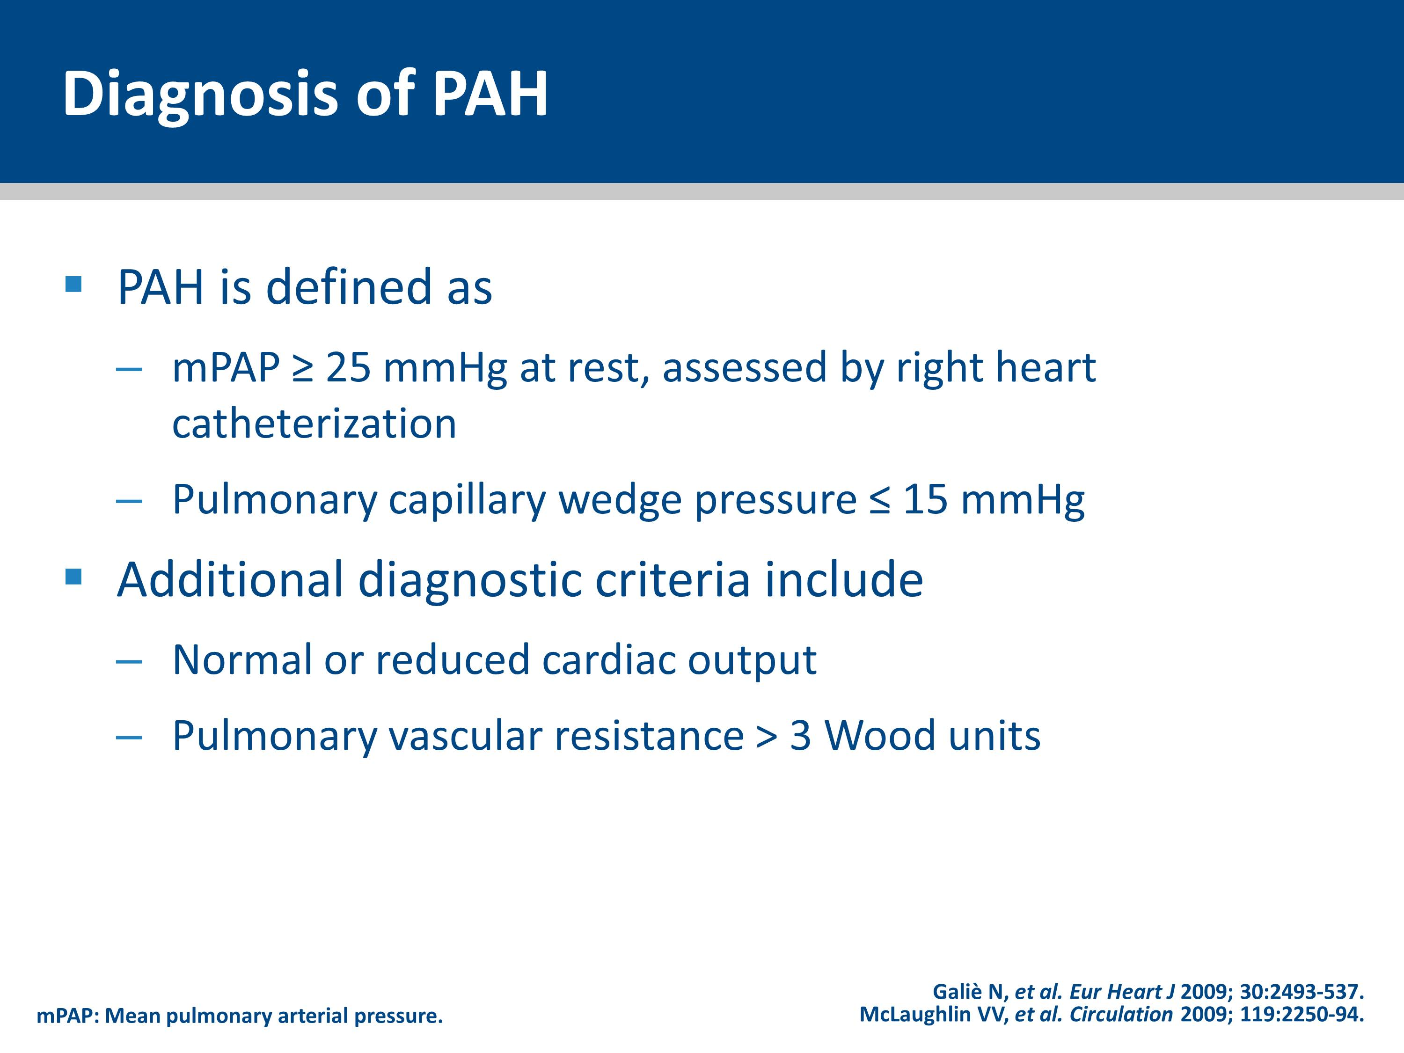
Notes:
10

Slide 11
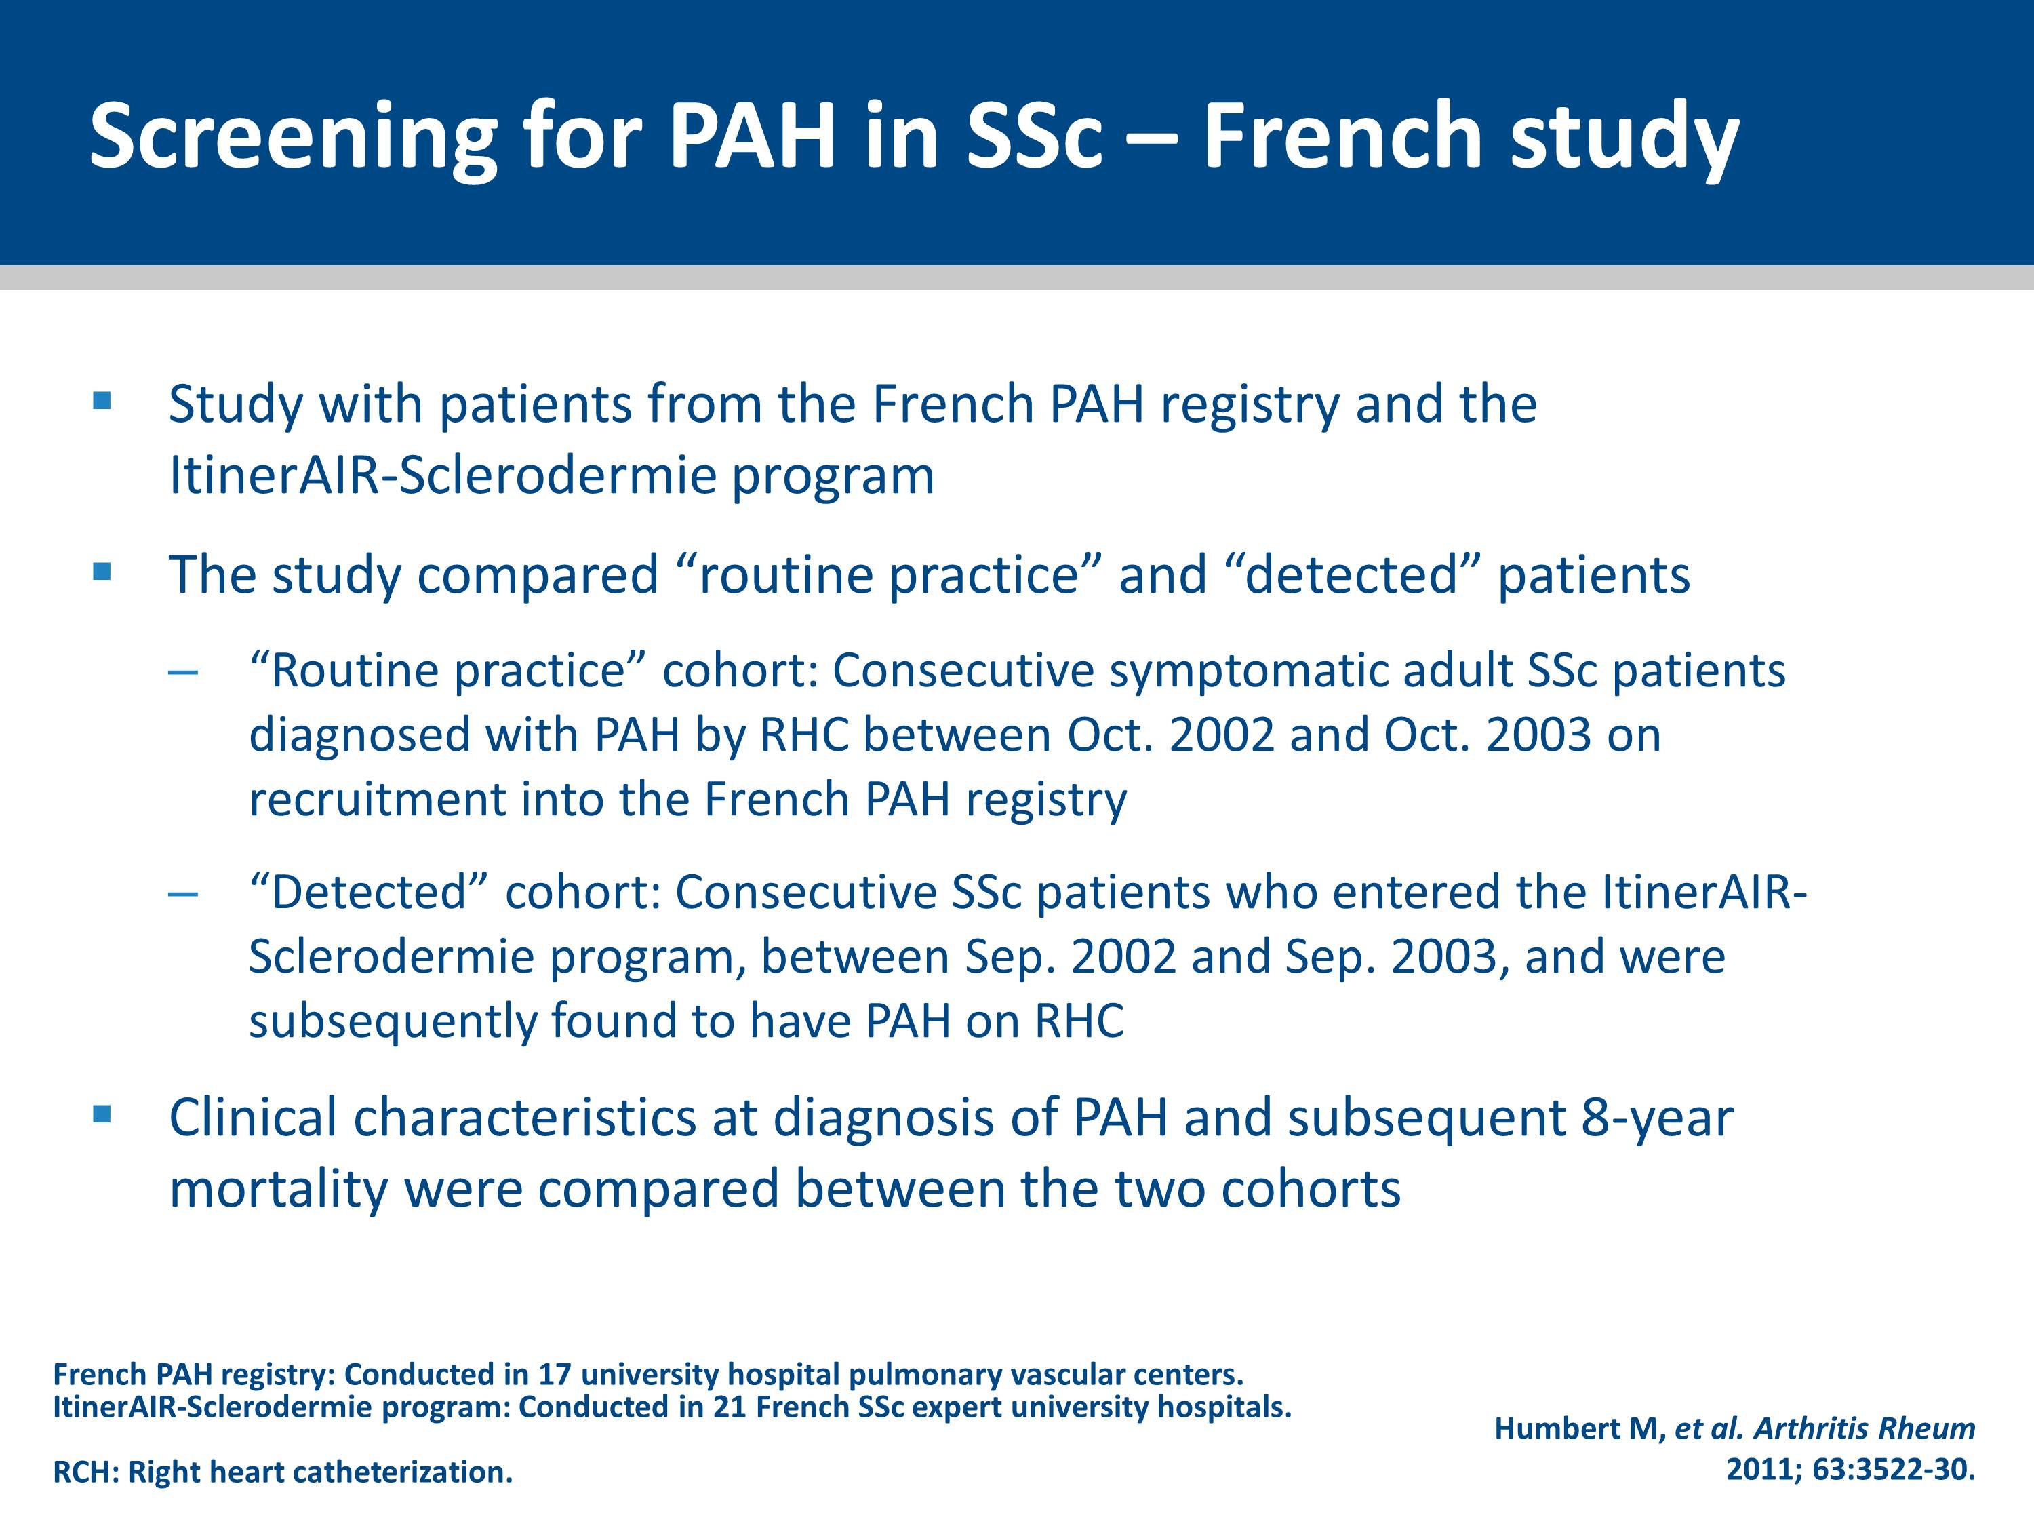
Notes:
11

Slide 12
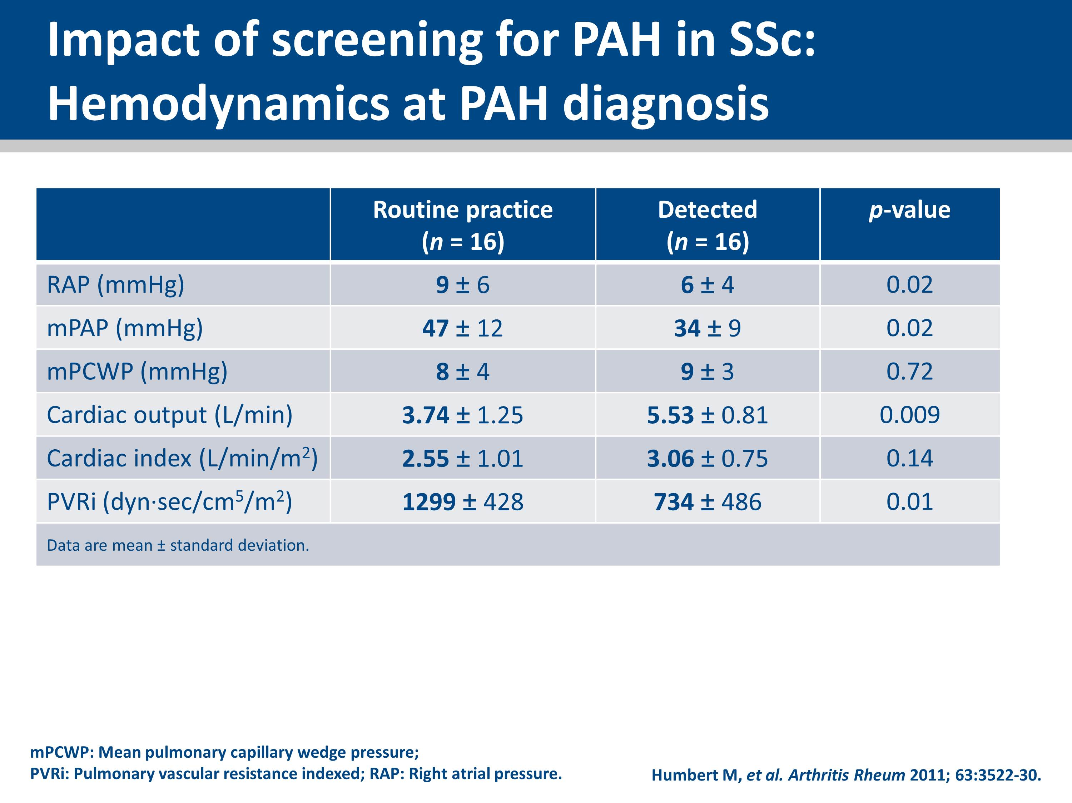
Notes:
When compared with PAH-SSc patients in the routine practice cohort, detected PAH-SSc patients had better cardiopulmonary hemodynamics with preserved right-heart function (lower RAP, mPAP, PVR, and higher cardiac output).
Although not shown on this slide, this study reported that PAH-SSc patients diagnosed in functional class III during routine clinical practice had more severely compromised hemodynamics than those identified in functional class III via the systematic detection program.

Slide 13
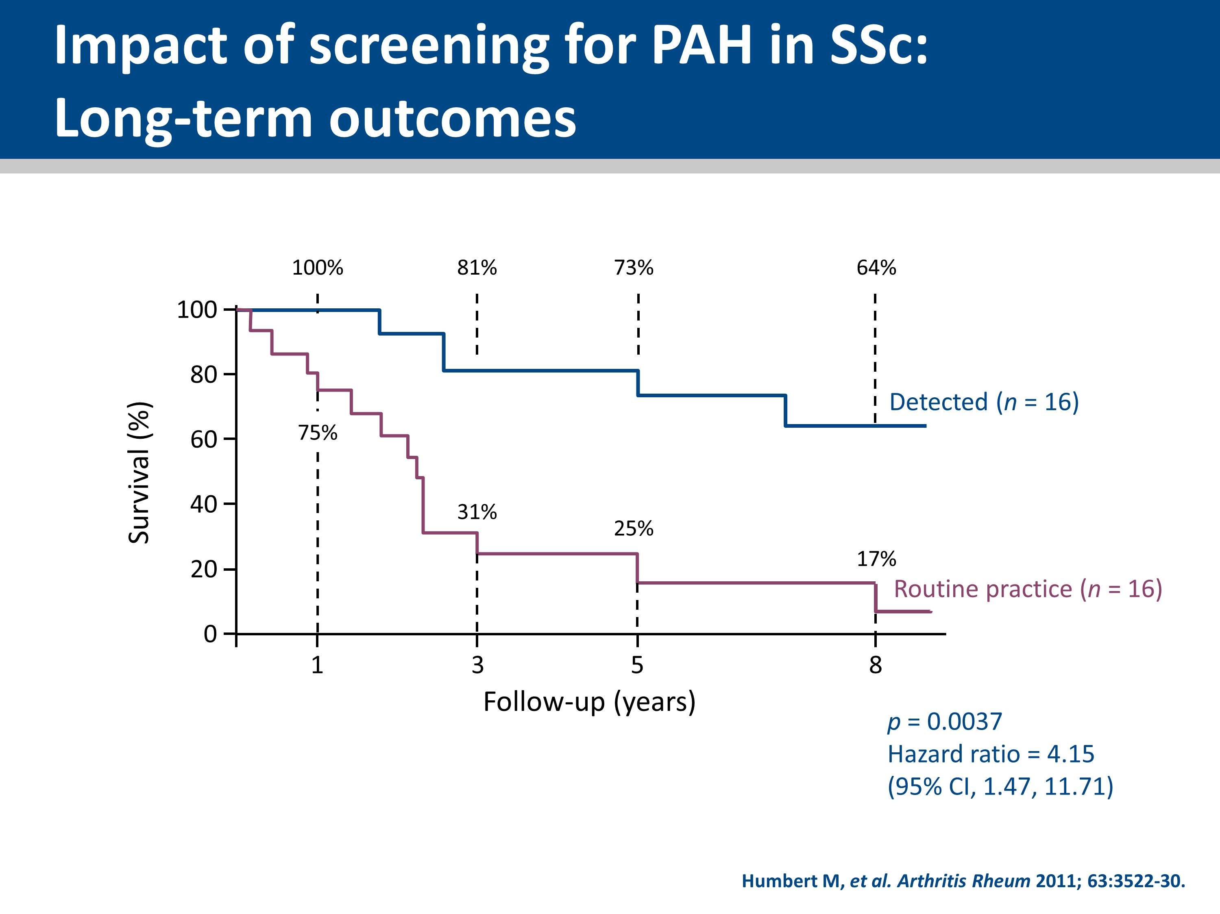
Notes:
Significantly higher survival rates were observed in detected PAH-SSc patients compared with those in routine practice.
Screening SSc patients for PAH identifies milder forms of the disease, allowing earlier management and improving long-term survival.

Slide 14
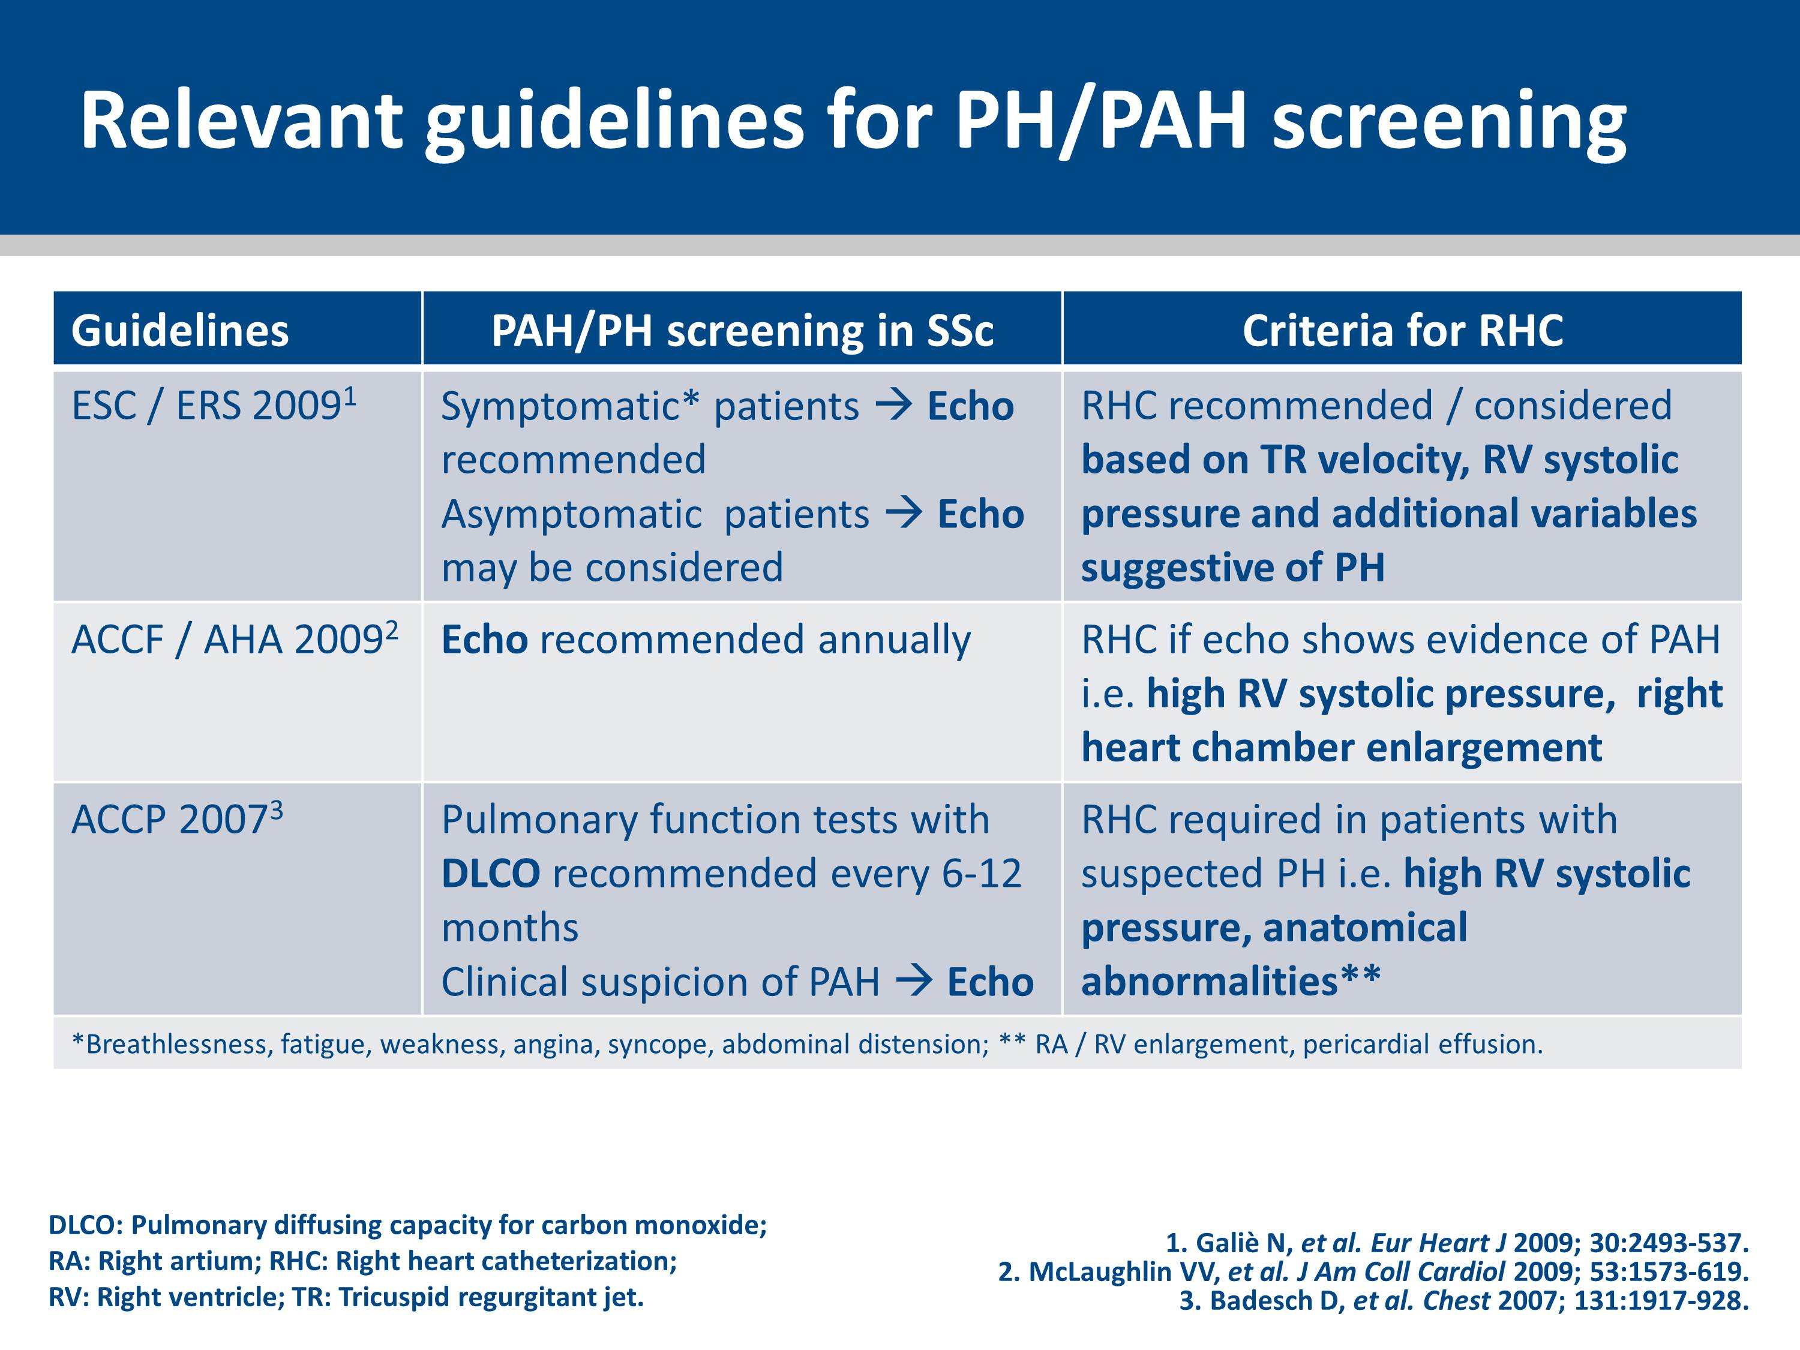

Slide 15
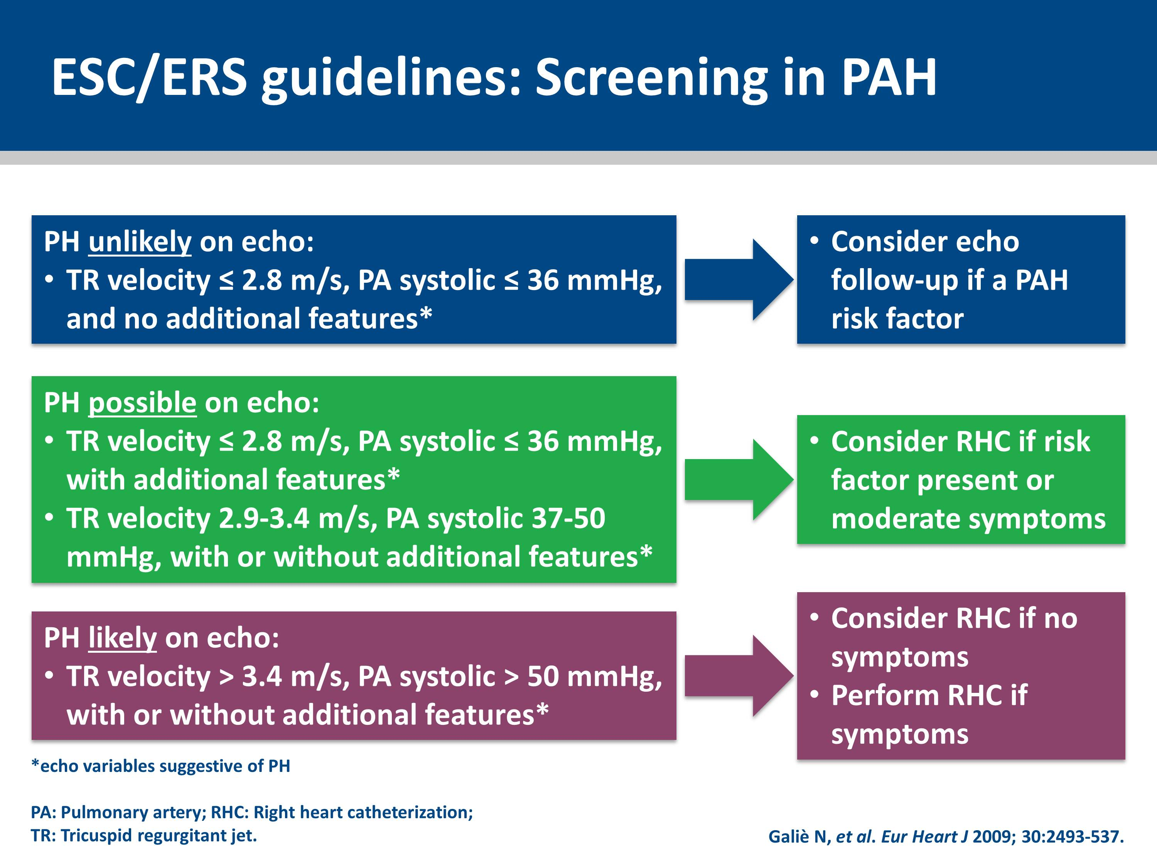

Slide 16


Slide 17
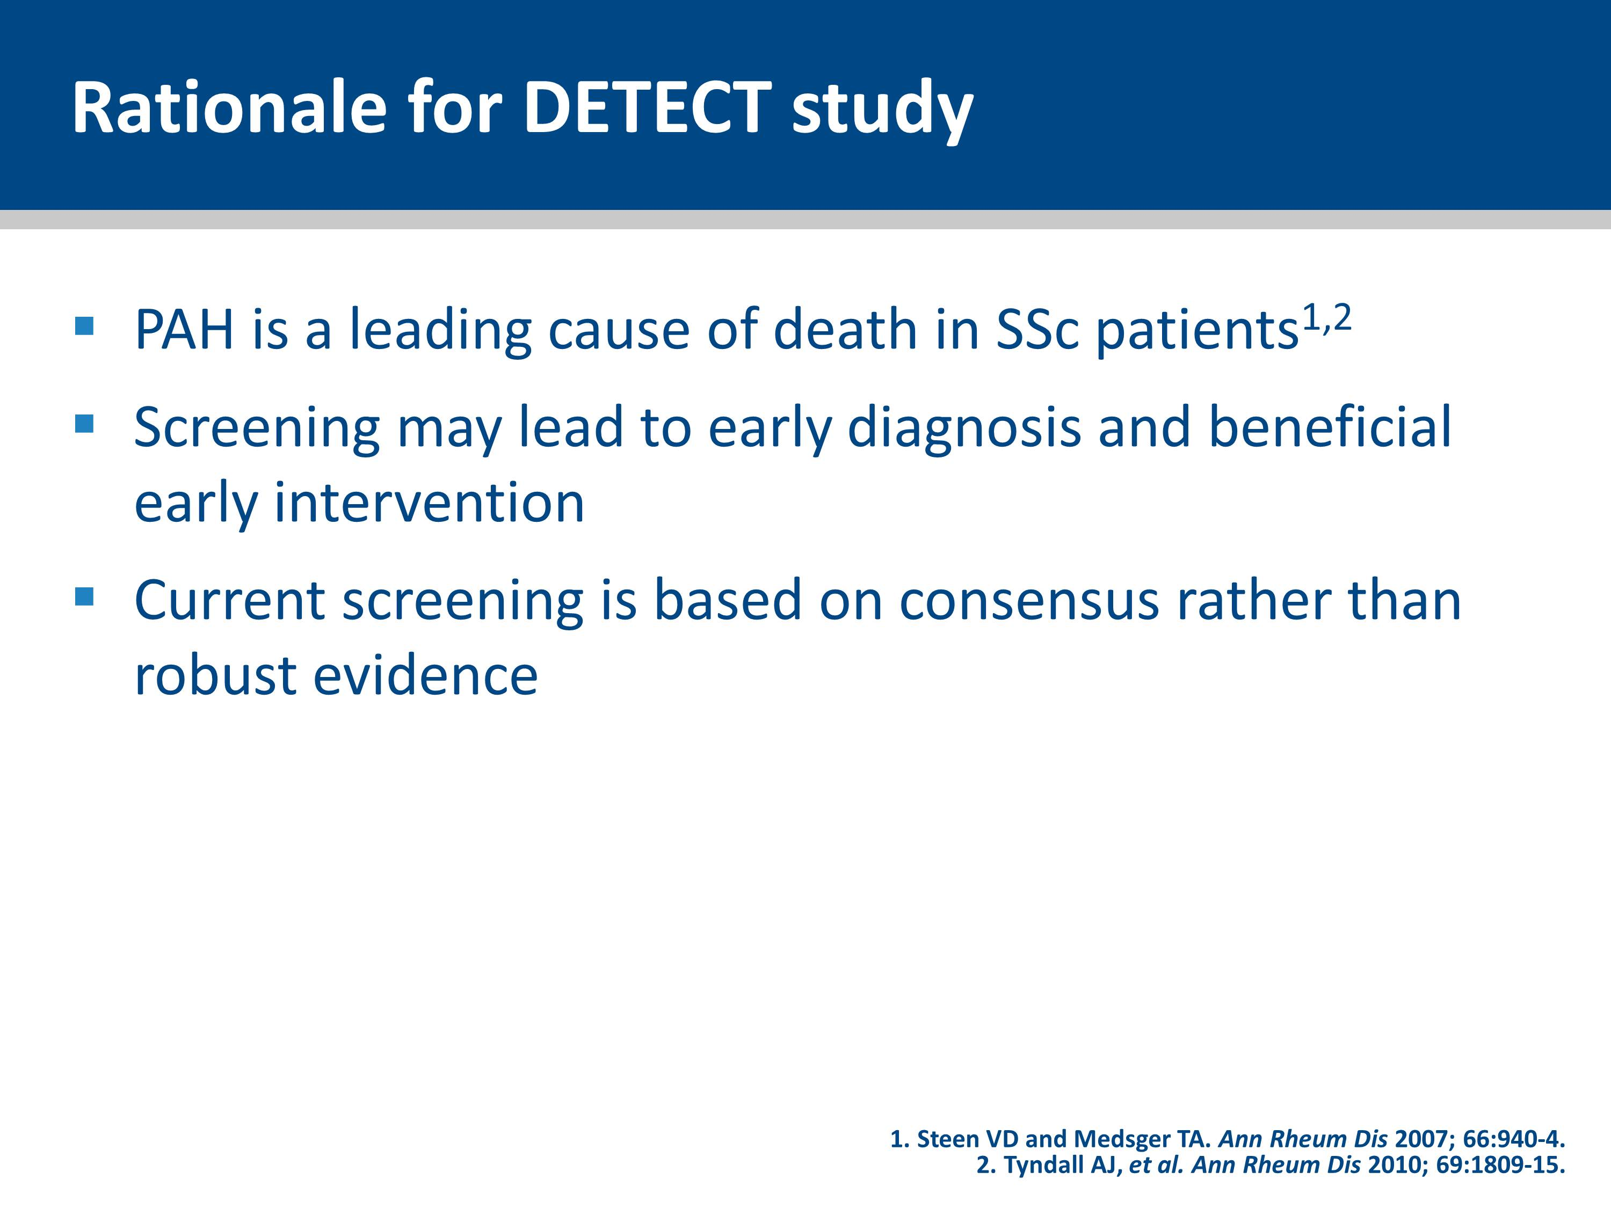
Notes:
3-year survival in SSc patients with PAH has been estimated at 56% (vs 94% in those without PAH)¹
Mortality remains high high despite current best PAH therapy
1. Hachulla E, et al. Rheumatology (Oxford) 2009; 48:304-8.

Slide 18
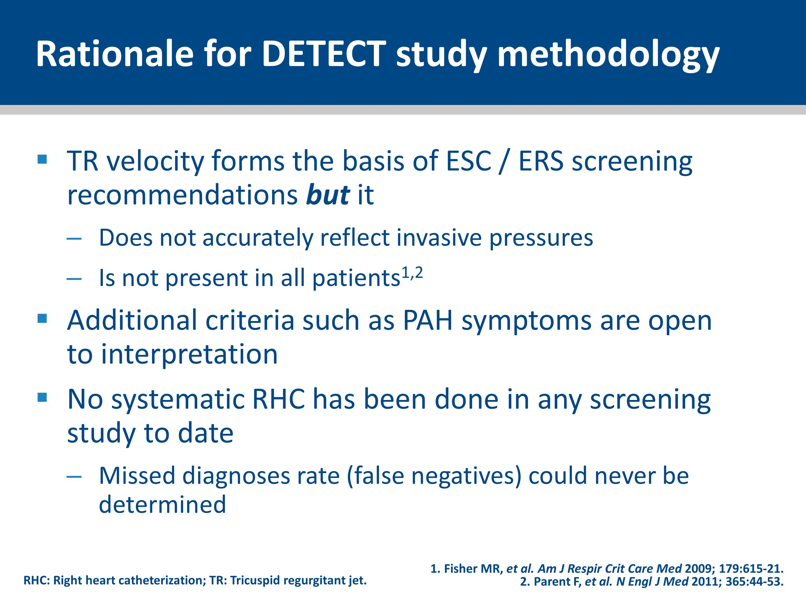
Notes:
Several organizations, including the American College of Cardiology Foundation/American Heart Association and the European Society of Cardiology/European Respiratory Society (ESC/ERS), have published a variety of screening recommendations relying mainly on symptoms and abnormal findings on transthoracic echocardiography.¹⁻³ Other clinical tools include NTproBNP as a marker of myocardial stress⁴ and disproportionately reduced DLCO.⁵⁻⁷
The most widely used echocardiographic parameter, TR velocity, does not accurately reflect invasive pressures and is not present in all patients.^{8, 9}
Recommendations regarding other evidence of PAH other than TR velocity (e.g. symptoms) are less detailed and therefore their application is likely to be variable between clinicians.
No previous screening studies have systematically performed RHC in all patients, precluding assessment of the rate of missed diagnoses.
1. Galiè N, et al. Eur Heart J 2009; 30: 2493−537.
2. McLaughlin VV, et al. Circulation 2009; 119: 2250−94.
3. Badesch DB, et al. J Am Coll Cardiol 2009; 54: S55–S66.
4. Williams MH, et al. Eur Heart J 2006; 27: 1485−94.
5. Steen V, et al. Arthritis Rheum 2003; 48: 516−22.
6. Schreiber BE, et al. Arthritis Rheum 2011; 63: 3531−9.
7. Allanore Y, et al. Arthritis Rheum 2008; 58: 284−91.
8.Fisher MR, et al. Am J Respir Crit Care Med 2009; 179: 615−21.
9. Parent F, et al. N Engl J Med 2011; 365: 44−53.

Slide 19
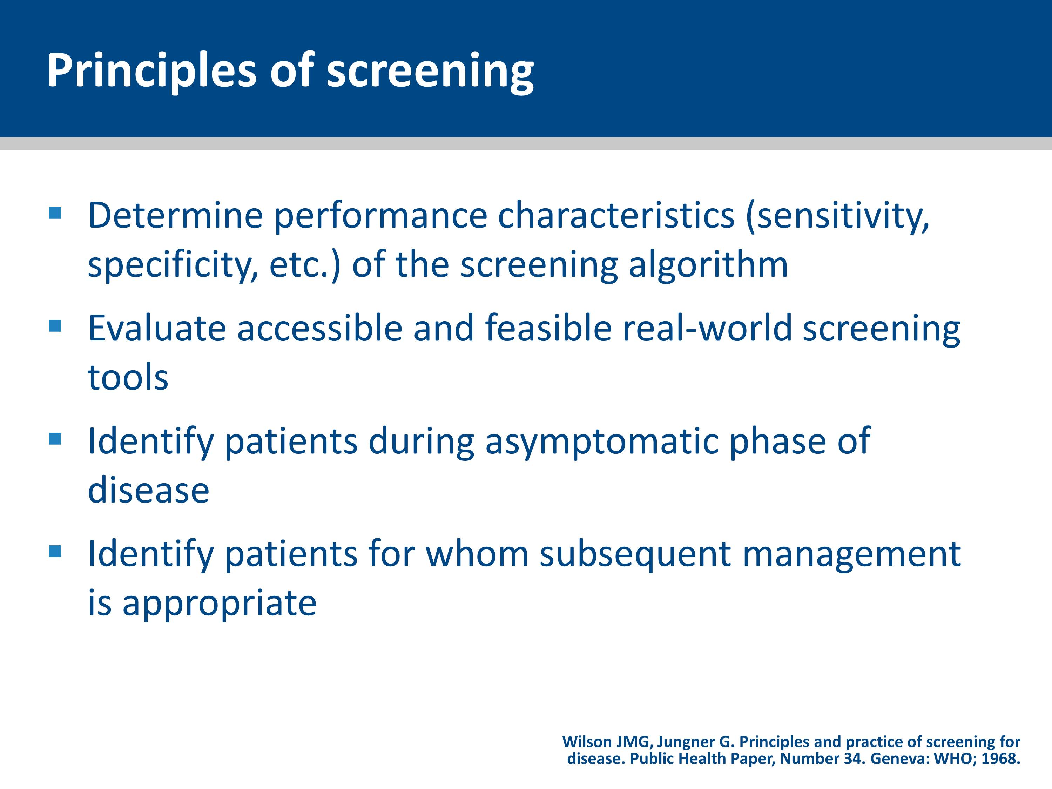

Slide 20
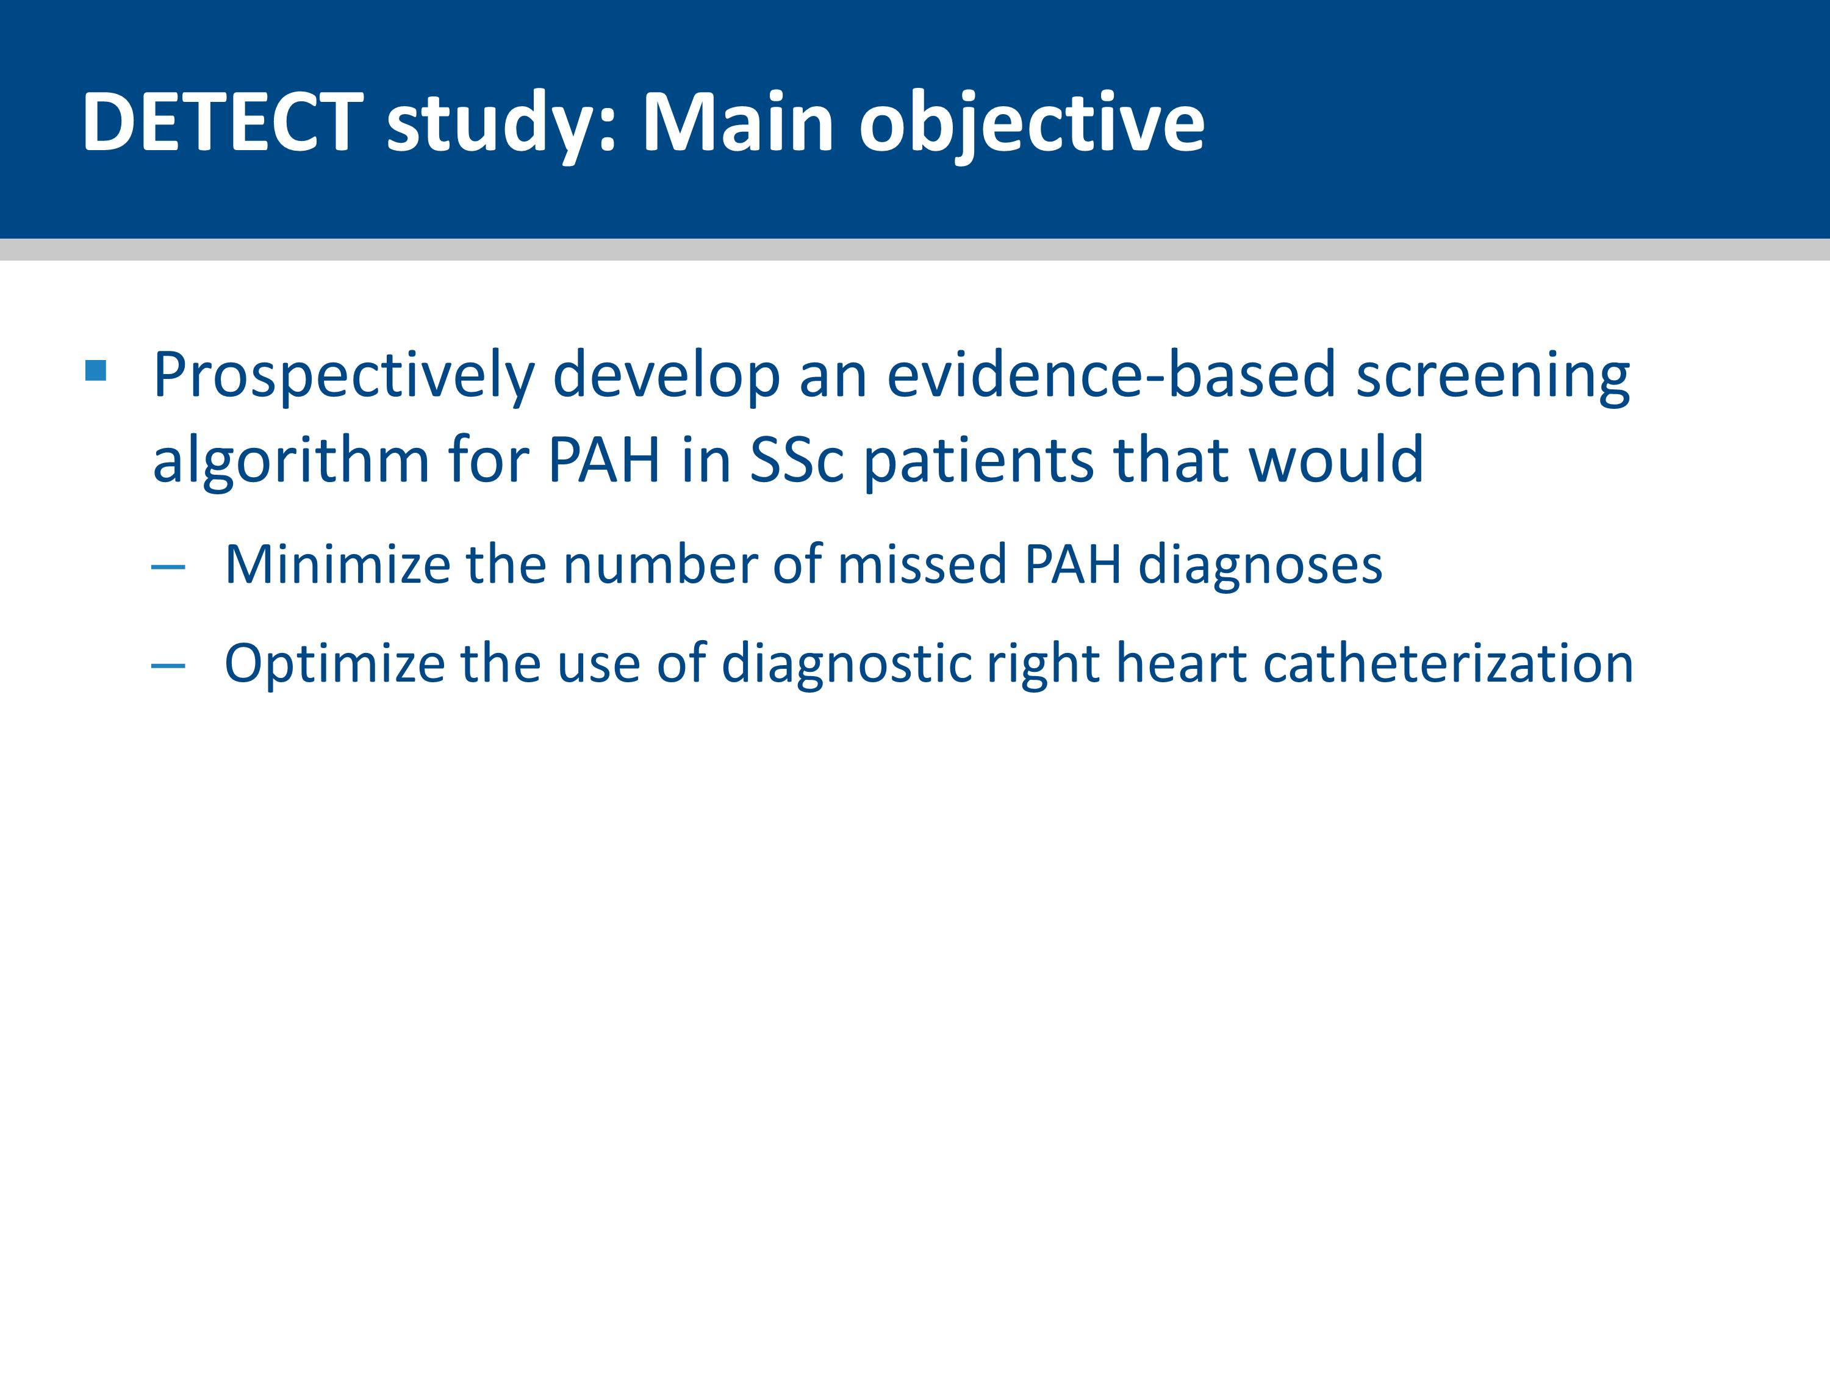

Slide 21


Slide 22
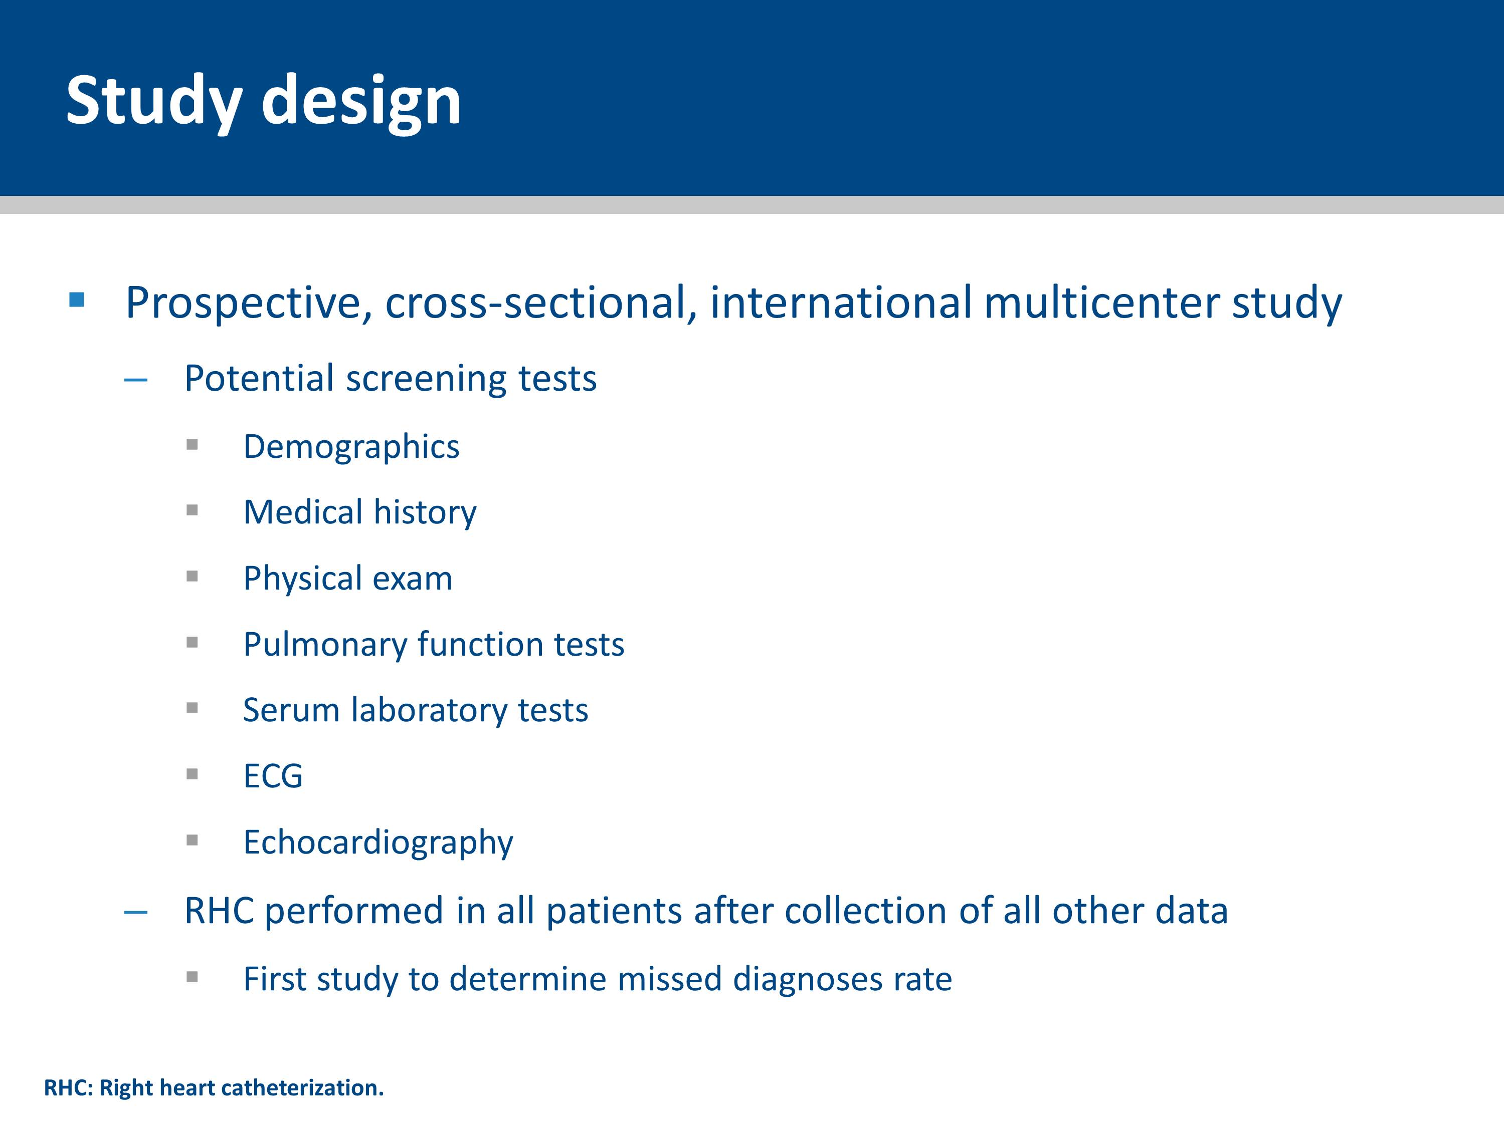
Notes:
DETECT was designed as a cross-sectional study in which right heart catheterization and echocardiography were systematically conducted according to standardized procedures.
Serum laboratory testing and data management were performed centrally and data quality was rigorously monitored.

Slide 23
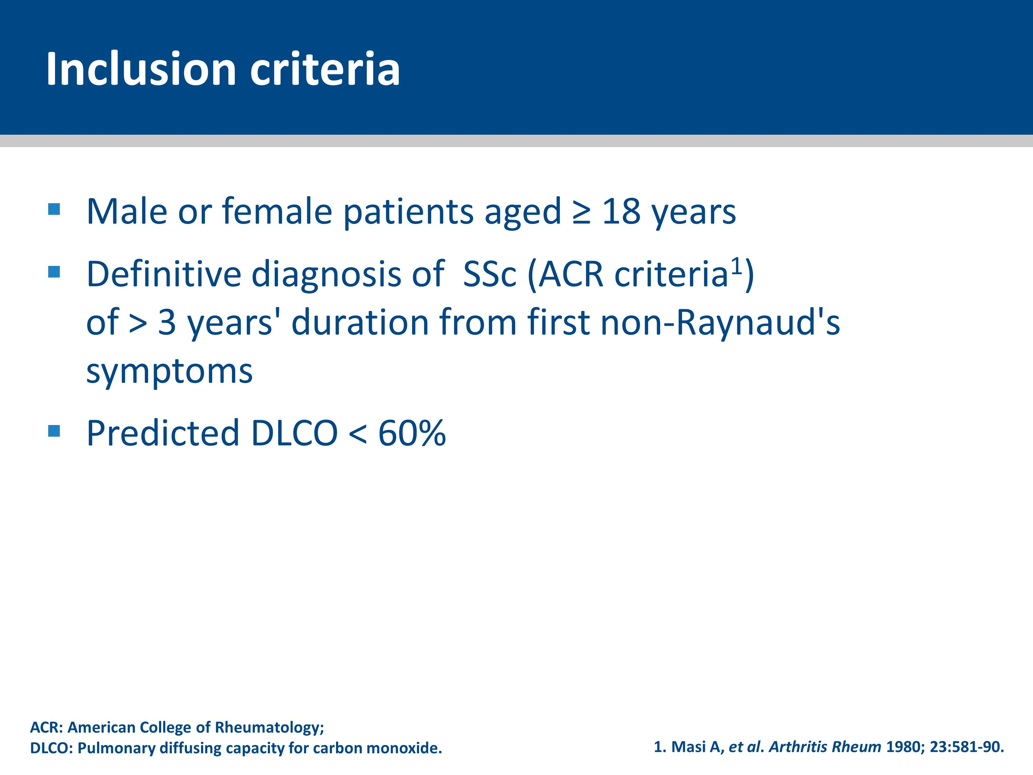
Notes:
Patients aged ≥ 18 years with a definitive diagnosis of SSc (American College of Rheumatology criteria¹) of > 3 years’ duration from first non-Raynaud’s symptom and a predicted DLCO of < 60% (to enrich for a higher likelihood of PAH), were included.
1. Masi A, et al. Arthritis Rheum 1980; 23:581-90.

Slide 24
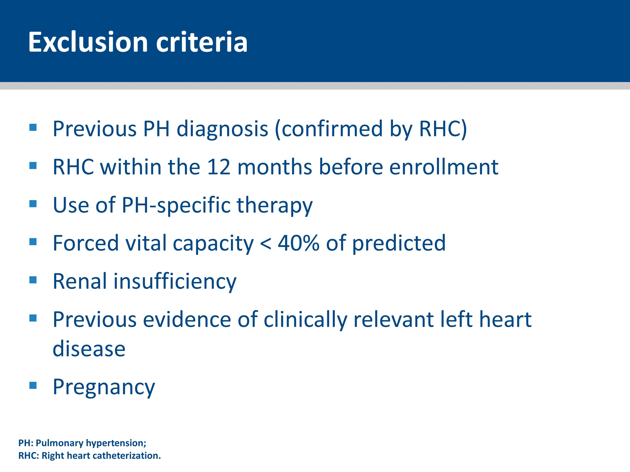
Notes:
Patients were excluded if they:
Had pulmonary hypertension confirmed by right heart catheterization prior to enrollment
Were receiving PH-specific therapy
Had a forced vital capacity (FVC) < 40% of predicted
Had renal insufficiency
Had previous evidence of clinically relevant left heart disease
Were pregnant

Slide 25
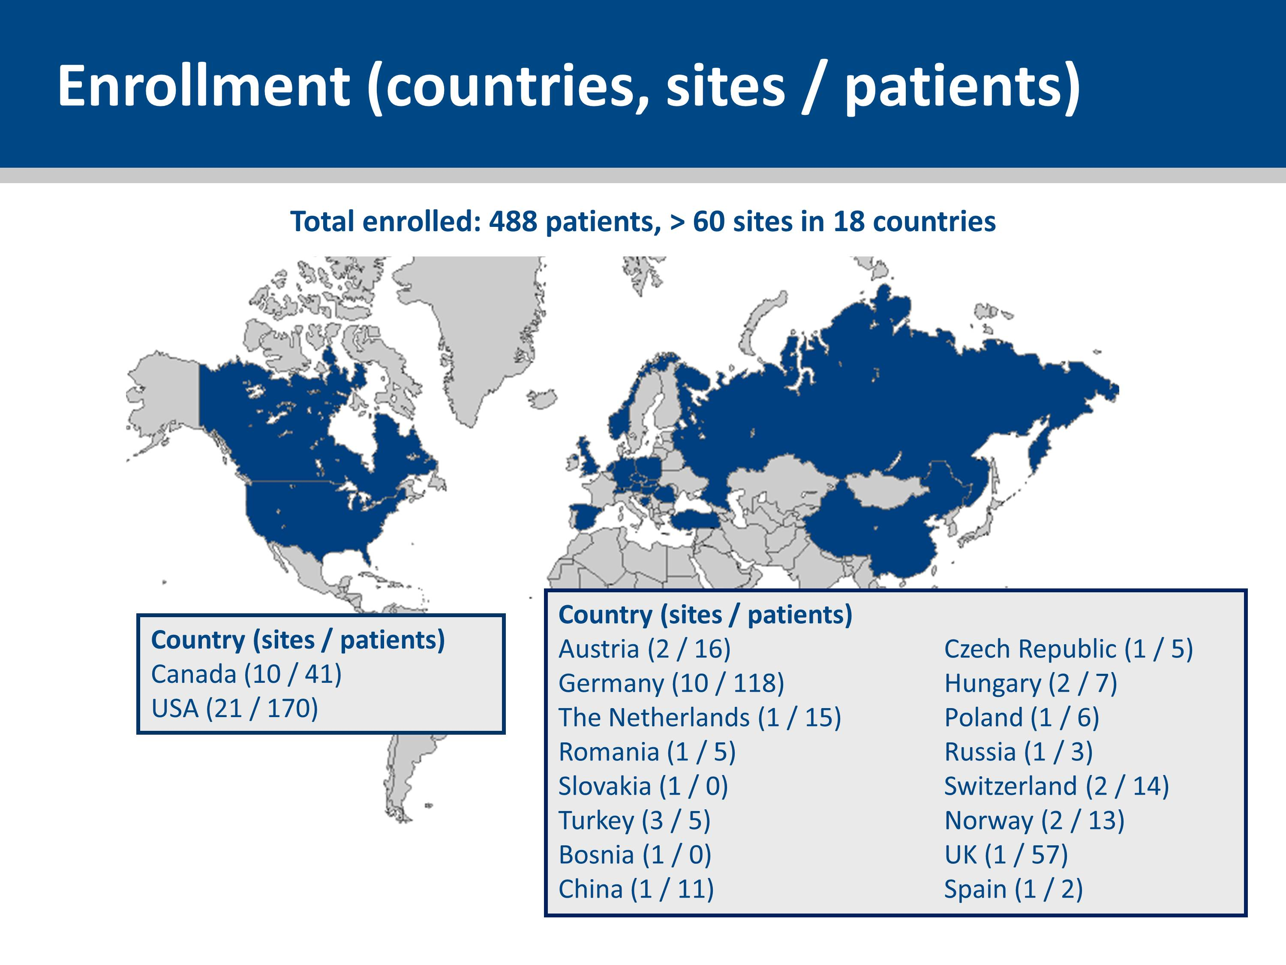
Notes:
Sixty-two experienced centers (managing at least 40 SSc patients) from 18 countries in North America, Europe, and Asia participated in the study between 2008 and 2011.

Slide 26
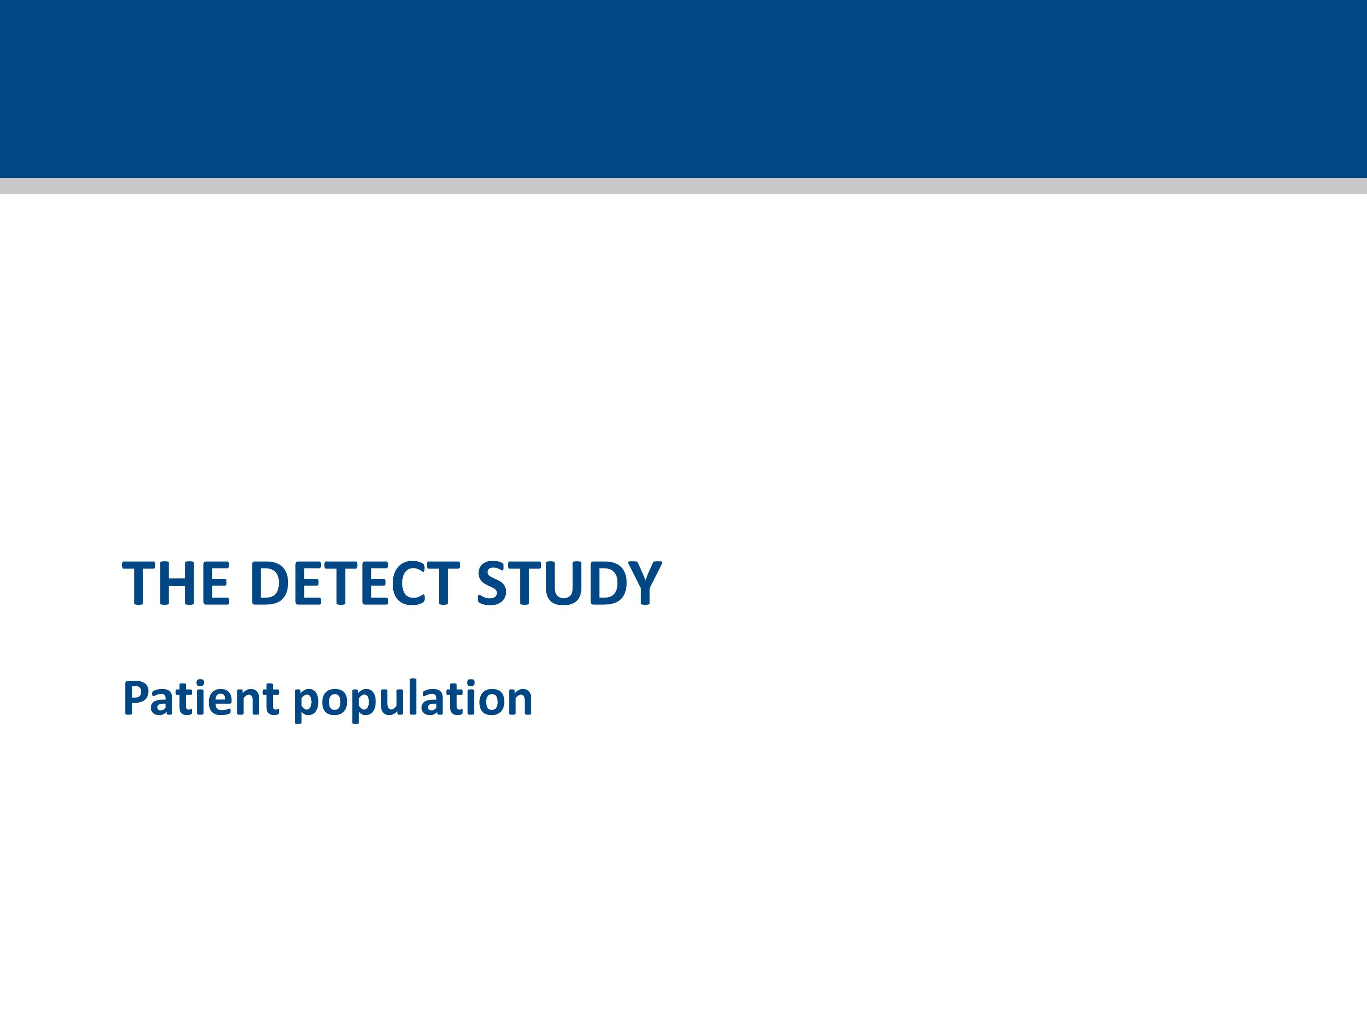

Slide 27
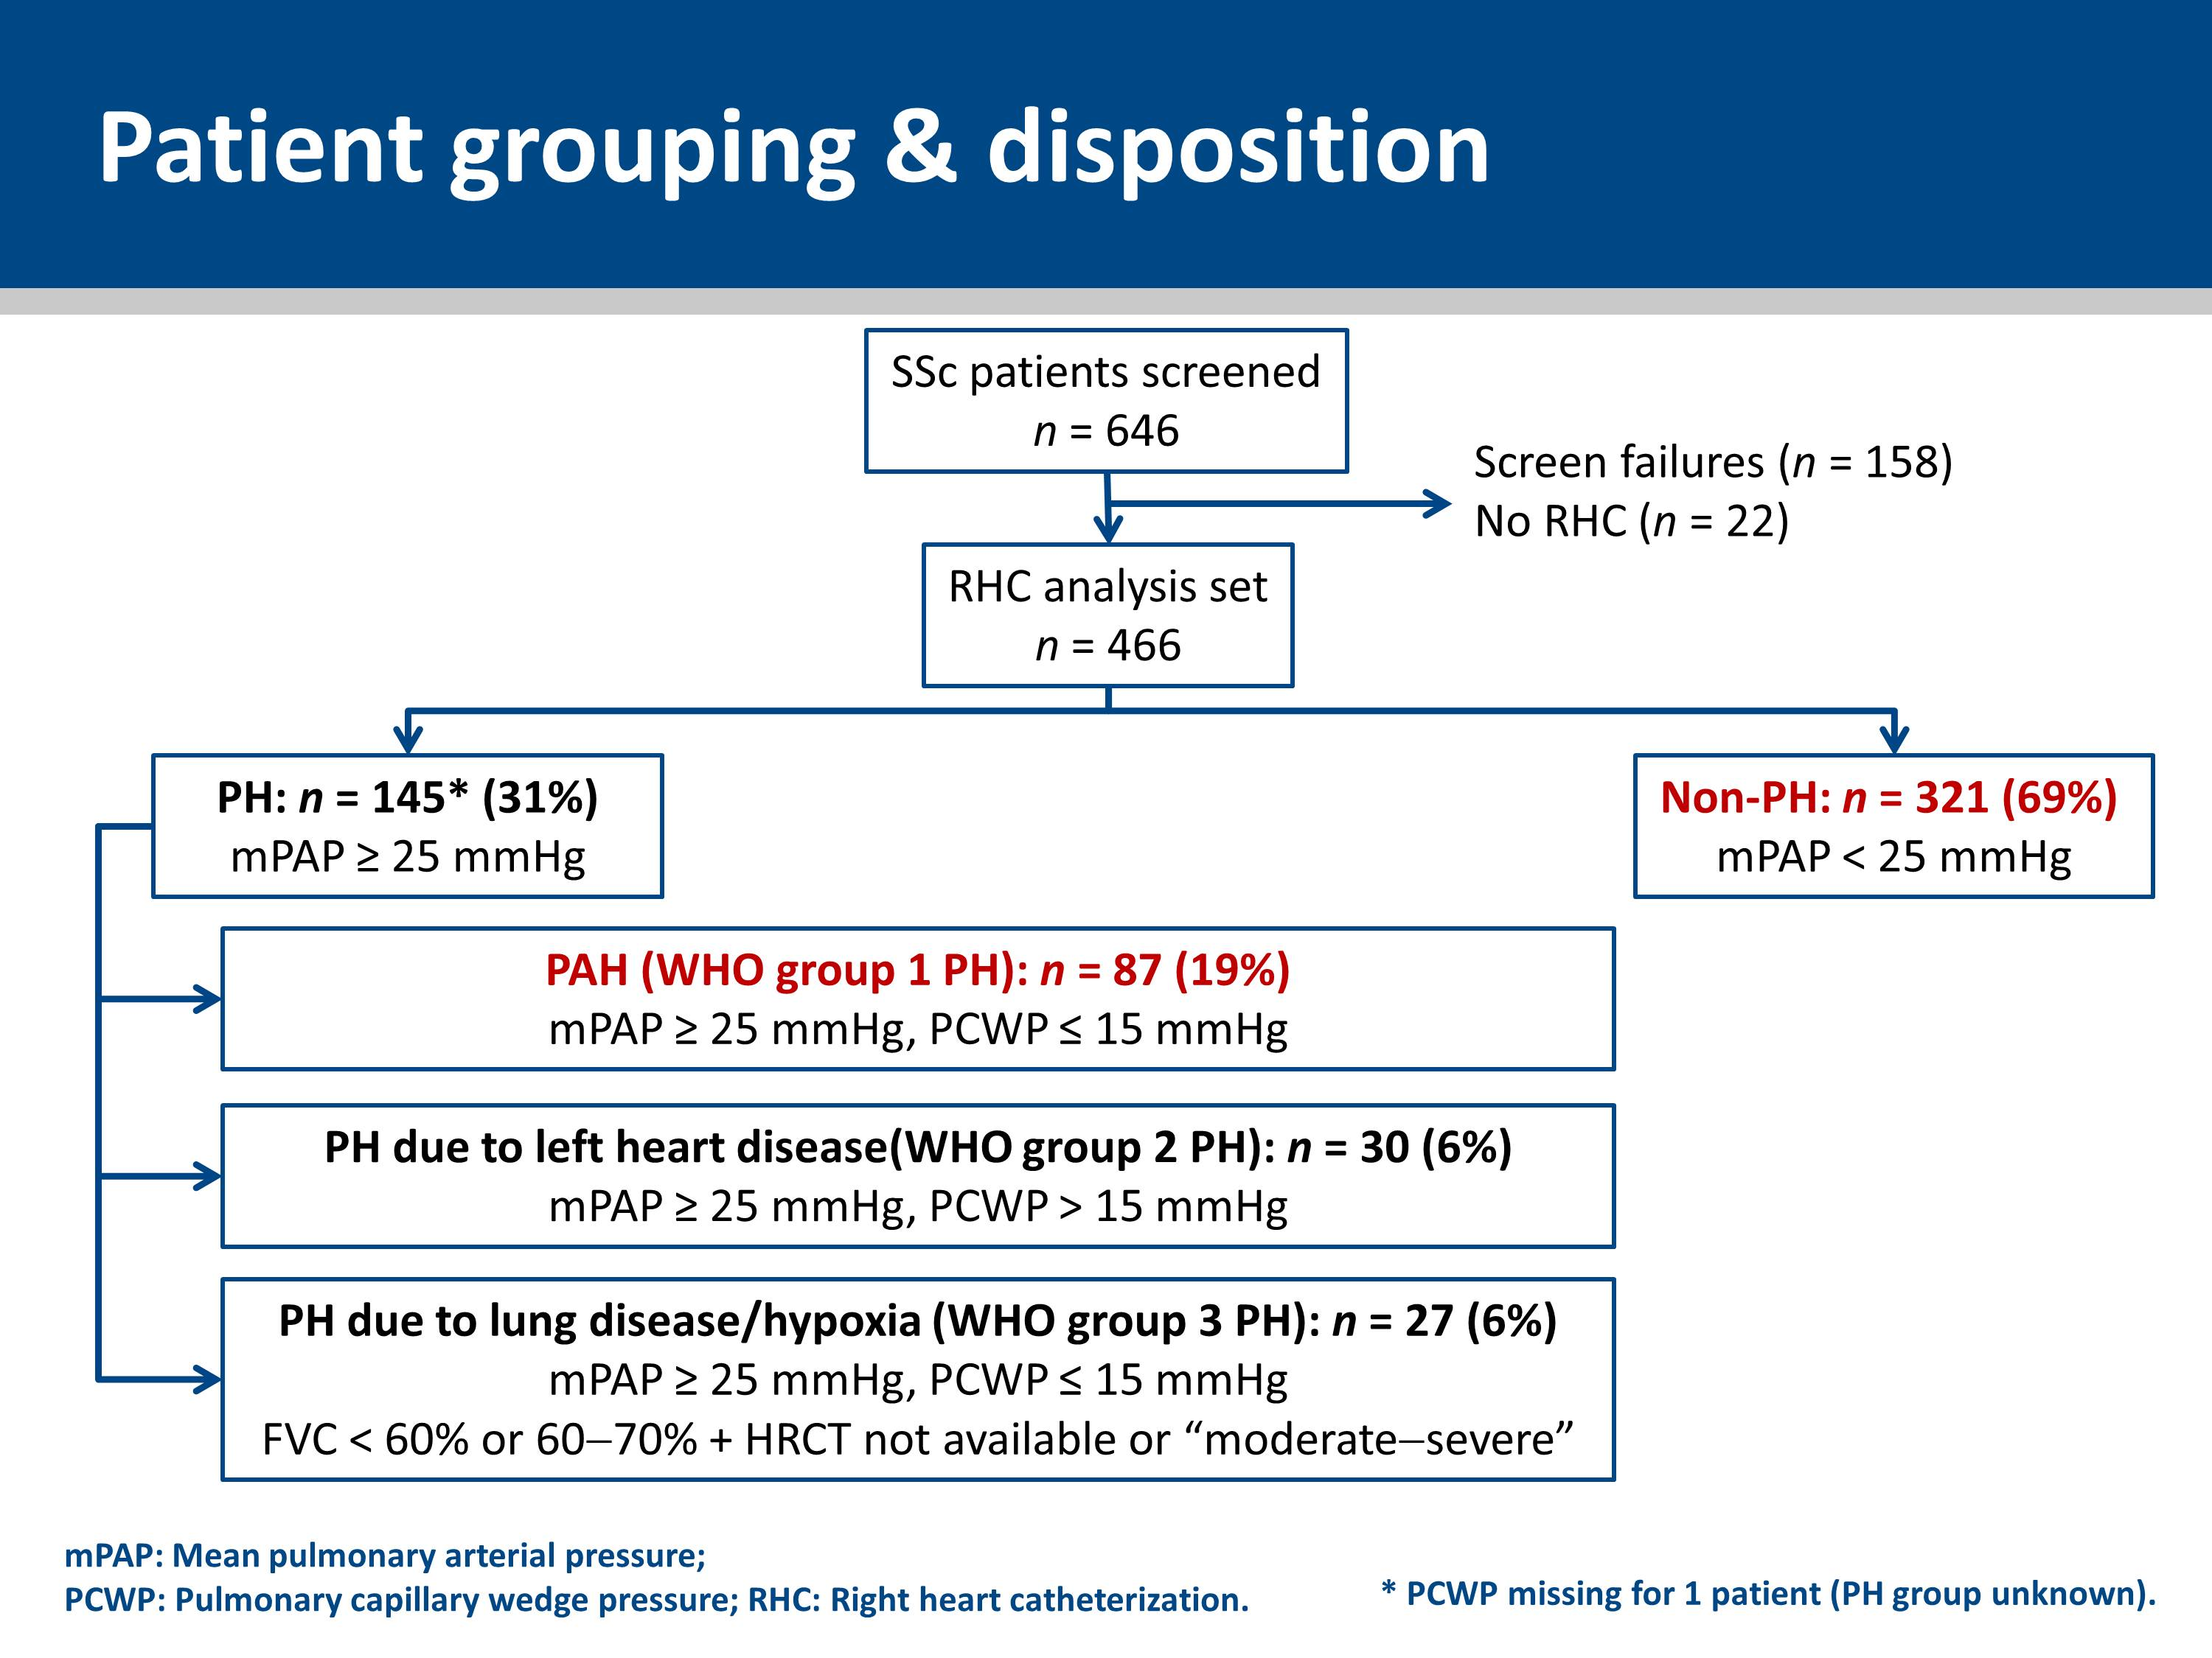
Notes:
Patients were classified according to current guidelines^{1,2} as:
Non-PH
PAH: WHO group 1 PH
PH due to left heart disease: WHO group 2 PH
PH due to lung disease/hypoxia: WHO group 3 PH (The WHO group 3 definition was based on Study Scientific Committee consensus).
1. Badesch DB et al. J Am Coll Cardiol 2009; 54: S55–S66.
2. Simonneau G et al. J Am Coll Cardiol 2009; 54: S43−S54.

Slide 28
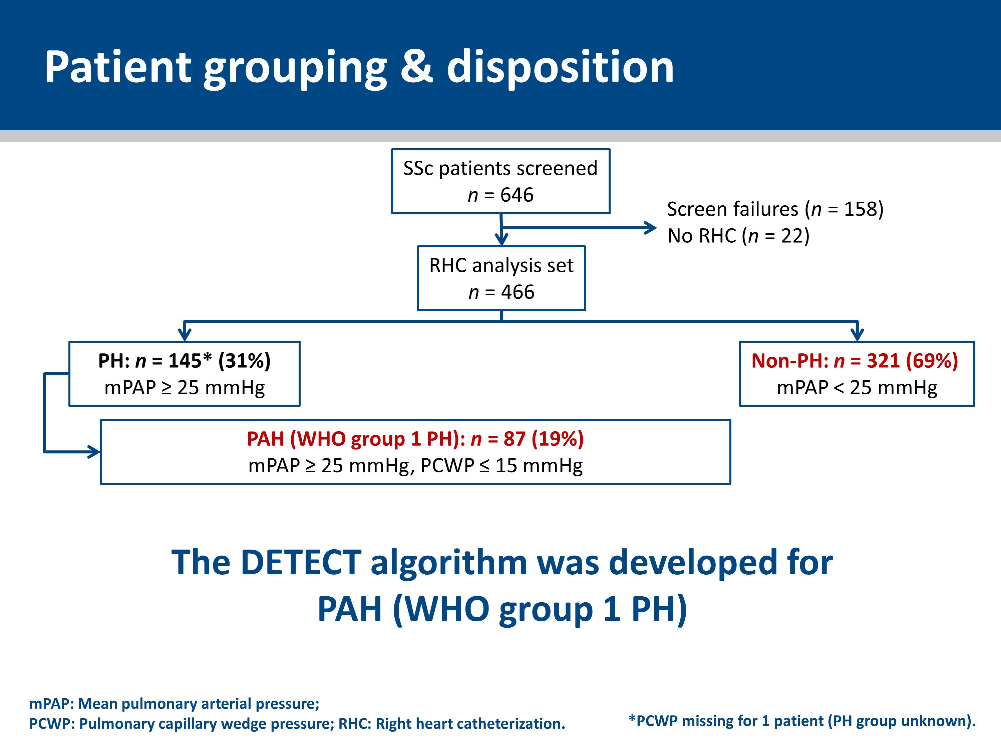
Notes:
The DETECT study algorithm was developed as a screening algorithm for PAH (WHO group 1 PH) in SSc patients.

Slide 29
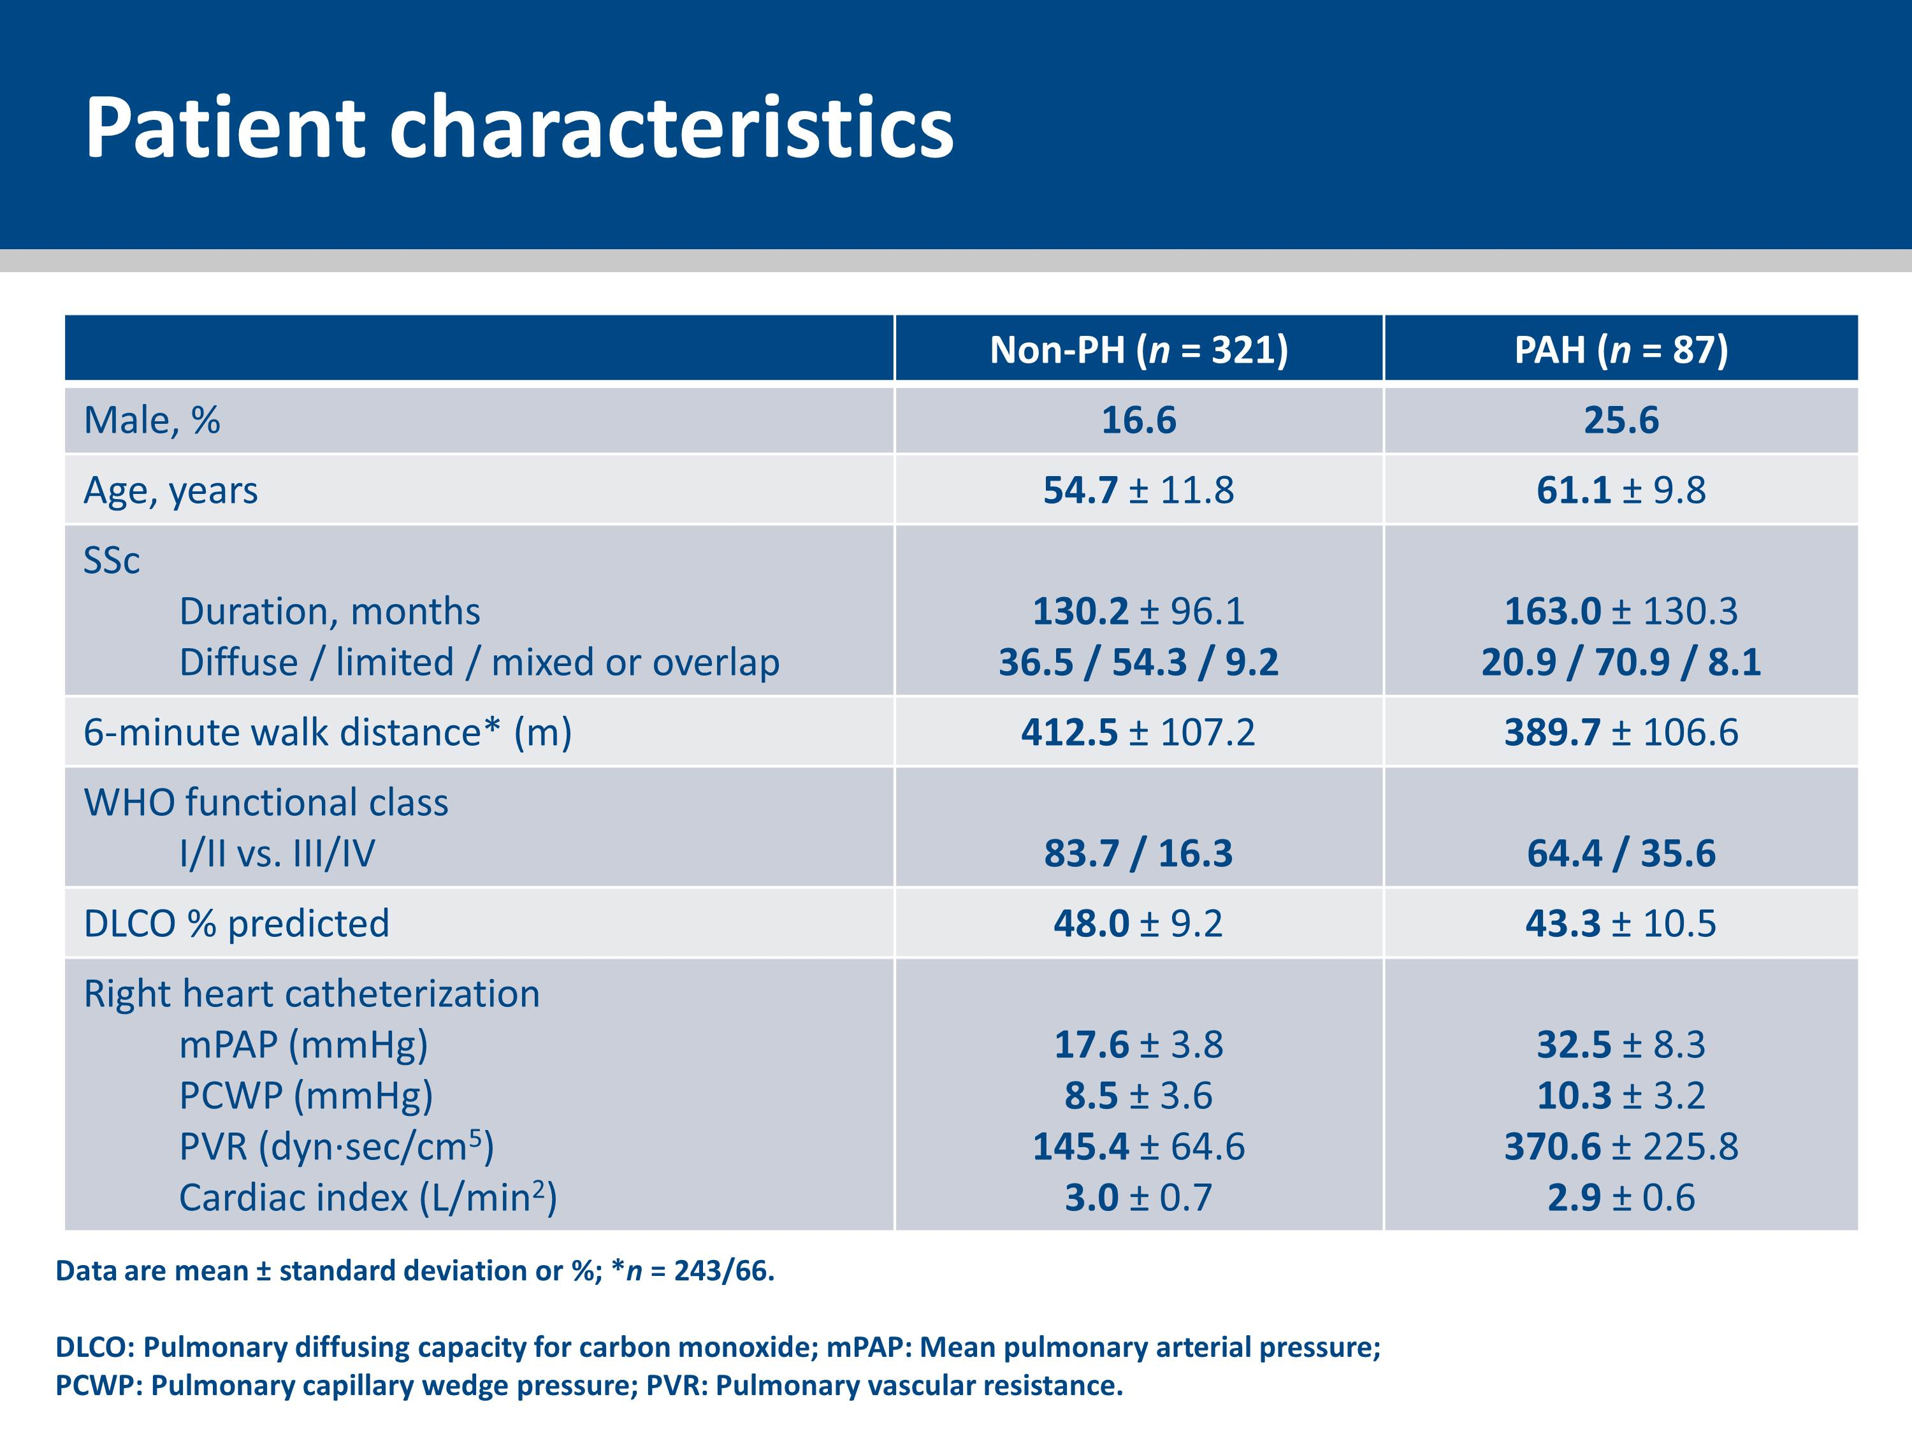
Notes:
In most patients (64%) PAH was mild (functional class I or II), with moderately elevated mPAP and PVR and preserved mean cardiac index.
Compared with non-PH patients, PAH patients were older, more likely to be male, in higher (more severe) functional class, more likely to have the limited cutaneous form of SSc, had worse gas transfer (as assessed by DLCO).
Exercise capacity on 6-minute walk distance was not associated with the presence of PAH. This is consistent with the lack of sensitivity of 6-minute walk distance in identifying cardiopulmonary compromise in early disease, perhaps due to SSc-associated restricted musculoskeletal mobility.

Slide 30
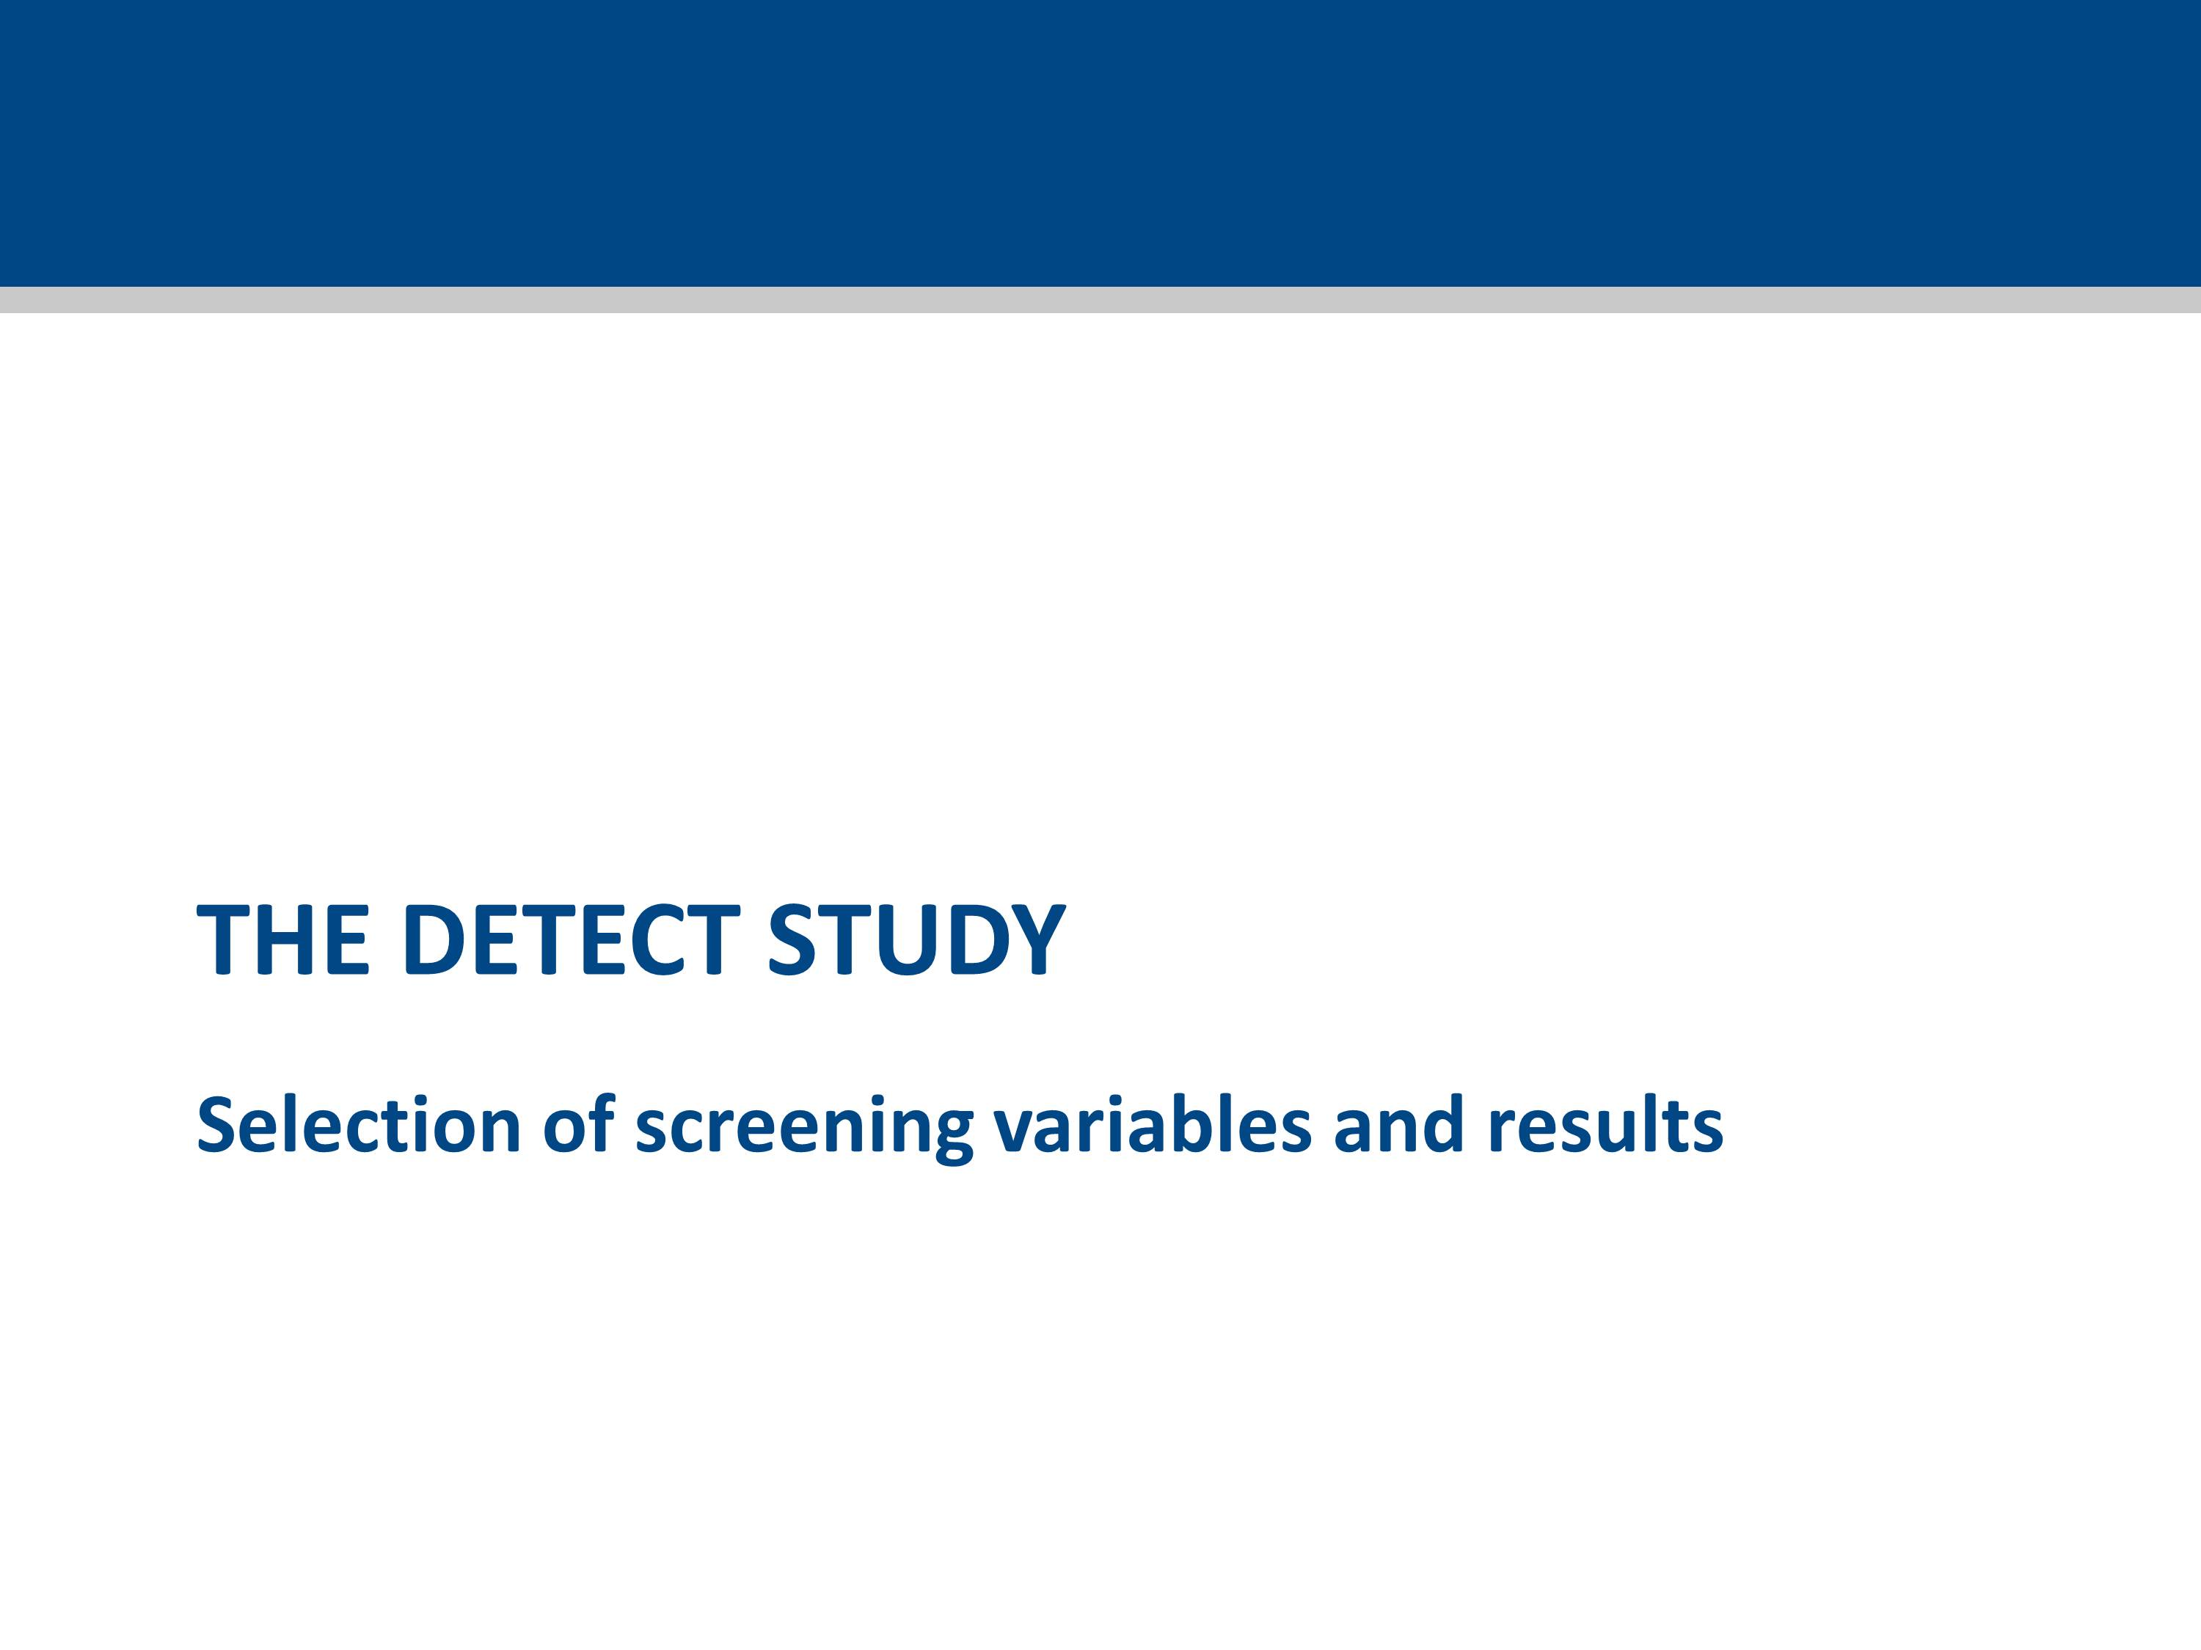

Slide 31
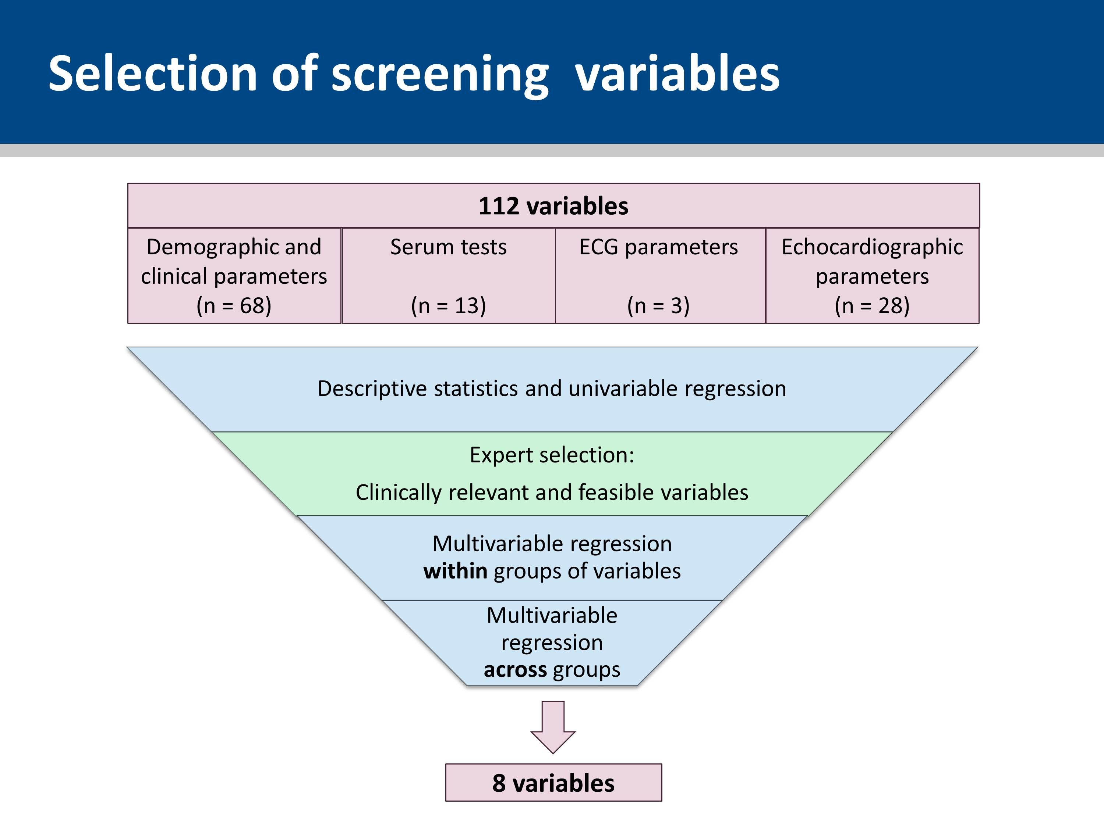
Notes:
From an initial 112 variables, 8 were selected based on their discriminatory ability to detect PAH.
The variables were selected following univariable and multivariable analyses, and clinical judgment of the Study Scientific Committee (based on feasibility and clinical plausibility).

Slide 32
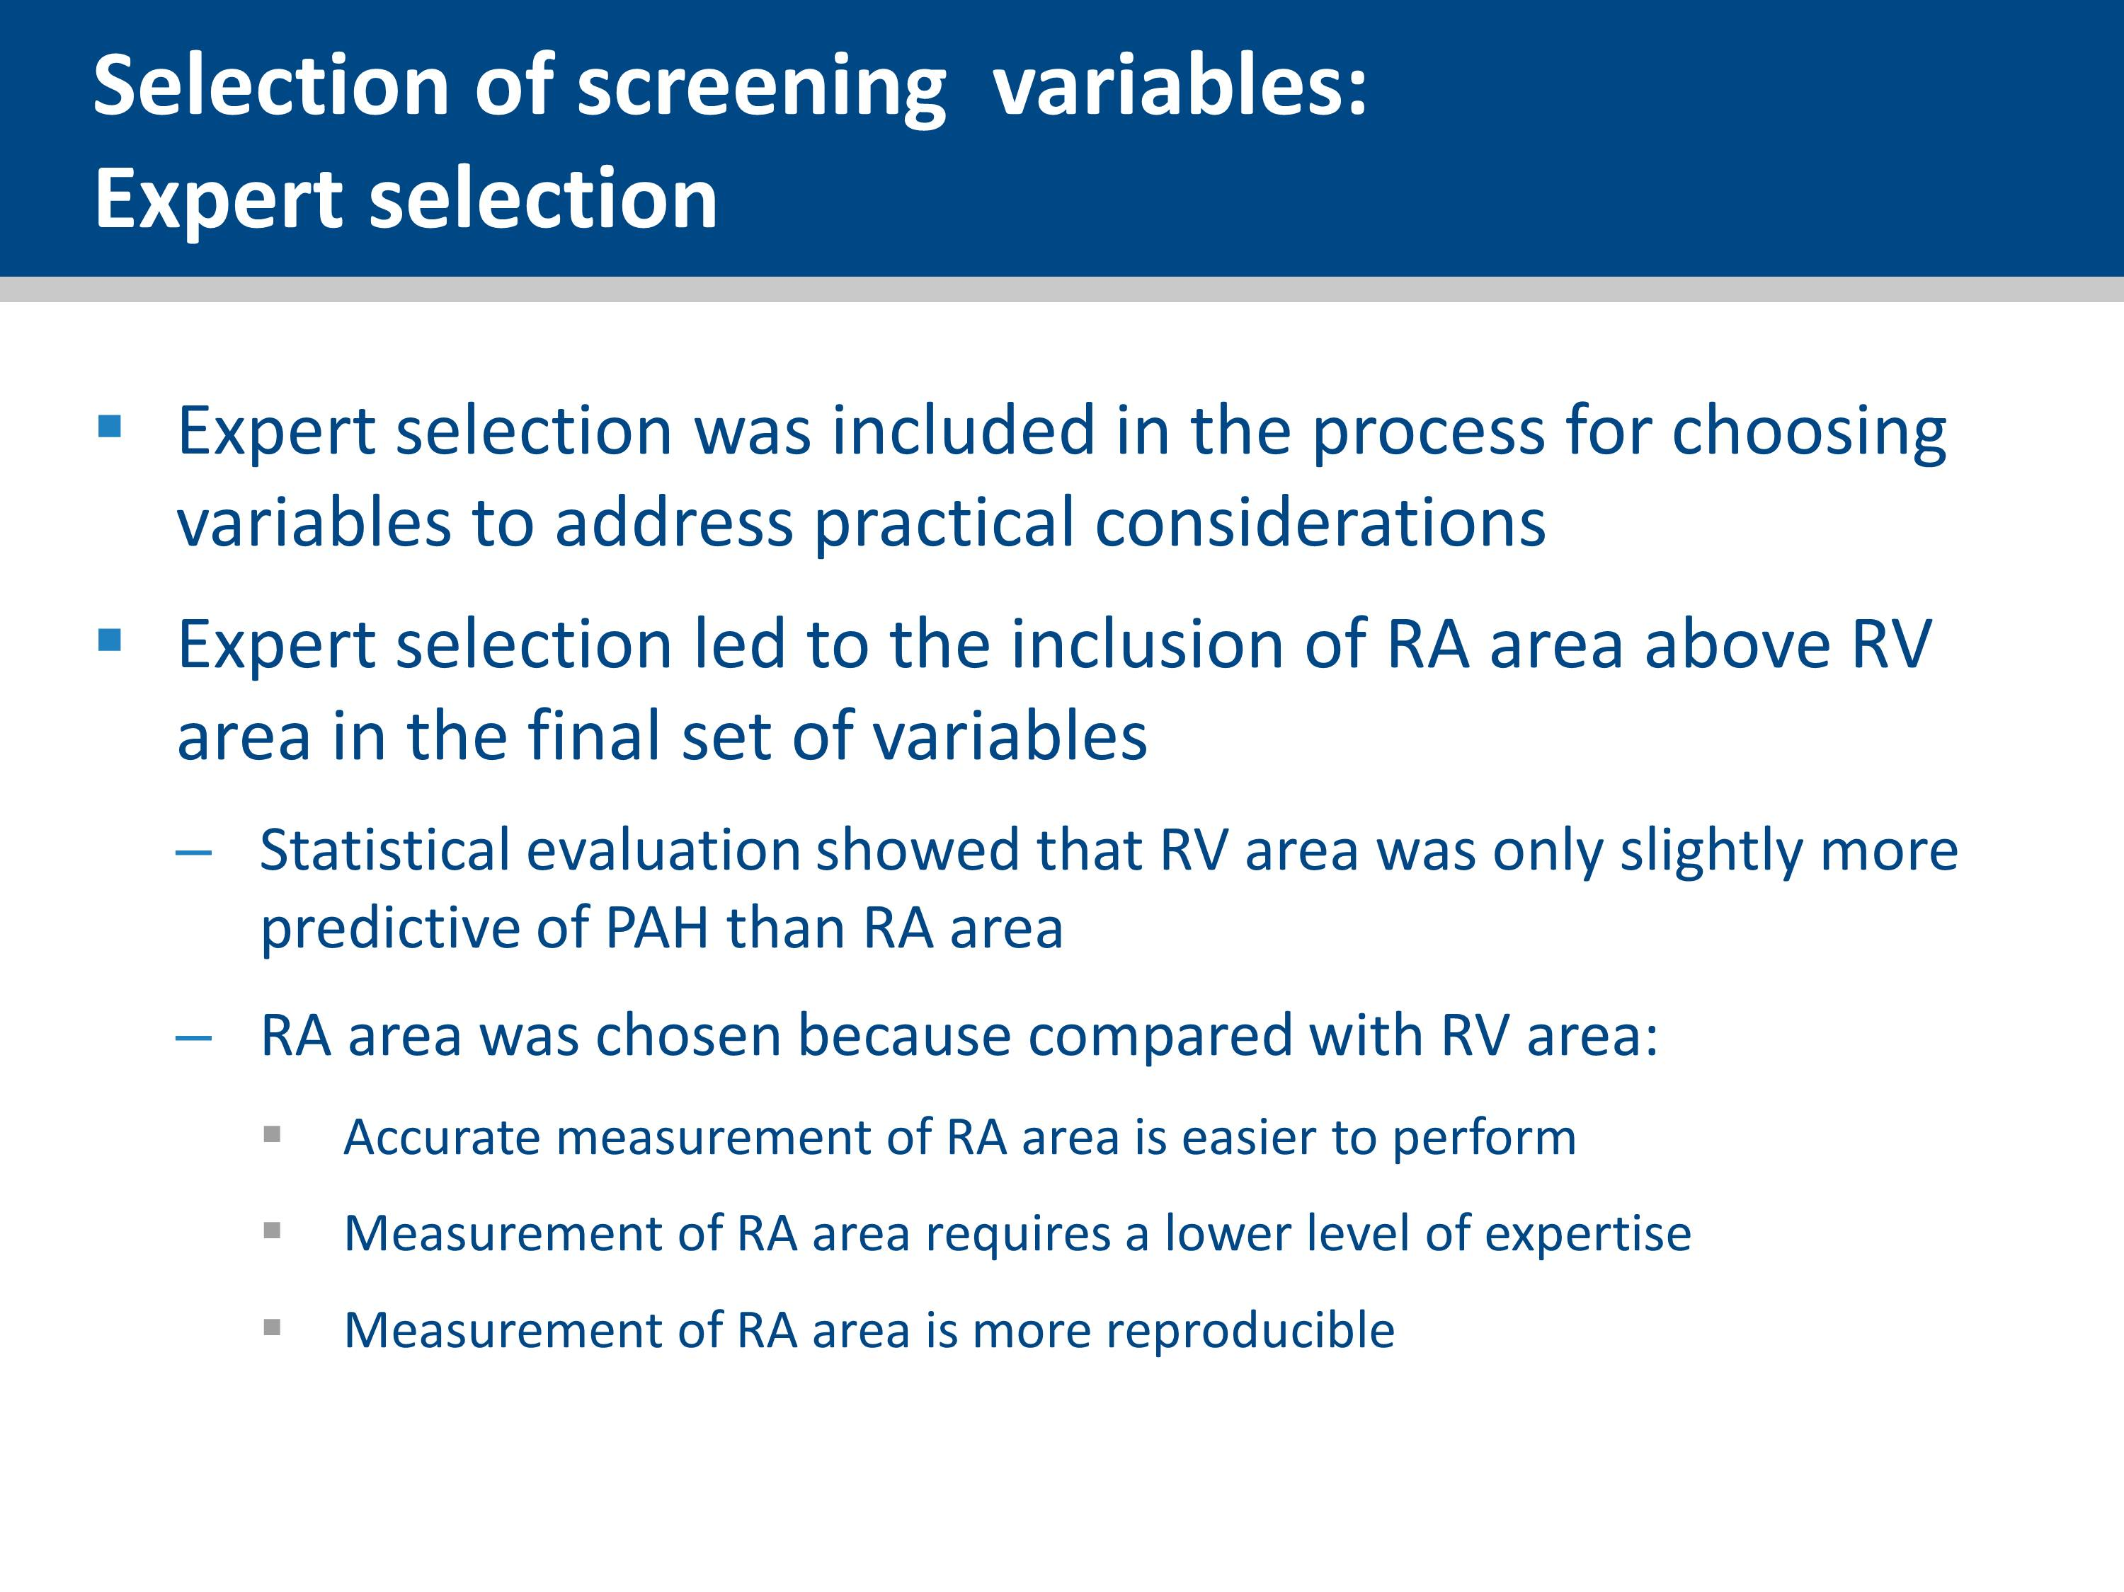
Notes:
Of all statistically selected final variables, the Study Scientific Committee replaced one echocardiographic variable (RV area) by another one (RA area), because the latter is regarded as easier to assess and likely to be more reproducible.
This replacement had a minimal effect on the performance of the step 2 model (AUC 0.89 and 0.88 using RV area and RA area, respectively).

Slide 33
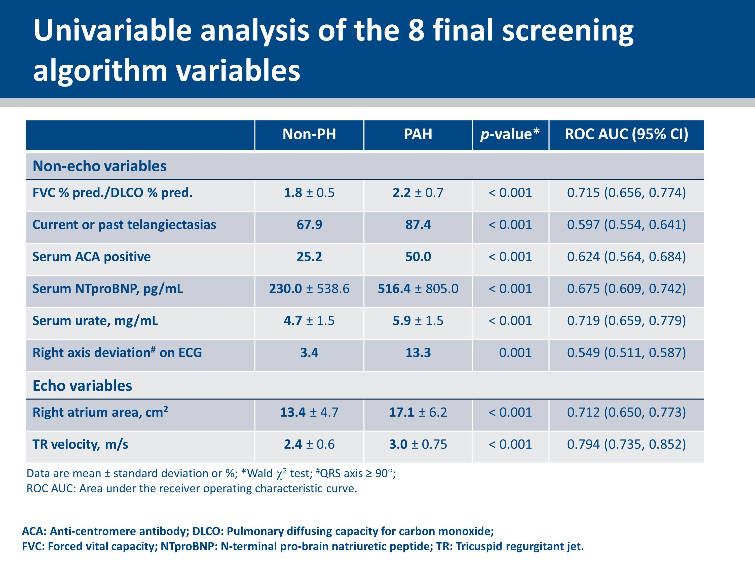
Notes:
This slide shows the individual performance of the 8 final variables.

Slide 34
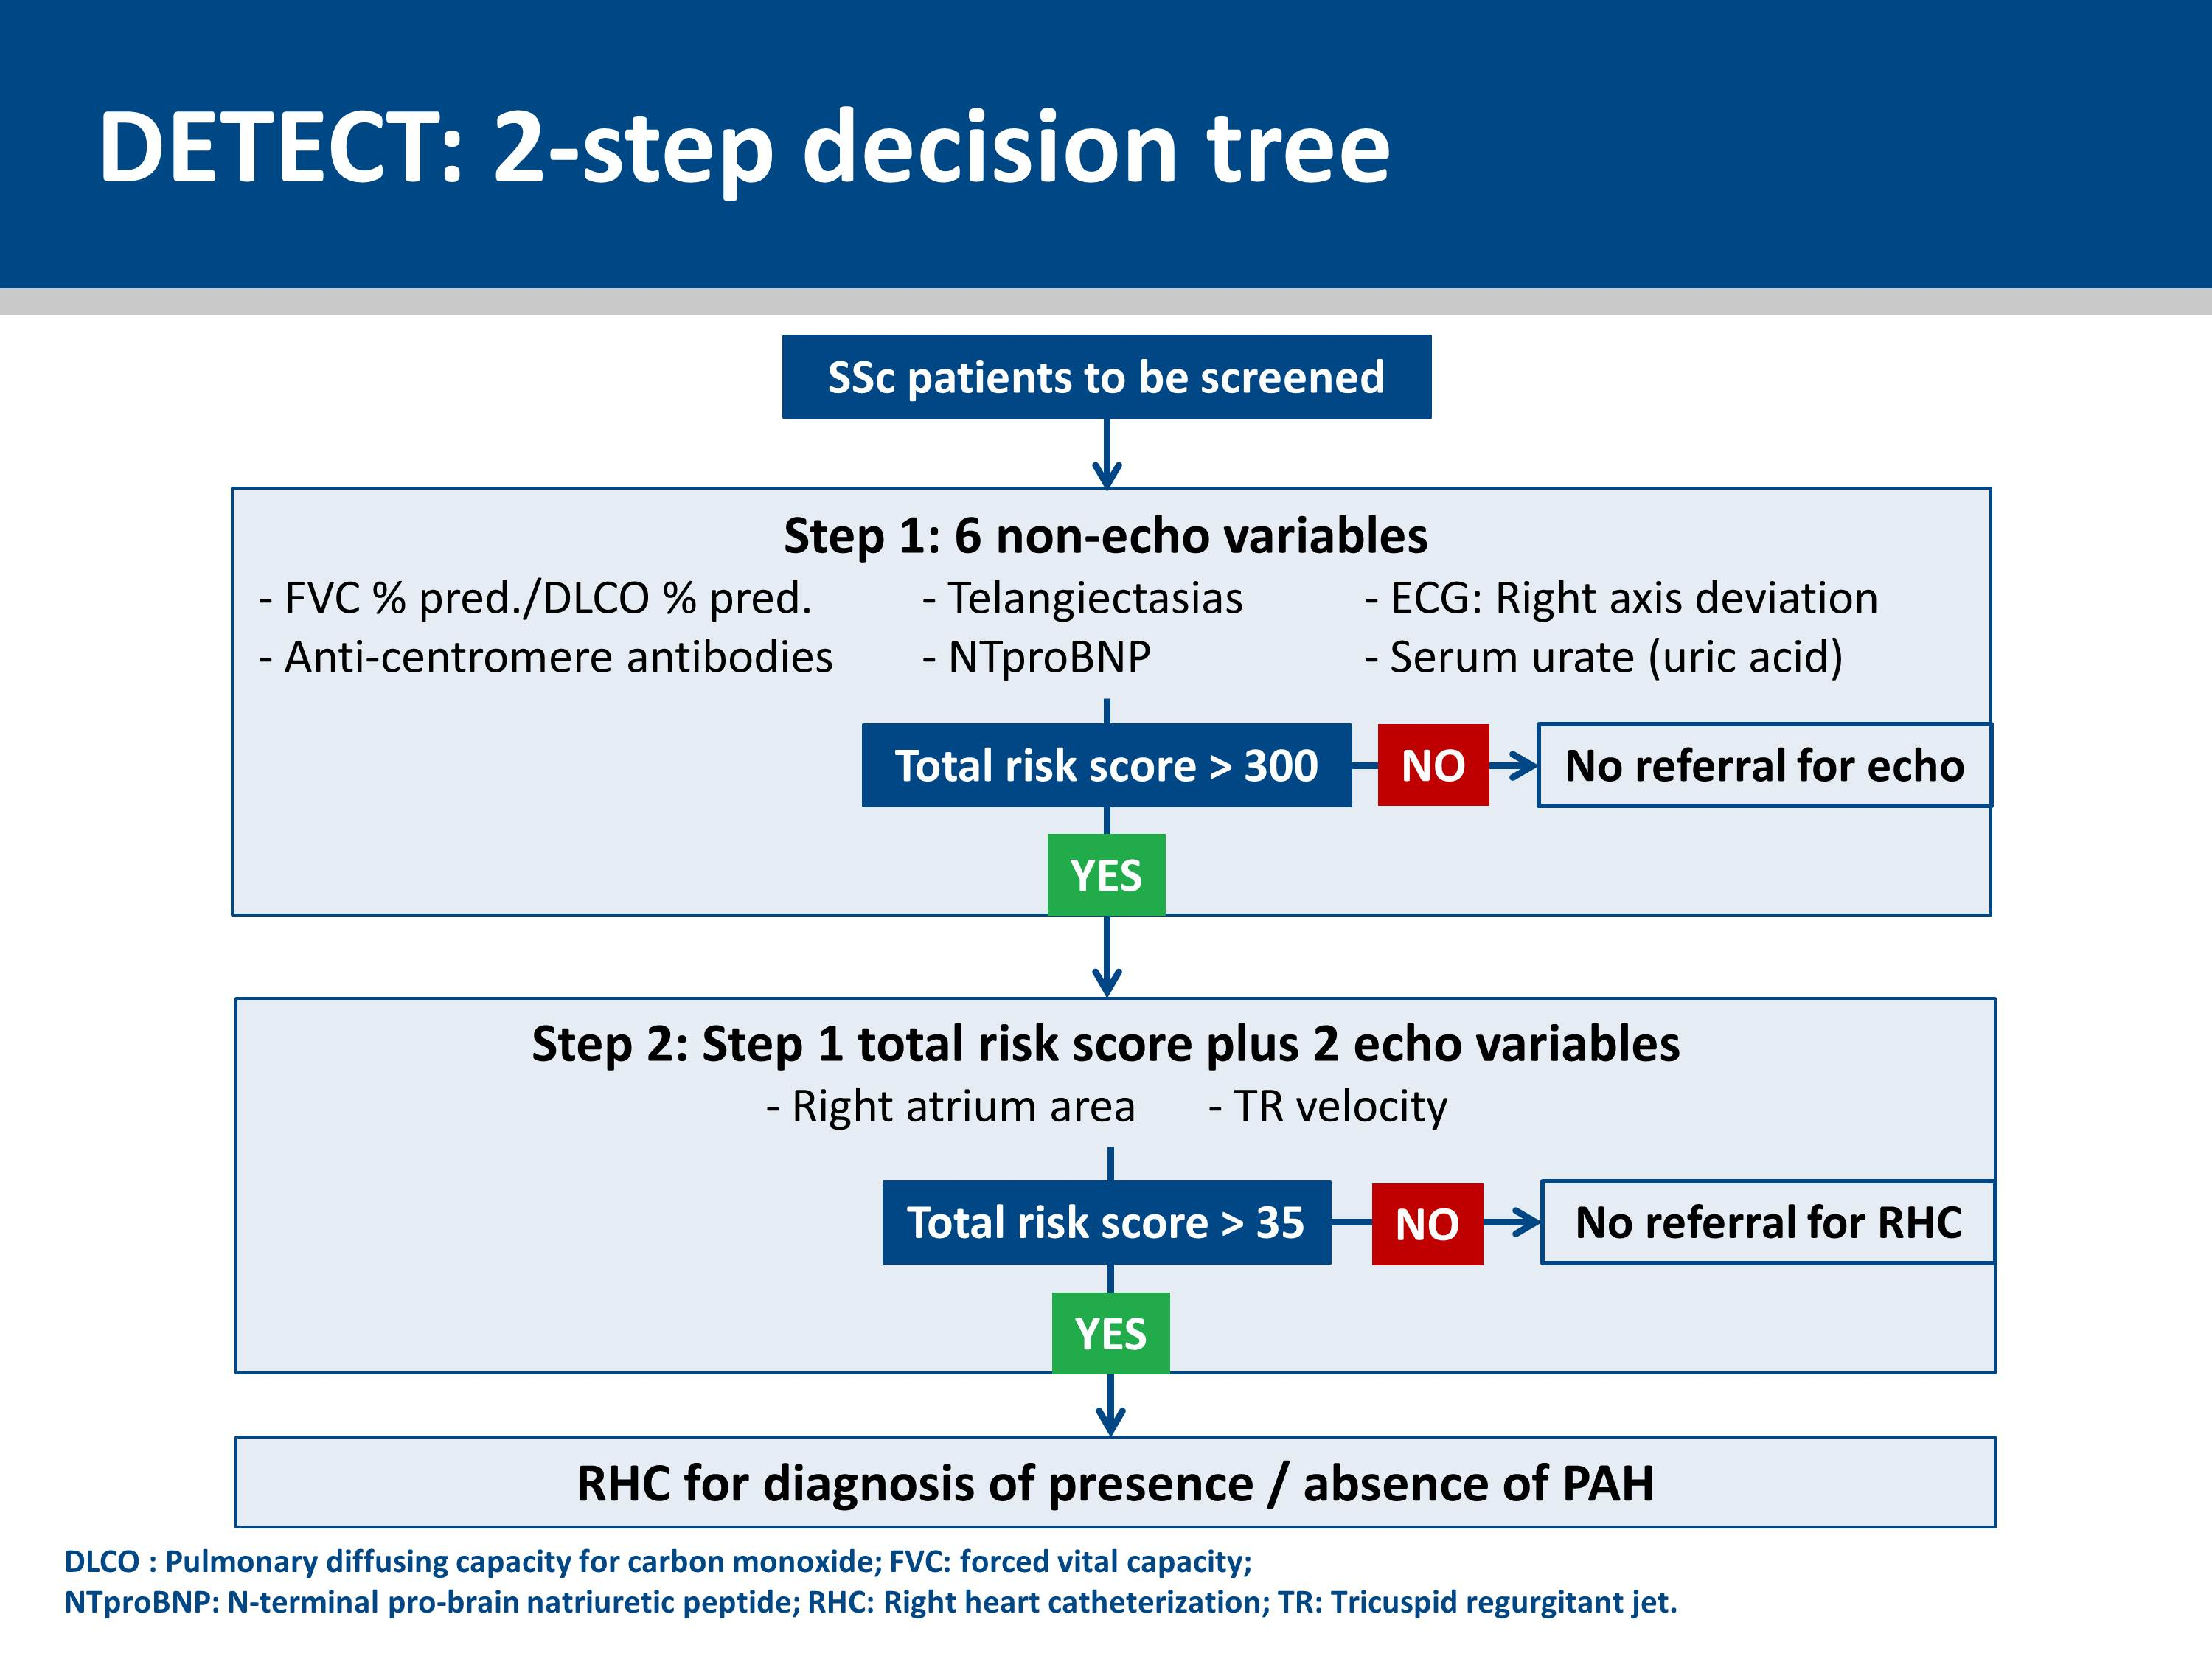
Notes:
The 8 variables were used to construct a screening algorithm.
To align the screening algorithm with real-world practice where the rheumatologist accesses non-echocardiographic data prior to referral to a cardiologist for echocardiography, the variables were divided into non-echocardiographic and echocardiographic variables.
Step 1 of the algorithm includes 6 non-echocardiographic variables, namely: FVC % predicted/DLCO % predicted, current/past telangiectasias, serum anti-centromere antibodies, serum NTproBNP, serum urate, and right axis deviation on ECG. A patient is assigned risk points for each variable, the resulting total risk score is used to determine the need for referral to echocardiography.
Step 2 includes 2 echocardiographic variables, namely; right atrium area and TR velocity. A patient is assigned risk points for each variable, in addition step 2 includes the carried-forward step 1 risk points. The resulting total risk score is used to determine the need for referral to right heart catheterization.

Slide 35
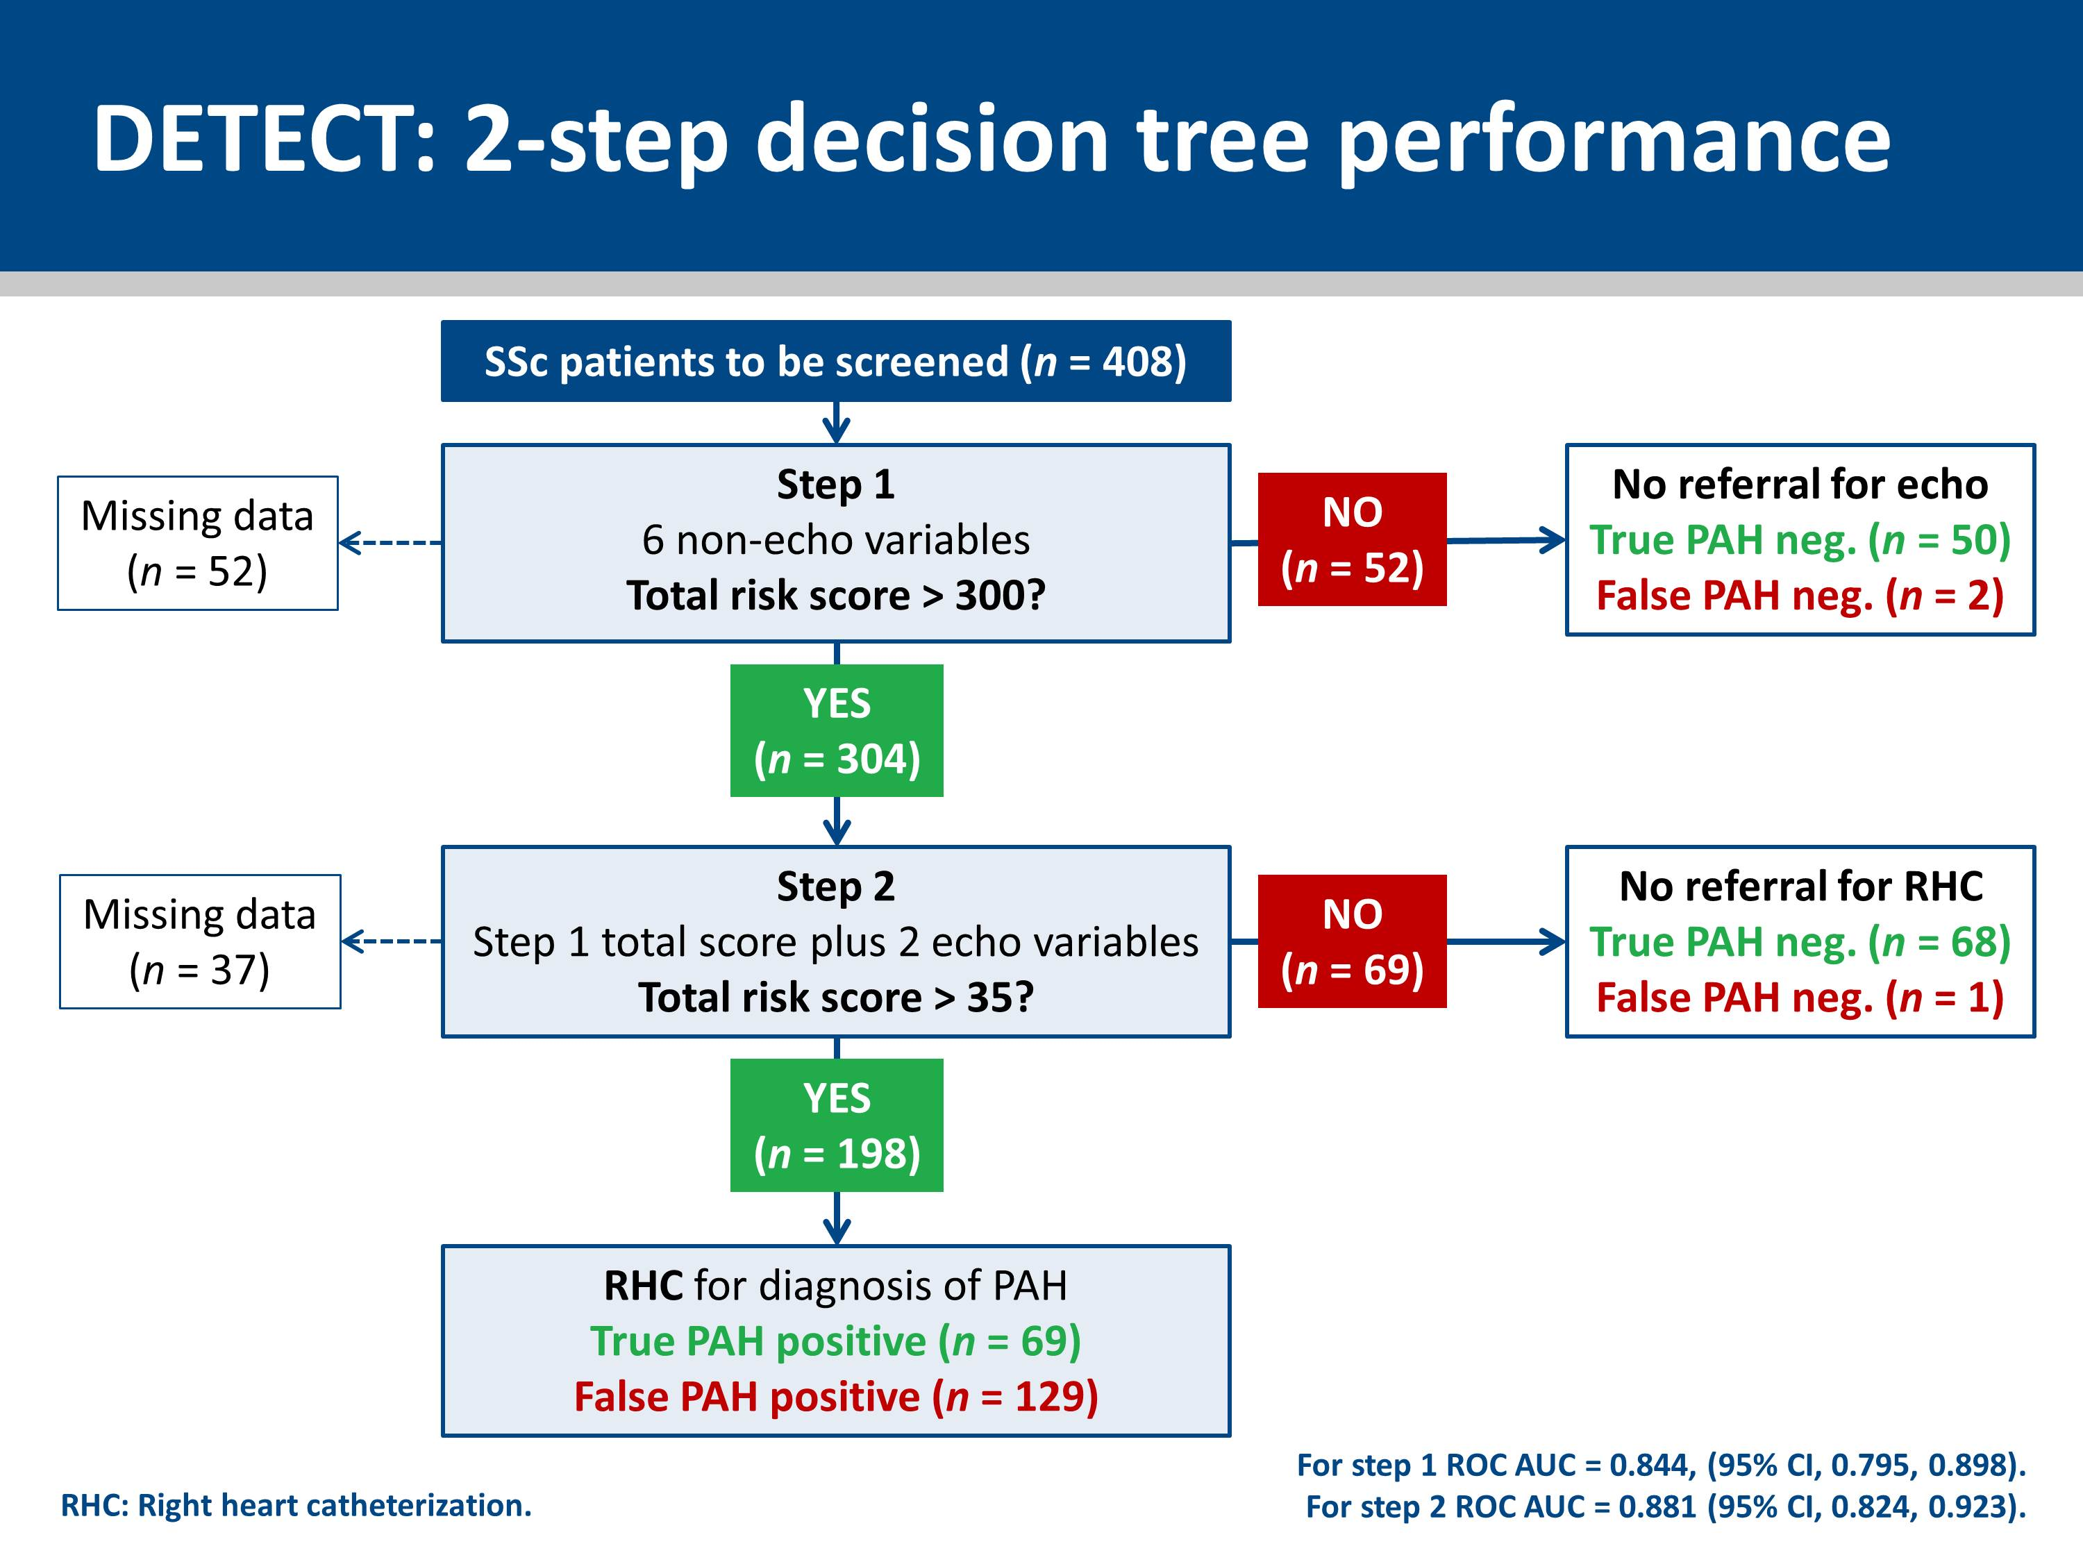

Slide 36
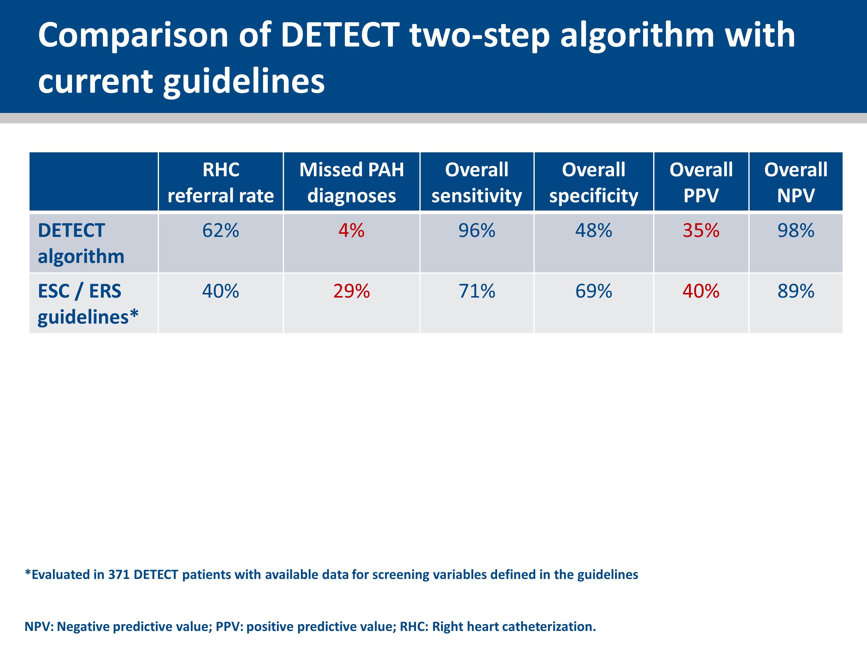
Notes:
In this slide we see a comparison between the DETECT algorithm with the ESC/ERS guidelines, when the referral rate to RHC is higher for DETECT (62% versus 40%).
The rate of missed PAH diagnoses was 4% (n = 3) applying the DETECT algorithm. The 4% missed diagnoses rate of the DETECT algorithm compares with 29% (n = 24) based on current ESC/ERS guidelines.
The PPV for the DETECT algorithm is 35% compared to 40% for the ESC/ERS guidelines.
Therefore in the DETECT population, when the referral rate is 62%, only 4% of patients with PAH are not diagnosed, and 35% of RHC resulted in a positive diagnosis for PAH.

Slide 37
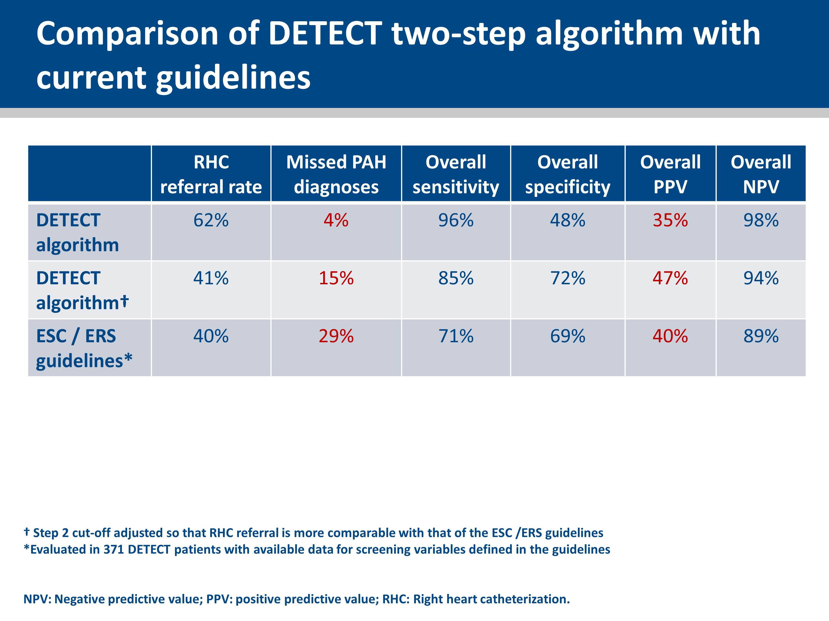
Notes:
This slides shows the scenario where the RHC referral rate is reduced from 62% to 41% (i.e. to a similar level as the 40% RHC referral rate observed with the ESC/ERS guidelines).
The rate of missed PAH diagnoses was 15% applying the DETECT algorithm. The 15% missed diagnoses rate of the DETECT algorithm compares with 29% based on current ESC/ERS guidelines.
The PPV for the DETECT algorithm is 47% compared to 40% for the ESC/ERS guidelines.
Therefore in the DETECT population, when the referral rate is 40%, only 15% of patients with PAH are not diagnosed, and 47% of RHC resulted in a positive diagnosis for PAH.

Slide 38
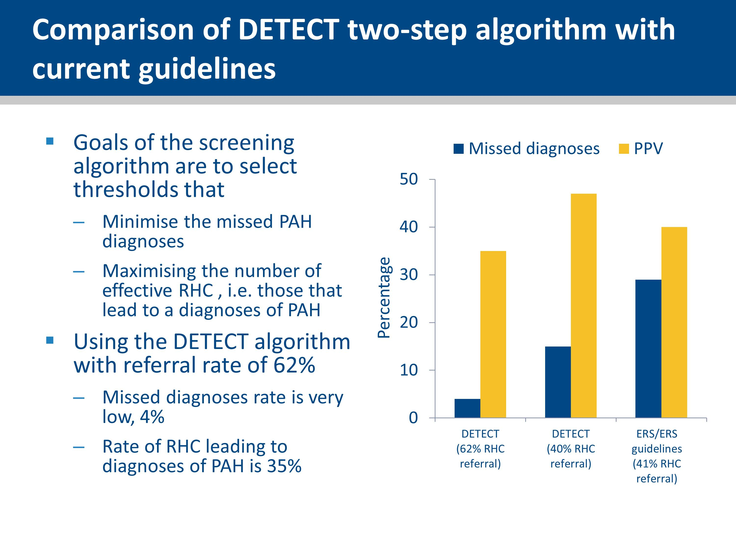

Slide 39
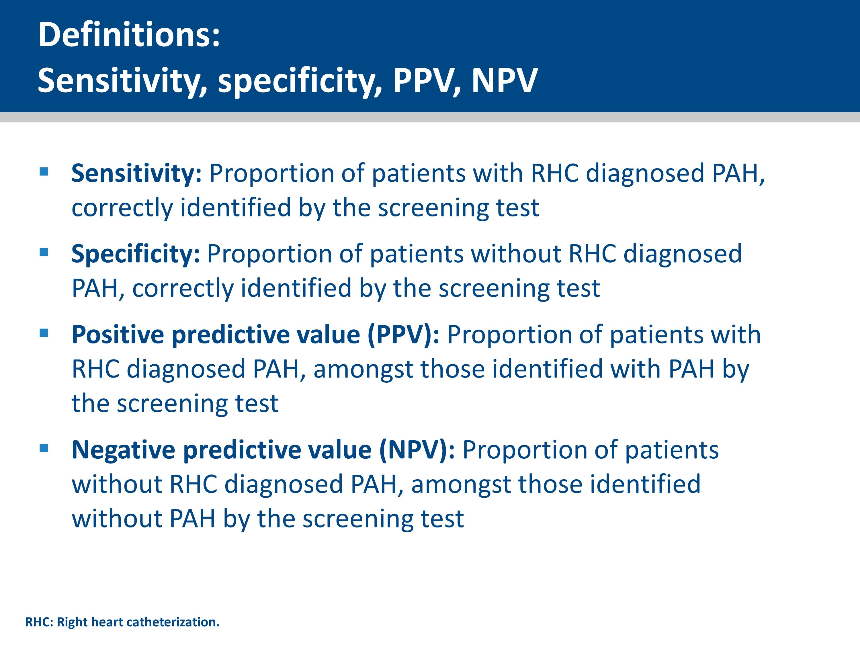

Slide 40
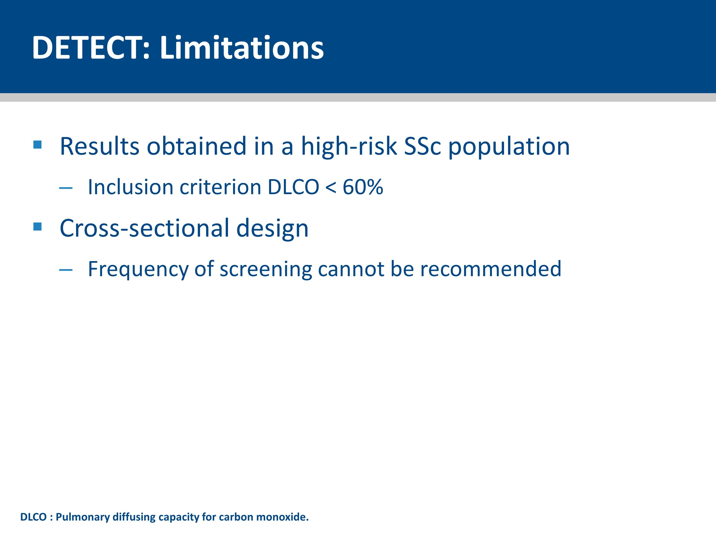
Notes:
The DETECT study inclusion criteria selected for prevalent SSc patients, which may have resulted in an over-representation of limited cutaneous SSc.
The data are based on cross-sectional analyses; it is not possible to determine algorithm performance long term or to recommend how frequently patients should be screened.

Slide 41
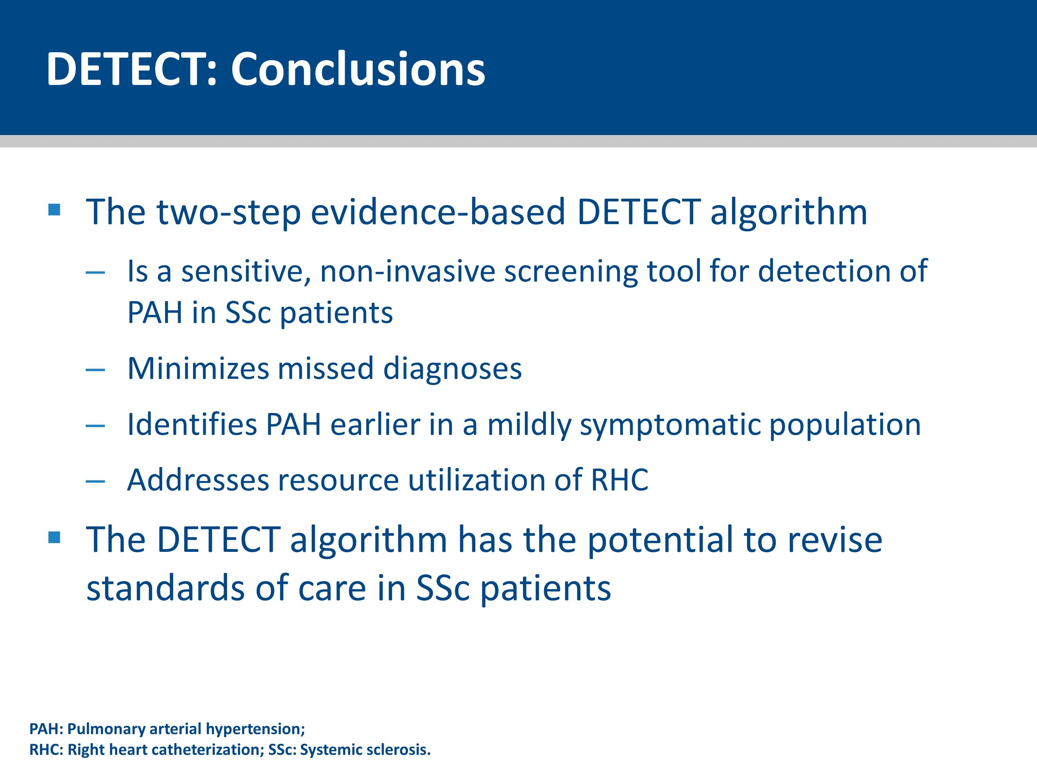
Notes:
The DETECT algorithm represents a highly sensitive screening tool for PAH in SSc with the ability to reduce missed diagnoses compared with current ESC/ERS screening recommendations, even when comparable rates of RHC utilization are chosen.
Evidence-based guideline recommendations for the identification of mildly symptomatic PAH patients can now be developed, facilitating earlier intervention.

Slide 42


Slide 43
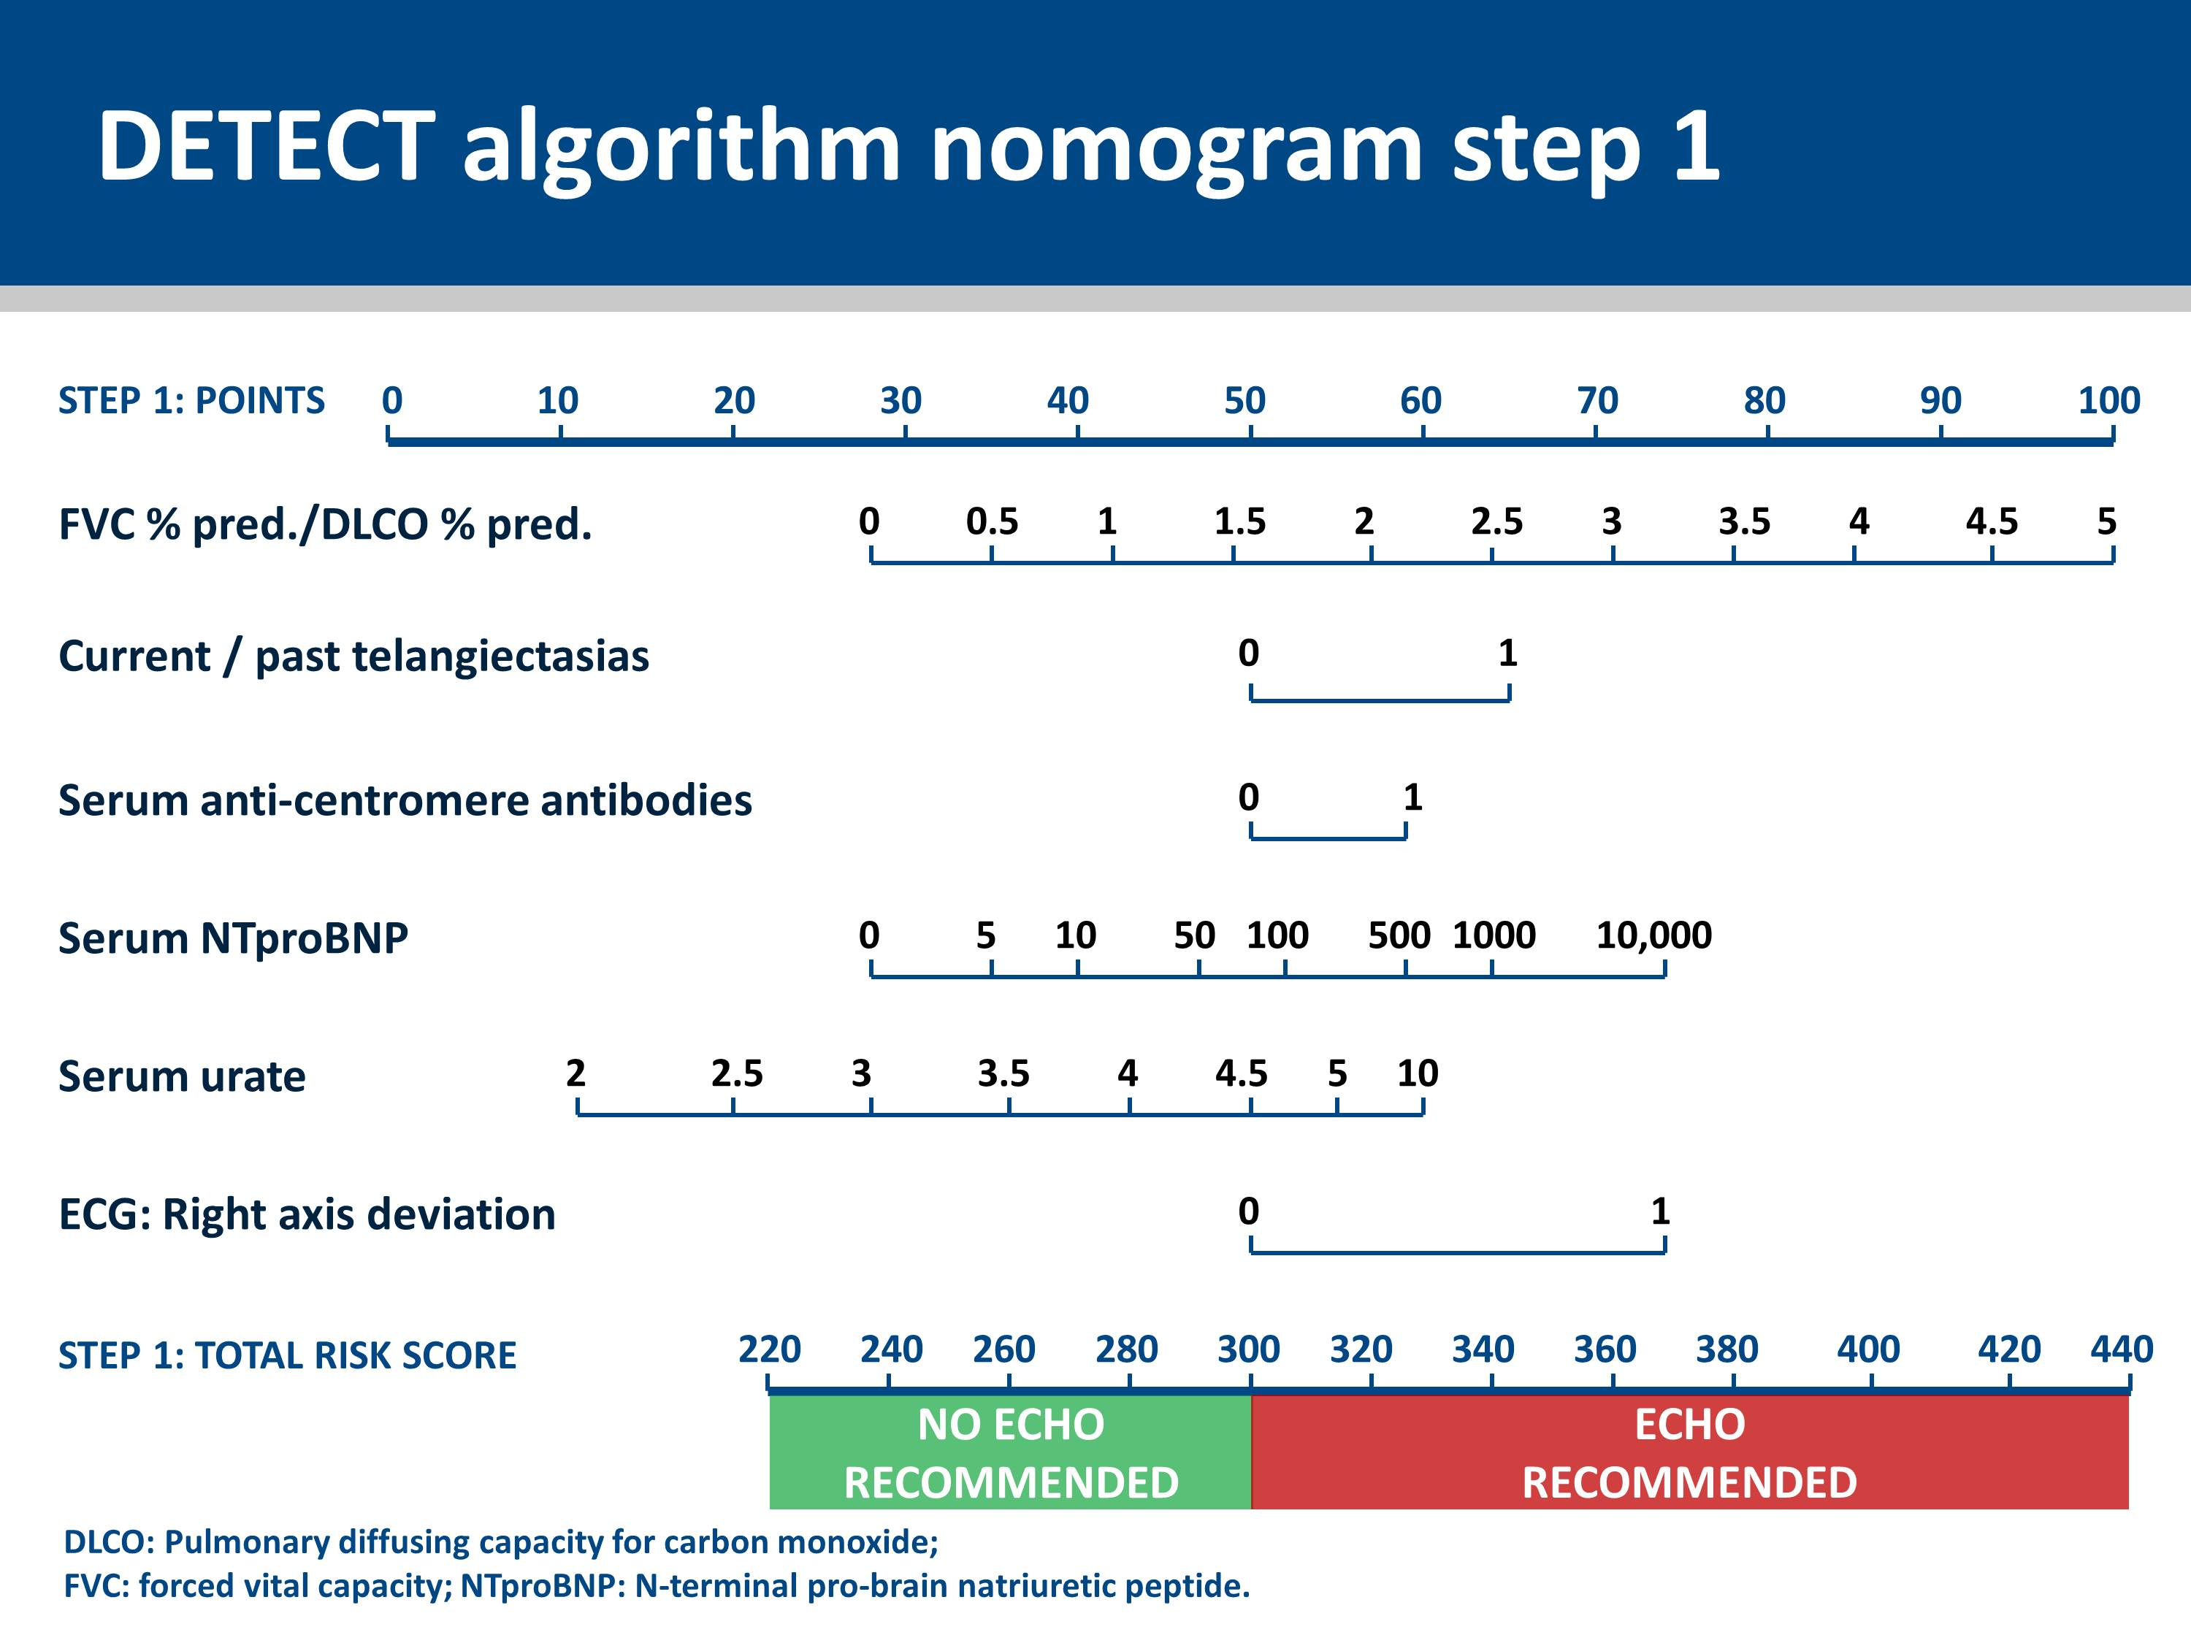
Notes:
Nomograms were derived from the two multivariable risk prediction models to allow classification of patients into risk sets for referral to echocardiography (step 1) and RHC (step 2).
This slide shows the nomogram for step 1.

Slide 44
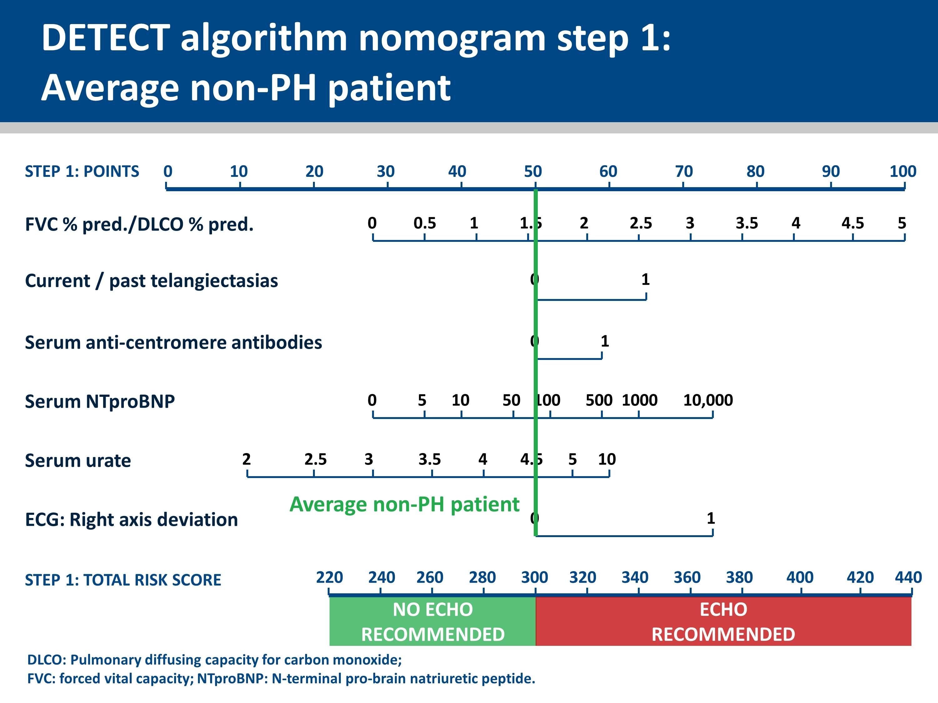
Notes:
This slide shows an average non-PH patient step 1 nomogram.

Slide 45
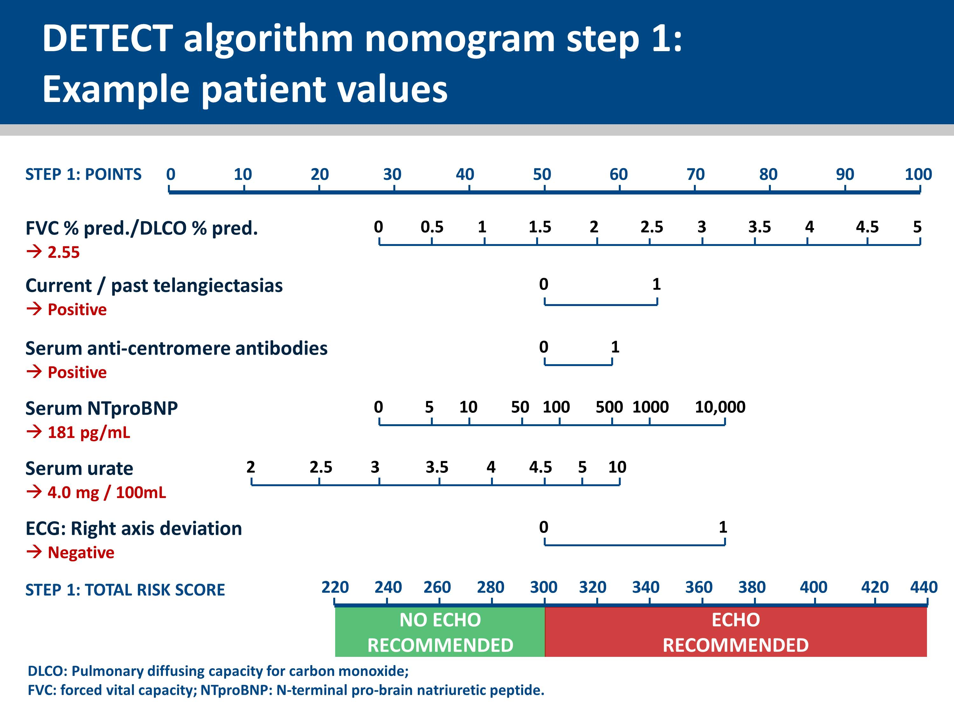
Notes:
The slide shows the patient values for each of the 6 variables.

Slide 46
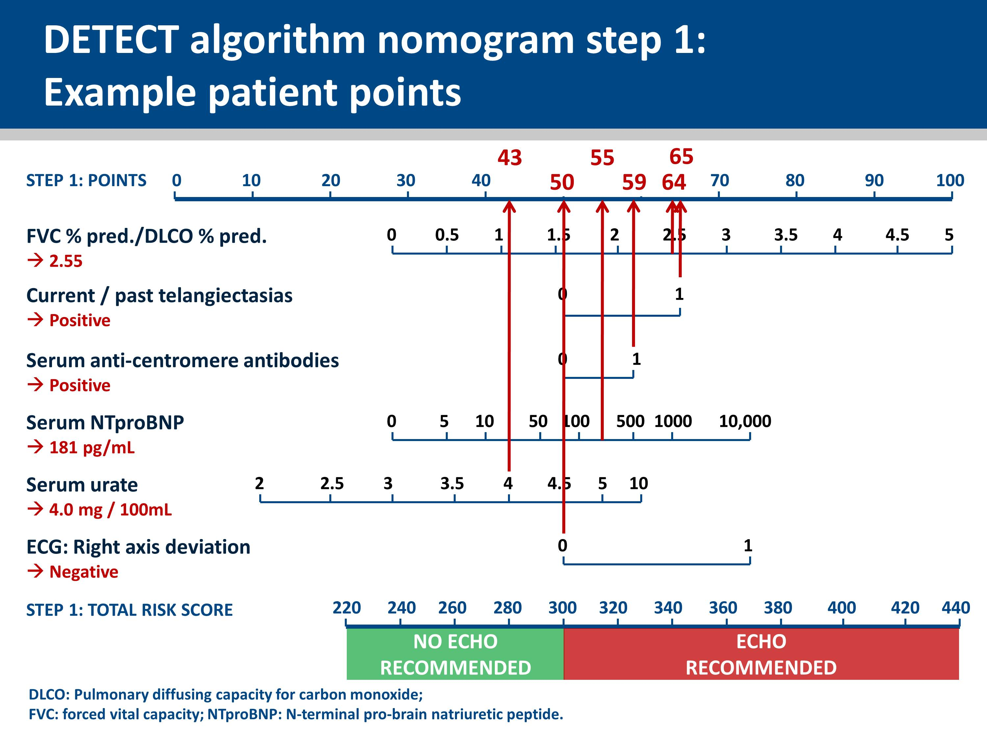
Notes:
For Step 1, the points for each variable can be assigned by drawing a vertical line from the measured value of that variable to the “points” line.
All variables contribute points irrespective of the measured value; e.g. a negative serum ACA will contribute 50 risk points. If one of the six values is missing, the total score can be calculated with only a minor impact on the model performance. In this case the missing variable is assigned 50 points, (except for current/past telangiectasias, which is assigned 65 points).
The nomograms cannot be reliably used if more than one variable is missing.

Slide 47
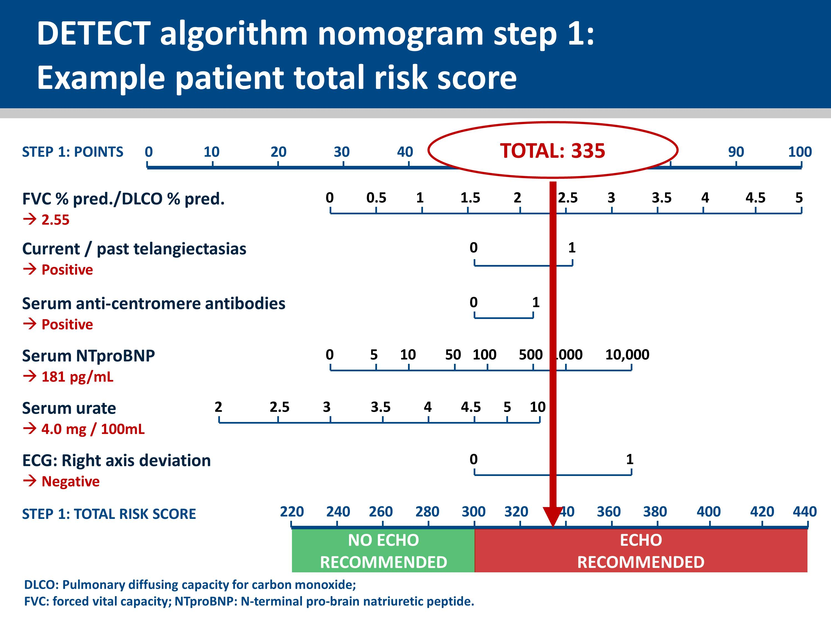
Notes:
The Step 1 total risk score is calculated by adding together the points for each variable. If the Step 1 total risk score for your patient is greater than 300, referral for echocardiography is recommended.

Slide 48
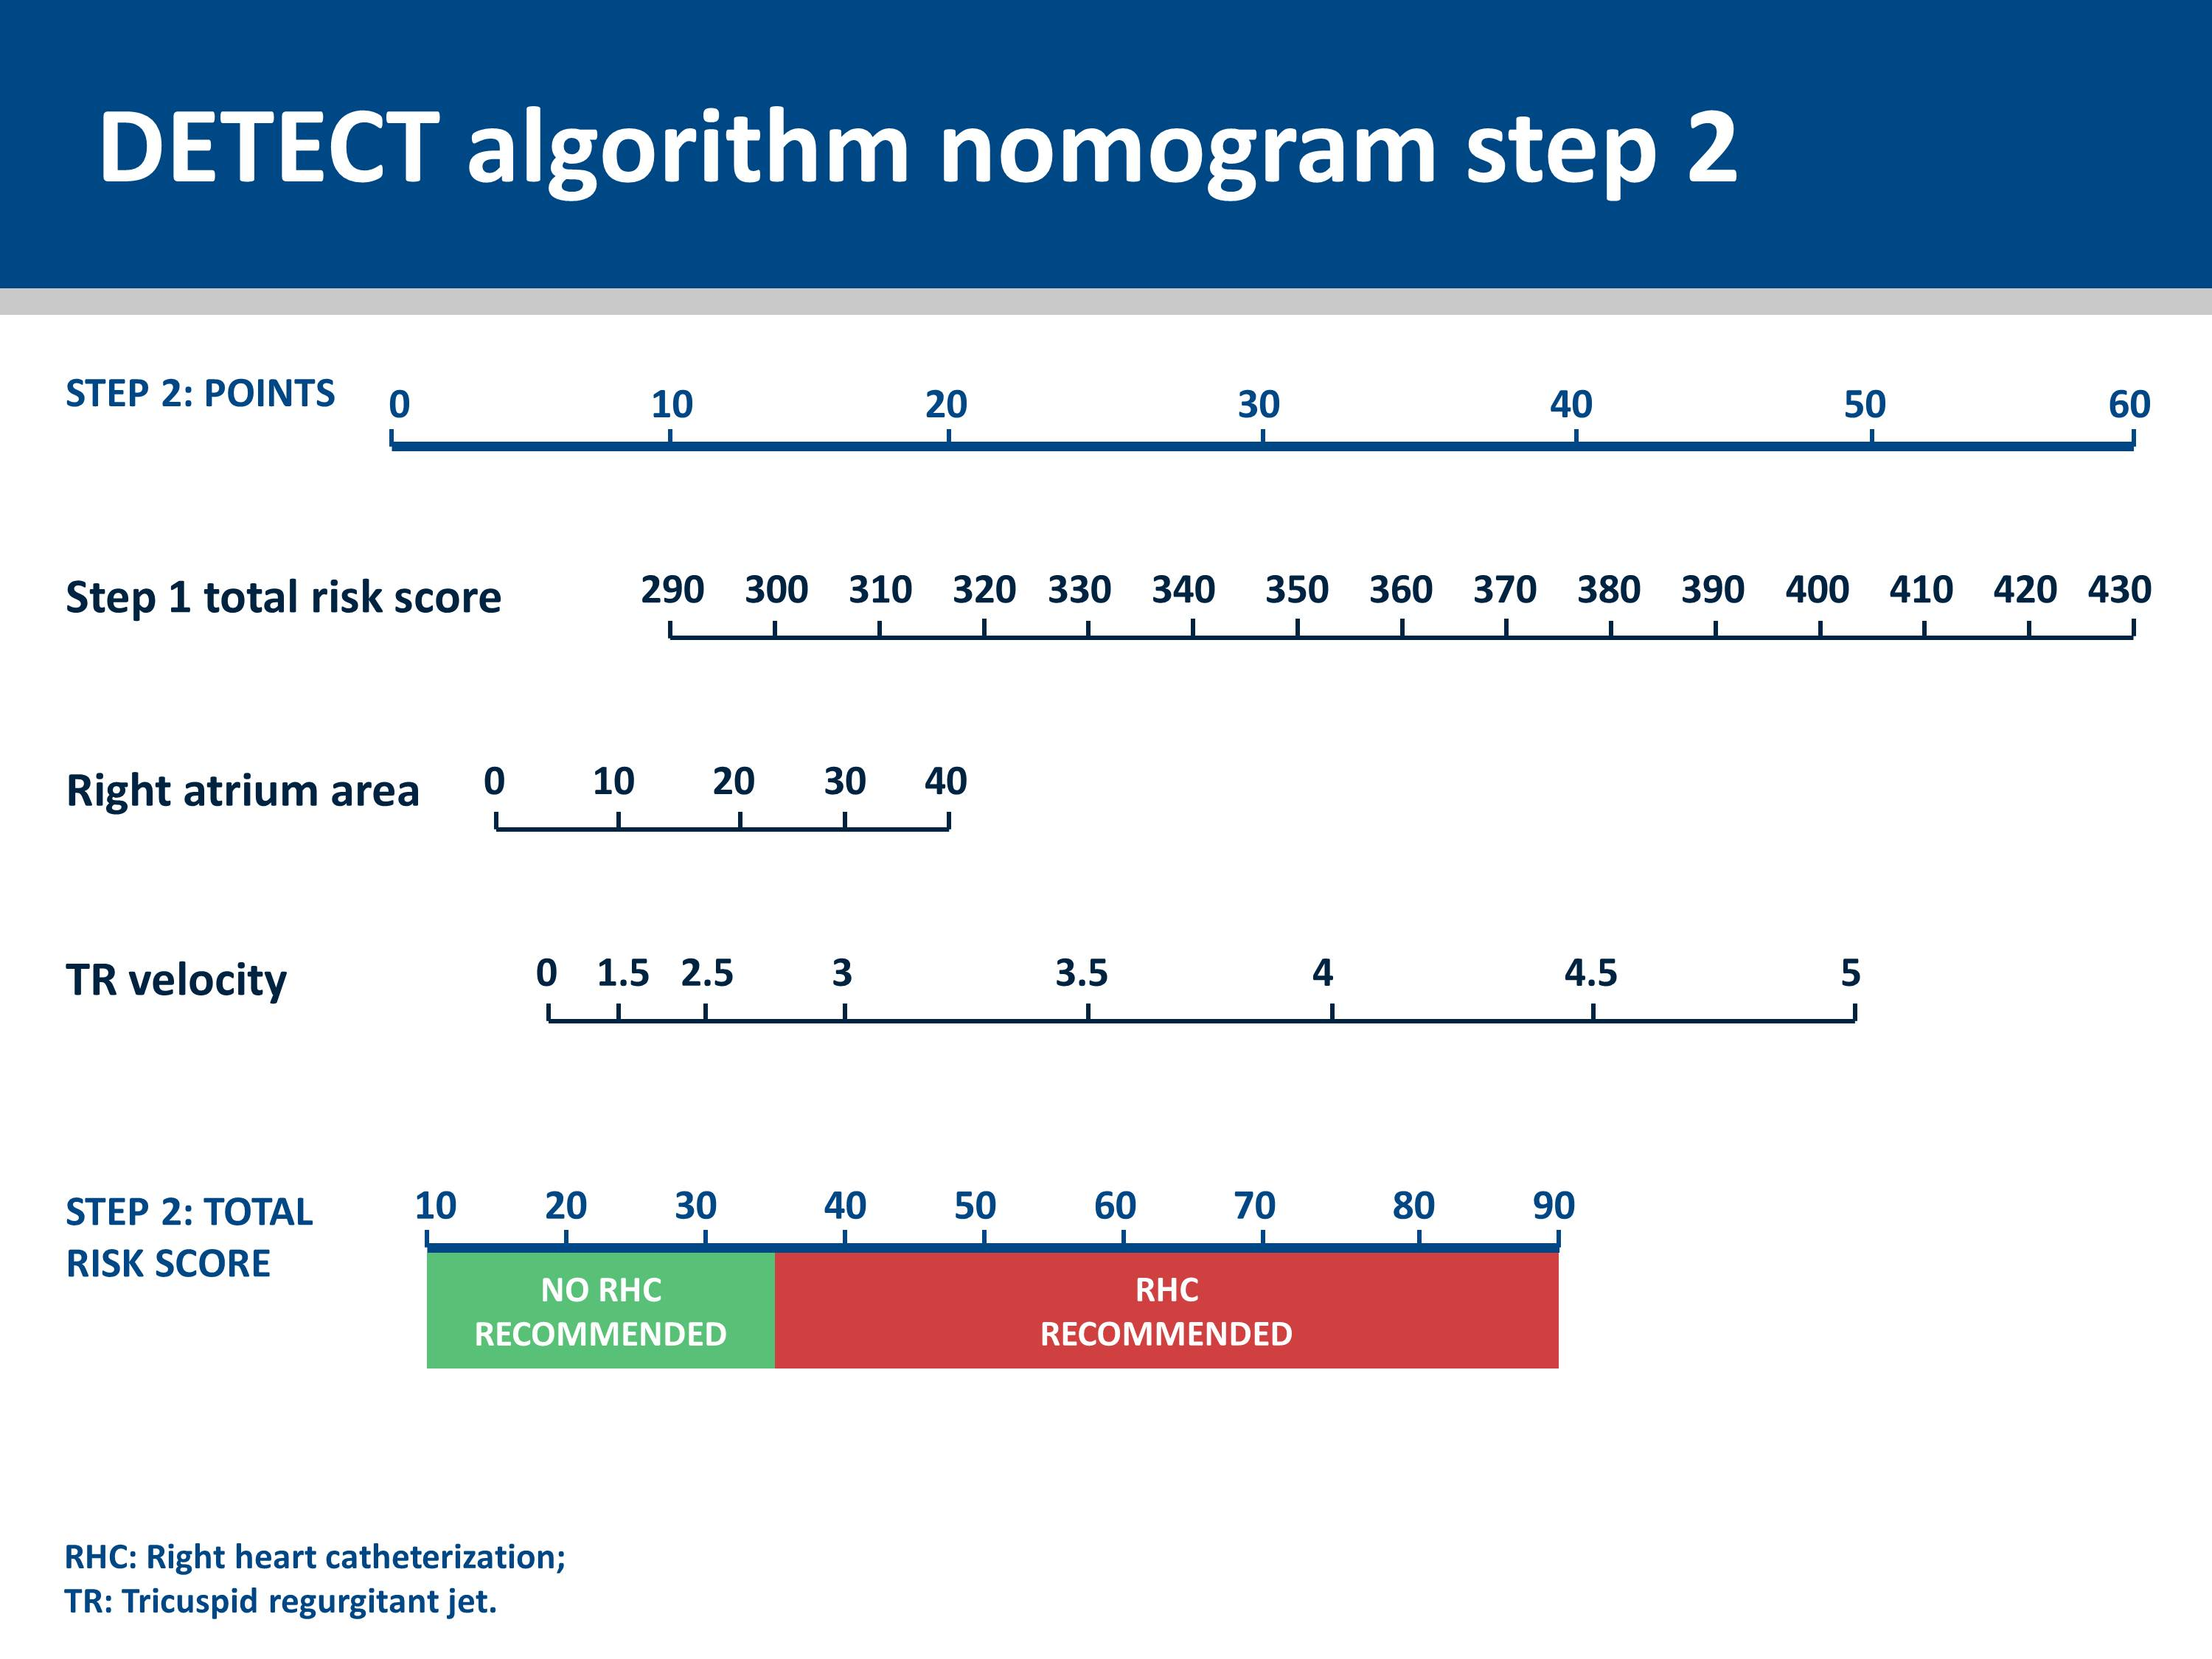
Notes:
Nomograms were derived from the two multivariable risk prediction models to allow classification of patients into risk sets for referral to echocardiography (step 1) and RHC (step 2).
This slide shows the nomogram for step 2.

Slide 49
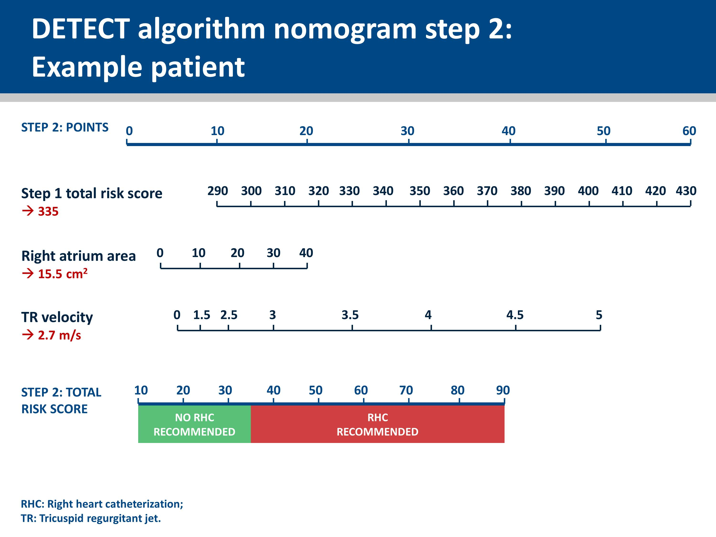
Notes:
The slide shows the carried forward ‘Step 1 total risk score’ and the two echocardiographic variables.

Slide 50
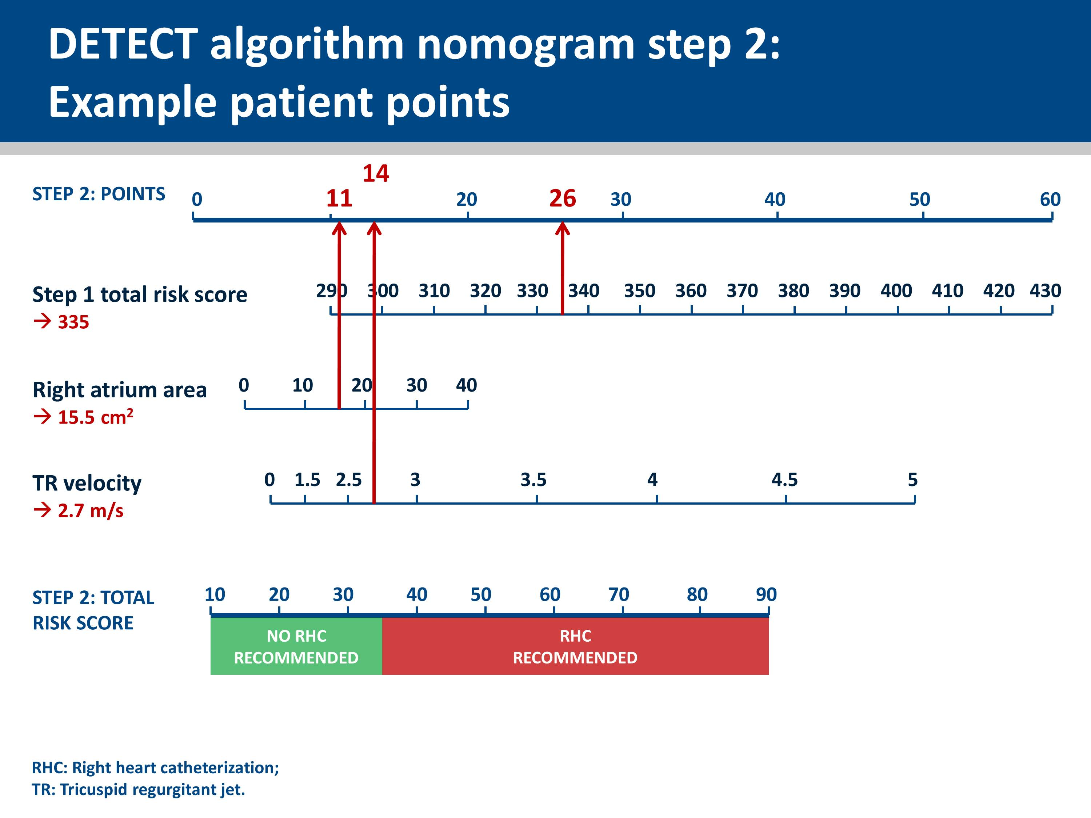
Notes:
For Step 2, the points for each variable (i.e. the 2 echocardiography variables and the Step 1 total risk score) are assigned by drawing a vertical line from the value of that variable to the “points” line.
Values for all Step 2 variables are required to calculate the Step 2 total risk score.

Slide 51
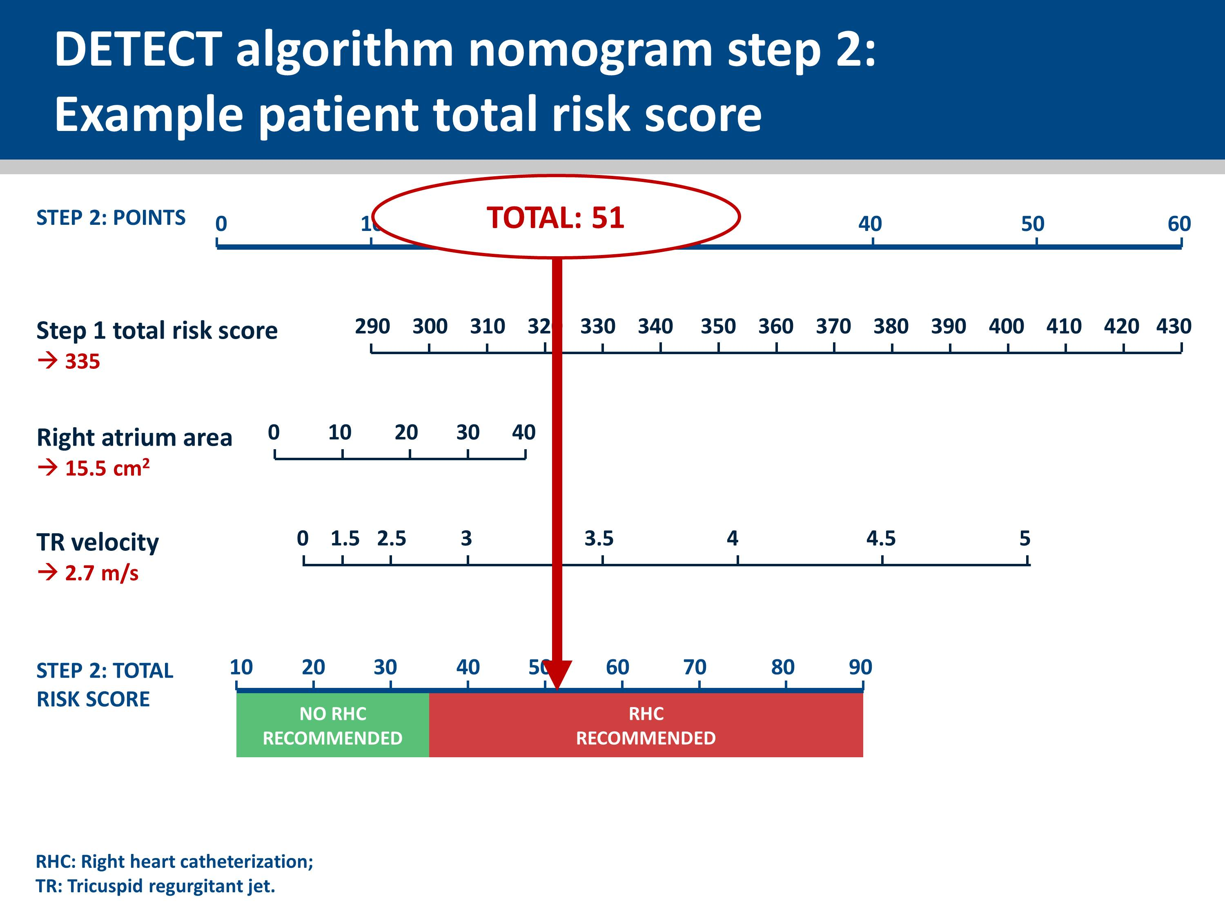
Notes:
The Step 2 total risk score is calculated by adding together the points for each variable.
If the Step 2 total risk score for your patient are greater than 35, referral for right heart catheterization is recommended.

